Slide 1
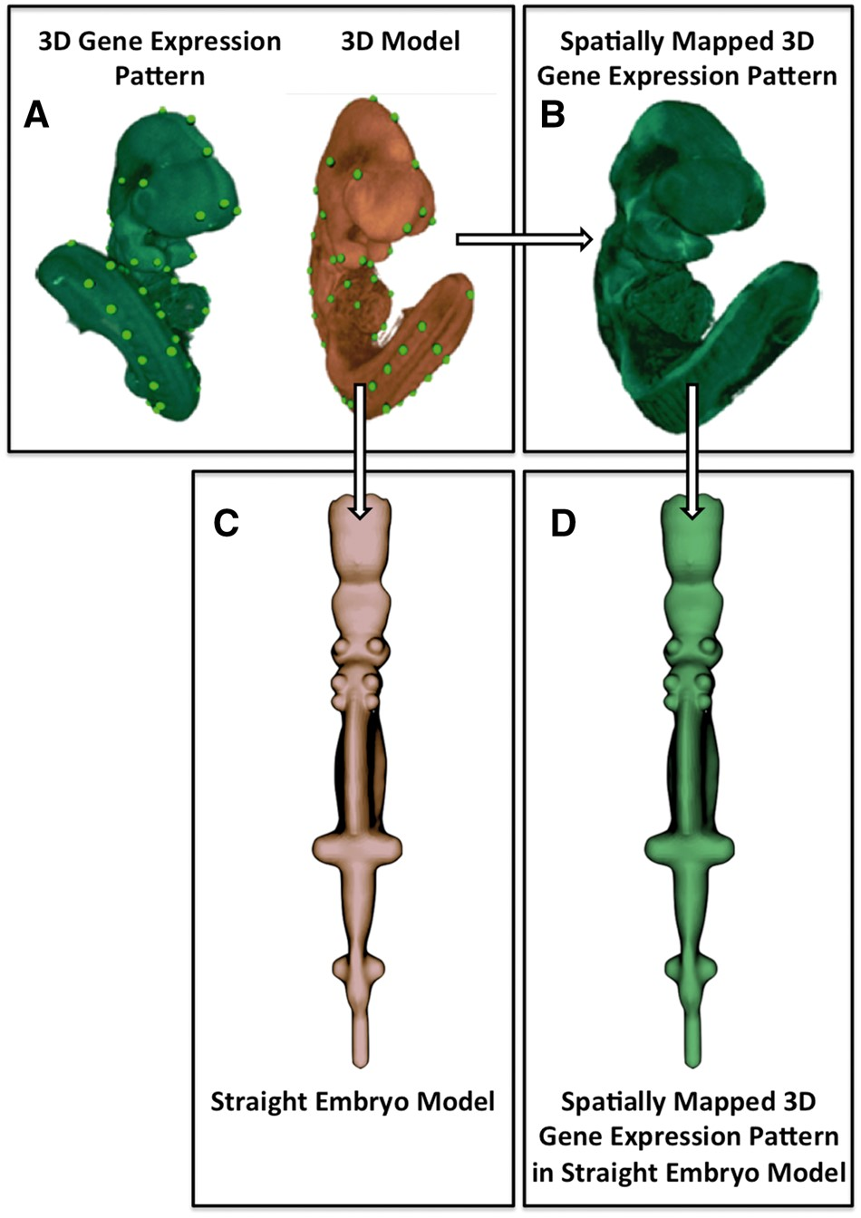
Figure 1. Image processing pipeline used to generate the straight mouse embryo. (A) Spatial warping using WlzWarp ...
Notes:
Figure 1. Image processing pipeline used to generate the straight mouse embryo. (A) Spatial warping using WlzWarp allows a user to place landmark points on a source image with gene expression (green) and a 3D model (orange) that utilizes a volumetric mesh. The green dots represent equivalent landmark points. (B) The spatial transform enables the gene expression pattern (green) to be mapped into the 3D model. Spatial warping of gene expression patterns using WlzWarp has been described previously in (10). (C) Spatial warping using WlzWarp was additionally used to straighten the mouse embryo model (landmark points not shown). The WlzWarp processing utilizes a CDT that enables complex non-linear deformations to be applied to 3D objects. (D) Gene expression patterns that were mapped into the 3D model (green) can be visualized in the context of the straight mouse embryo model.
Unless provided in the caption above, the following copyright applies to the content of this slide: © The Author(s) 2017. Published by Oxford University Press.This is an Open Access article distributed under the terms of the Creative Commons Attribution License (http://creativecommons.org/licenses/by/4.0/), which permits unrestricted reuse, distribution, and reproduction in any medium, provided the original work is properly cited.

Slide 2
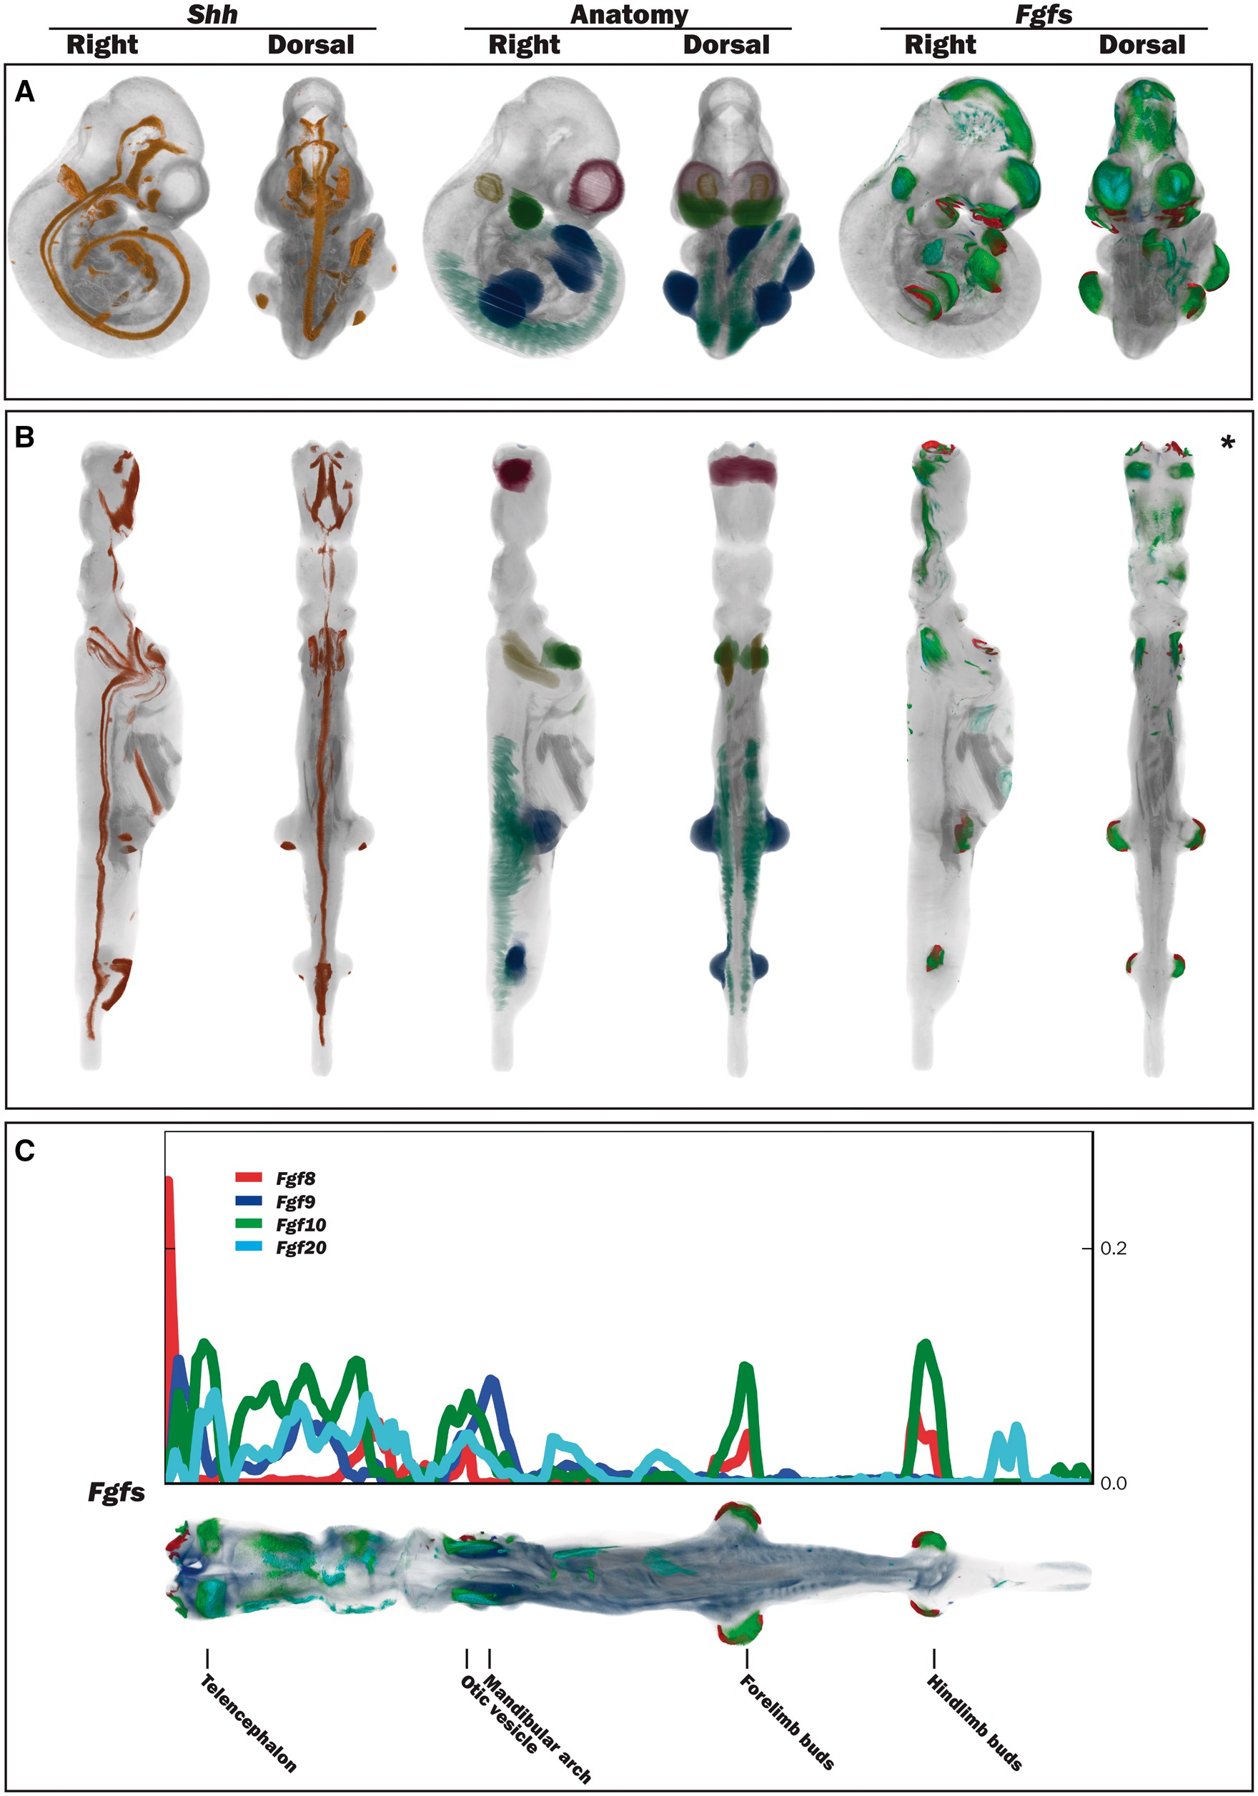
Figure 2. Straightening the 3D mouse embryo model. (A) Dorsal and lateral views of the original TS17 (E10.5) curled ...
Notes:
Figure 2. Straightening the 3D mouse embryo model. (A) Dorsal and lateral views of the original TS17 (E10.5) curled embryo model showing Shh expression, delineated anatomical components and Fgf gene expression. (B) Dorsal and lateral views of the respective straightened embryo model to that in A. Shh expression: observed in the A–P axis midline in the original and straight embryo models, and also in the posterior region of the forelimb and hindlimb buds. Anatomy domains: those shown are the telencephalic vesicles, otic vesicles, mandibular arches, forelimb and hindlimb buds and the somites. Fgf8, Fgf9, Fgf10 and Fgf20 expression patterns: these were spatially mapped as a test case to evaluate the utility of the straight mouse as a data visualization tool. (C) Graphical representation of Fgf gene expression patterns along the A–P axis in relation to the straight mouse embryo. The straight embryo shown is the same as that in B*, but with different opacity and thresholding values. Plot shows distribution of spatially mapped patterns along the A–P axis with the fraction of volume occupied by the thresholded gene expression patterns on the vertical axis.
Unless provided in the caption above, the following copyright applies to the content of this slide: © The Author(s) 2017. Published by Oxford University Press.This is an Open Access article distributed under the terms of the Creative Commons Attribution License (http://creativecommons.org/licenses/by/4.0/), which permits unrestricted reuse, distribution, and reproduction in any medium, provided the original work is properly cited.

Slide 3
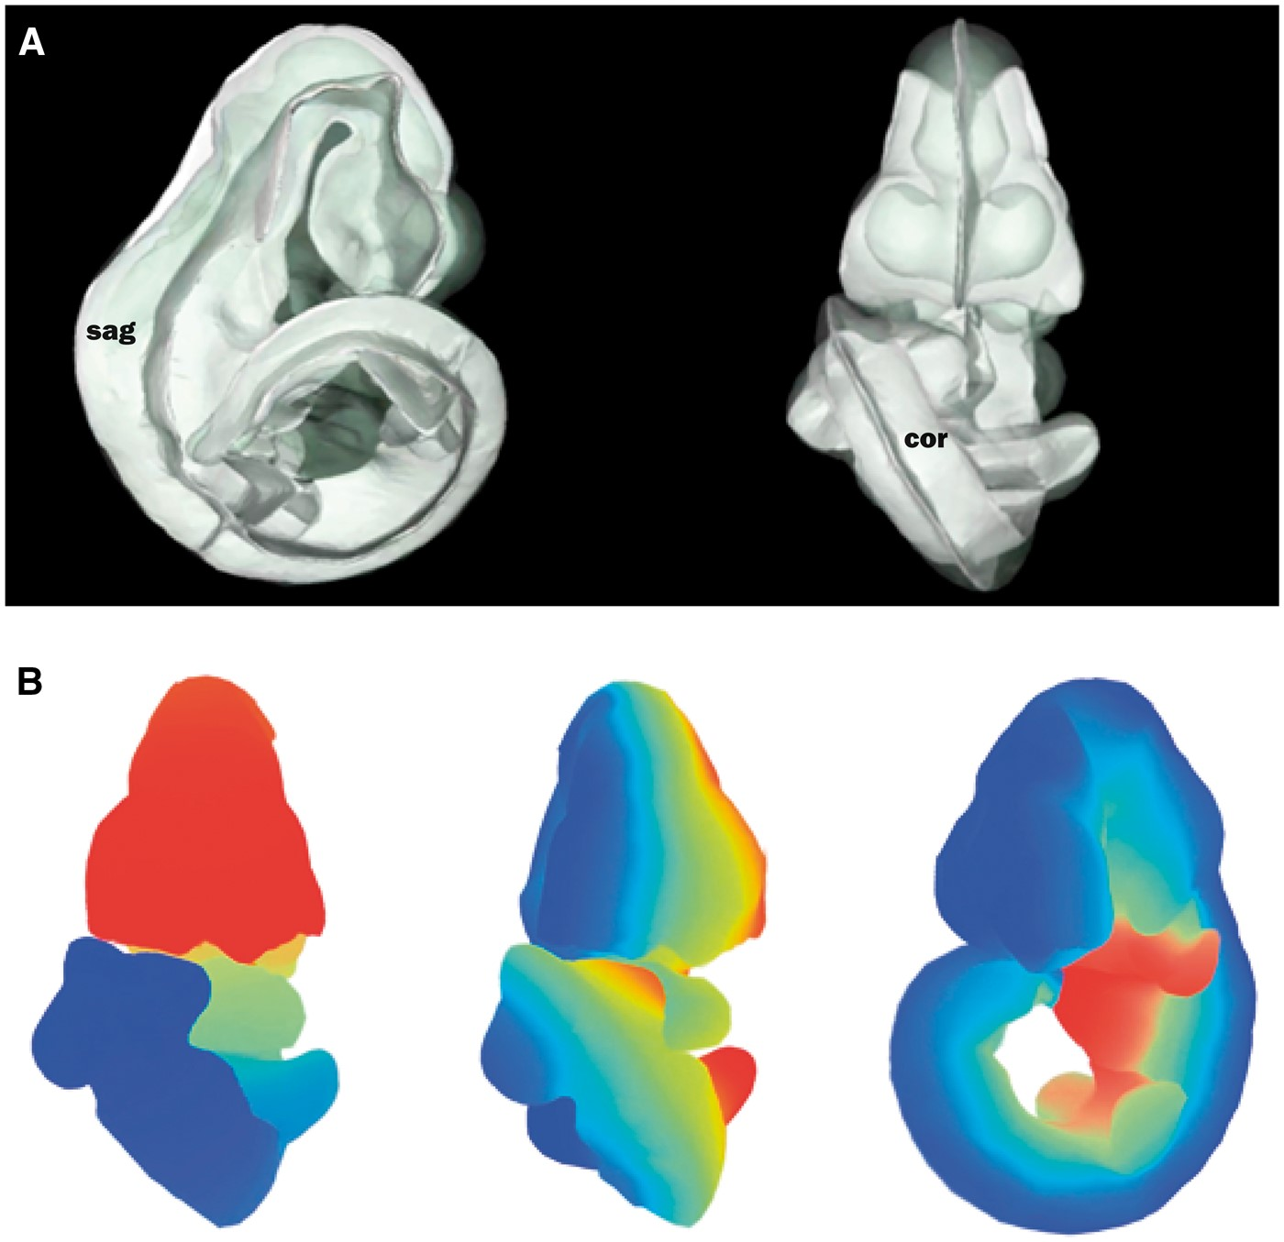
Figure 3. Defining axial planes on the 3D mouse embryo model. (A) Reverse spatial warping allowed axial planes to be ...
Notes:
Figure 3. Defining axial planes on the 3D mouse embryo model. (A) Reverse spatial warping allowed axial planes to be defined on the straight mouse embryo model. Sagittal and coronal planes from this reverse transform are shown in the context of the original 3D mouse embryo model. sag, sagittal plane; cor, coronal plane. (B) Colourmaps from red to blue used to demonstrate A–P (left), L–R (middle) and V–D (right) axes in the original, curled embryo model. These axes represent the anatomical coordinates of the embryo model.
Unless provided in the caption above, the following copyright applies to the content of this slide: © The Author(s) 2017. Published by Oxford University Press.This is an Open Access article distributed under the terms of the Creative Commons Attribution License (http://creativecommons.org/licenses/by/4.0/), which permits unrestricted reuse, distribution, and reproduction in any medium, provided the original work is properly cited.

