Slide 1
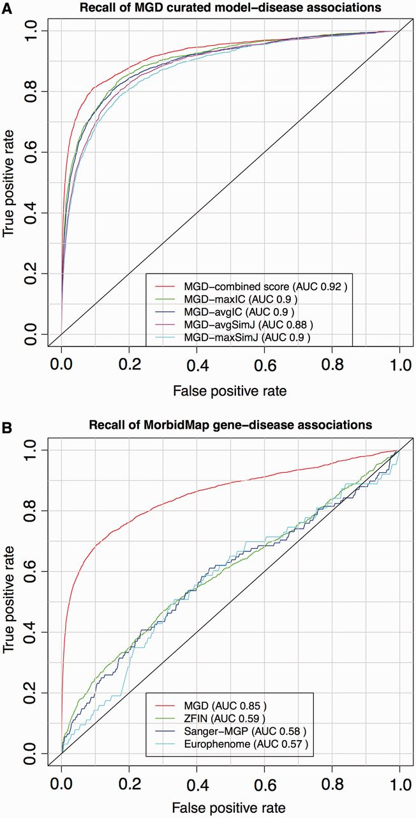
Figure 2. ROC analysis of PhenoDigm’s phenotype prioritization method applied to MGD’s curated mouse model–disease ...
Notes:
Figure 2. ROC analysis of PhenoDigm’s phenotype prioritization method applied to MGD’s curated mouse model–disease associations (top) and OMIM MorbidMap known gene–disease associations (bottom). The success of PhenoDigm applied to disease and MGD phenotypes is shown in the top panel for the combined score used in PhenoDigm as well as the maxIC, avgIC, maxSimJ and avgSimJ measures used for the original MouseFinder implementation. The bottom panel shows the recall of known gene–disease associations when comparing OMIM phenotypes with MGD, ZFIN, Sanger-MGP or Europhenome model organism phenotypes.
Unless provided in the caption above, the following copyright applies to the content of this slide: © The Author(s) 2013. Published by Oxford University Press.This is an Open Access article distributed under the terms of the Creative Commons Attribution Non-Commercial License (http://creativecommons.org/licenses/by-nc/3.0/), which permits non-commercial re-use, distribution, and reproduction in any medium, provided the original work is properly cited. For commercial re-use, please contact journals.permissions@oup.com

