Slide 1
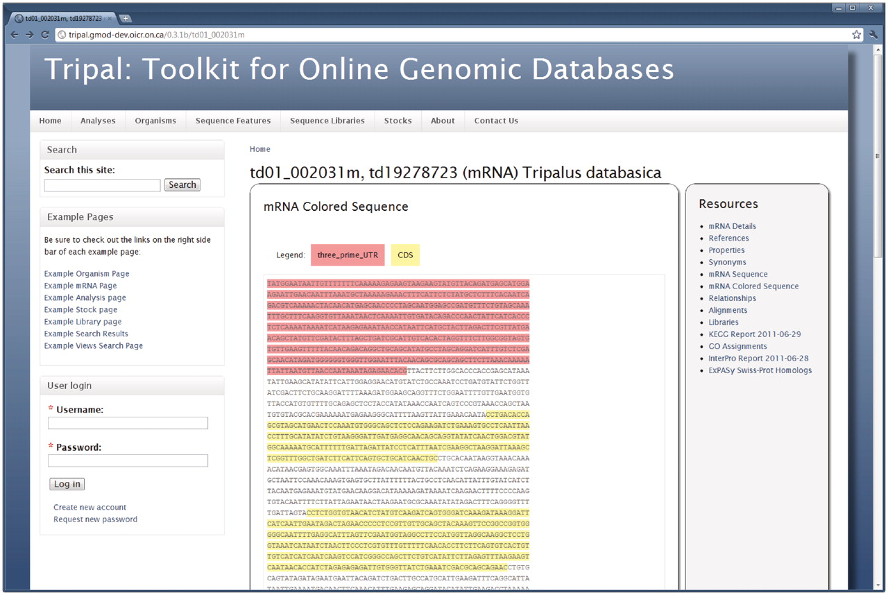
Figure 4. The feature page. Similar to the organism page, the right sidebar of the feature page provides a list of ...
Notes:
Figure 4. The feature page. Similar to the organism page, the right sidebar of the feature page provides a list of available data for a genomic sequence. Here the genomic sequence for an mRNA feature is shown. This is viewable by clicking the ‘mRNA Colored Sequence’ link. Visitors can also view synonyms, properties, alignments and external references for the feature. Library information will be viewable if the feature is derived from a library. Analyses results are also available on this page. In this example, BLAST homology results against the ExPASy Swiss-Prot database, InterProScan and KEGG/KASS results are available for viewing. Site administrators may customize which links are shown and can change the wording on many of the data views to better fit their community by editing the Tripal template files. Here the default look-and-feel is shown.
Unless provided in the caption above, the following copyright applies to the content of this slide: © The Author(s) 2011. Published by Oxford University Press.This is an Open Access article distributed under the terms of the Creative Commons Attribution Non-Commercial License (http://creativecommons.org/licenses/by-nc/3.0), which permits unrestricted non-commercial use, distribution, and reproduction in any medium, provided the original work is properly cited.

