Slide 1
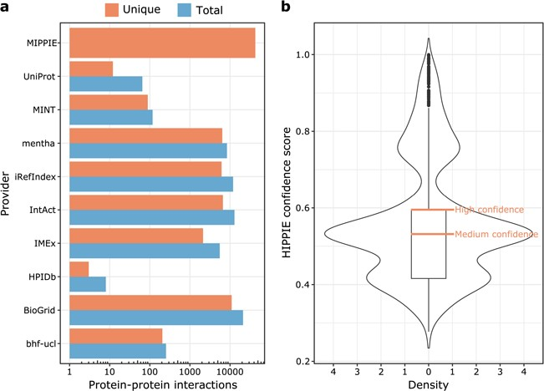
Figure 1 (a) MIPPIE stores 42 610 unique PPIs that originate from nine different molecular interaction providers. Some ...
Notes:
Figure 1 (a) MIPPIE stores 42 610 unique PPIs that originate from nine different molecular interaction providers. Some PPIs are reported by more than one provider, so the plot shows the total and unique number of interactions contributed by each one. (b) Distribution of confidence scores assigned to the 42 610 PPIs in MIPPIE. Interactions with scores above the median of the distribution are a mix of medium and high-quality PPIs, whereas interactions with scores above the upper quartile of the distribution are high quality PPIs only.
Unless provided in the caption above, the following copyright applies to the content of this slide: © The Author(s) 2020. Published by Oxford University Press.This is an Open Access article distributed under the terms of the Creative Commons Attribution License (http://creativecommons.org/licenses/by/4.0/), which permits unrestricted reuse, distribution, and reproduction in any medium, provided the original work is properly cited.

