Slide 1
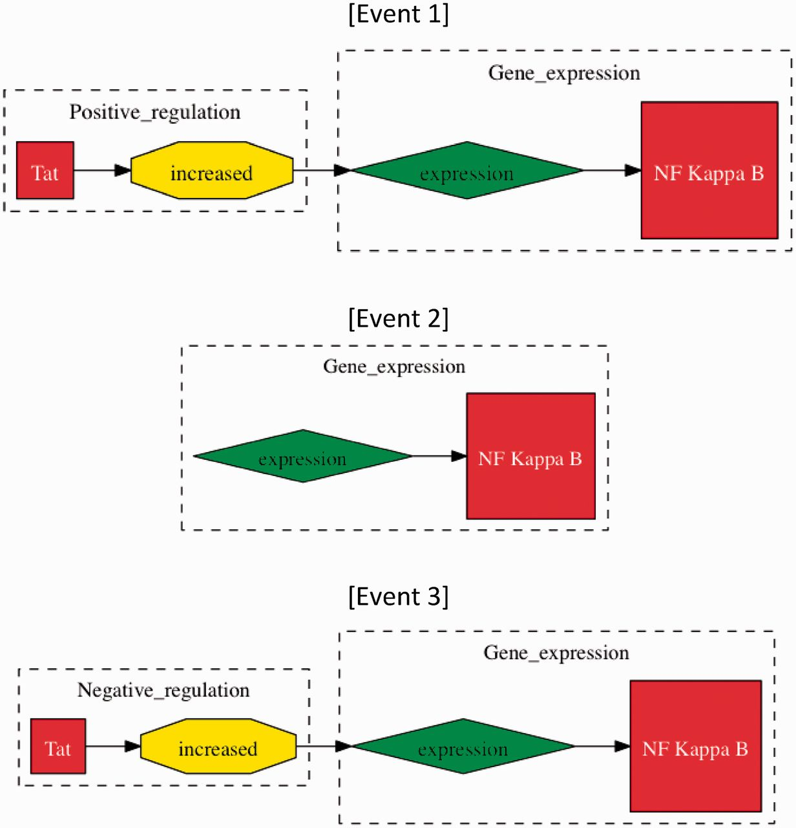
Figure 2. Methods of event evaluation. The three events have been extracted from the sentence “Tat increased the ...
Notes:
Figure 2. Methods of event evaluation. The three events have been extracted from the sentence “Tat increased the expression of NF kappa B”. In approximate evaluation, both events 1 and 2 would be counted as true positives, whereas only Event 1 would be considered a true positive in stringent event evaluation, as ‘Tat positive regulation (increased)’ is missing. Event 3 would be a false positive in both categories of evaluation, whereby ‘increased’ does not signify negative regulation.
Unless provided in the caption above, the following copyright applies to the content of this slide: © The Author(s) 2012. Published by Oxford University Press.This is an Open Access article distributed under the terms of the Creative Commons Attribution Non-Commercial License (http://creativecommons.org/licenses/by-nc/3.0), which permits unrestricted non-commercial use, distribution, and reproduction in any medium, provided the original work is properly cited.

