Slide 1
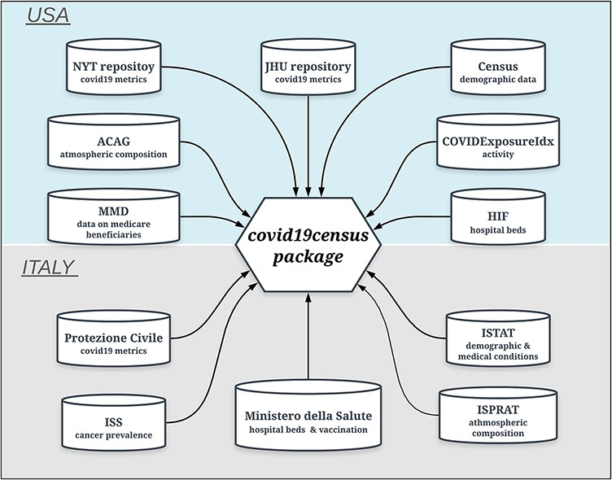
Figure 1. Data sources of the ‘covid19census’ package. Top: repositories for U.S.-related county data. Bottom: sources ...
Notes:
Figure 1. Data sources of the ‘covid19census’ package. Top: repositories for U.S.-related county data. Bottom: sources for Italian data aggregated at the regional level. Note that COVID-19 U.S. and Italian metrics are retrieved dynamically from repositories that are updated daily.
Unless provided in the caption above, the following copyright applies to the content of this slide: © The Author(s) 2021. Published by Oxford University Press.This is an Open Access article distributed under the terms of the Creative Commons Attribution License (http://creativecommons.org/licenses/by/4.0/), which permits unrestricted reuse, distribution, and reproduction in any medium, provided the original work is properly cited.

