Slide 1
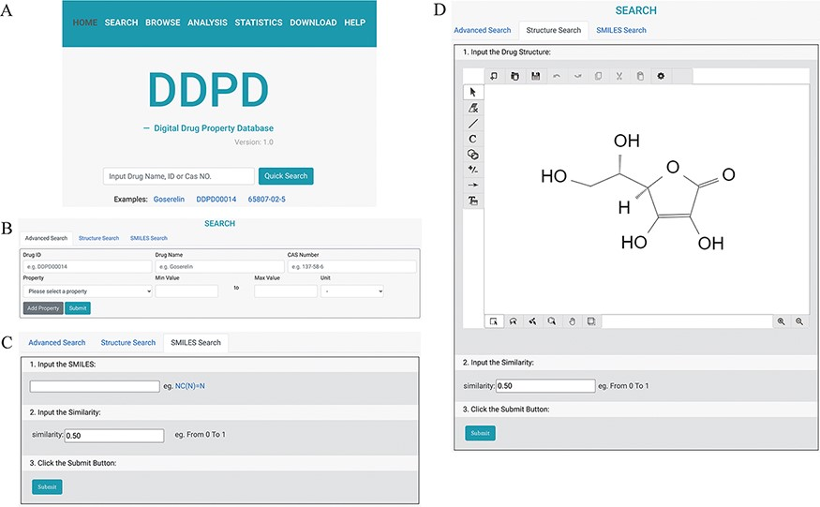
Figure 1. The search pages of DDPD: (A) On the home page, users can conduct simple search via drug name, DDPD ID or CAS ...
Notes:
Figure 1. The search pages of DDPD: (A) On the home page, users can conduct simple search via drug name, DDPD ID or CAS number. (B, C, D) On the search page, users can perform more advanced searches via one or more drug property values, SMILES or structure. (D) In Structure Search tab, users can draw chemical structures using the developed drawing tool.
Unless provided in the caption above, the following copyright applies to the content of this slide: © The Author(s) 2022. Published by Oxford University Press.This is an Open Access article distributed under the terms of the Creative Commons Attribution License (https://creativecommons.org/licenses/by/4.0/), which permits unrestricted reuse, distribution, and reproduction in any medium, provided the original work is properly cited.

Slide 2
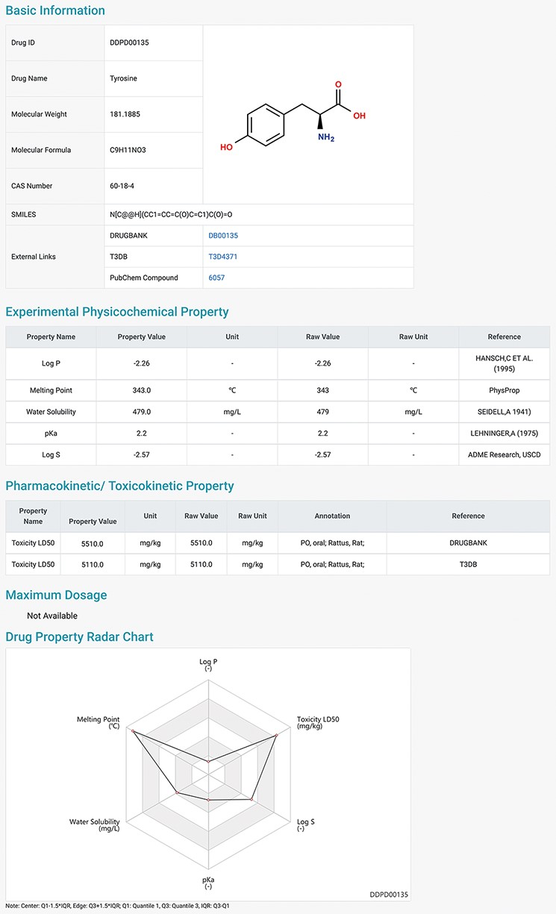
Figure 2. Detailed information page of a drug example. Users can view detailed information of the selected drug, ...
Notes:
Figure 2. Detailed information page of a drug example. Users can view detailed information of the selected drug, including basic information, physicochemical properties, pharmacokinetic and toxicokinetic properties, as well as maximum dosages. A radar chart which displays the values of all the properties of the selected drug is shown at the bottom.
Unless provided in the caption above, the following copyright applies to the content of this slide: © The Author(s) 2022. Published by Oxford University Press.This is an Open Access article distributed under the terms of the Creative Commons Attribution License (https://creativecommons.org/licenses/by/4.0/), which permits unrestricted reuse, distribution, and reproduction in any medium, provided the original work is properly cited.

Slide 3
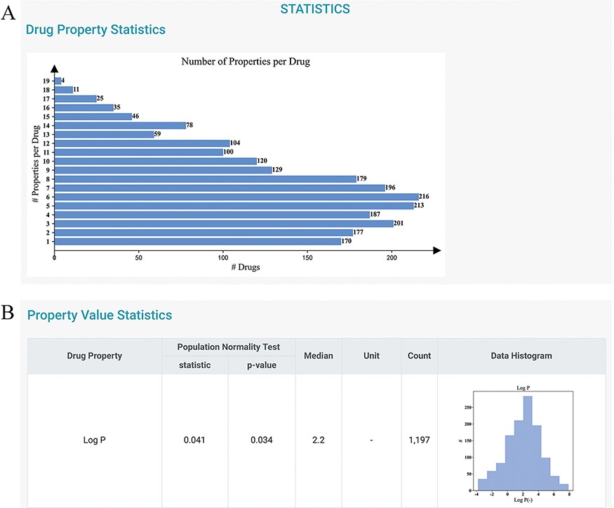
Figure 3. Statistics page of DDPD. (A) Barplot shows the number of properties per drug. (B) Property value statistics ...
Notes:
Figure 3. Statistics page of DDPD. (A) Barplot shows the number of properties per drug. (B) Property value statistics such as histogram for log P is provided. Log P of all drugs in our database is to some degree normally distributed with a median of 2.2 (normality test P-value = 0.034).
Unless provided in the caption above, the following copyright applies to the content of this slide: © The Author(s) 2022. Published by Oxford University Press.This is an Open Access article distributed under the terms of the Creative Commons Attribution License (https://creativecommons.org/licenses/by/4.0/), which permits unrestricted reuse, distribution, and reproduction in any medium, provided the original work is properly cited.

Slide 4
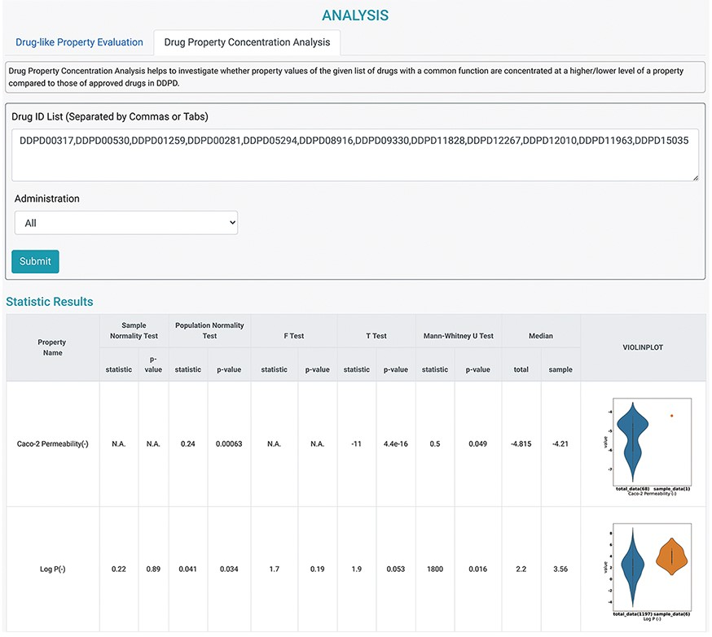
Figure 4. Analysis tools of DDPD. Using the Drug Property Concentration Analysis tab of the Analysis page, users can ...
Notes:
Figure 4. Analysis tools of DDPD. Using the Drug Property Concentration Analysis tab of the Analysis page, users can query a list of drugs via DDPD ID and visualize the property value distribution of the query list via violin plots. The blue violin plots represent the property value distribution of all the approved drugs in our database. The orange plots represent the distribution of the queried compounds. For the queried drugs for caco-2 permeability, only one data entry is found, therefore, one orange dot is shown. Additionally, the pvalues of the selected statistical tests are calculated and listed in the respective columns.
Unless provided in the caption above, the following copyright applies to the content of this slide: © The Author(s) 2022. Published by Oxford University Press.This is an Open Access article distributed under the terms of the Creative Commons Attribution License (https://creativecommons.org/licenses/by/4.0/), which permits unrestricted reuse, distribution, and reproduction in any medium, provided the original work is properly cited.

Slide 5
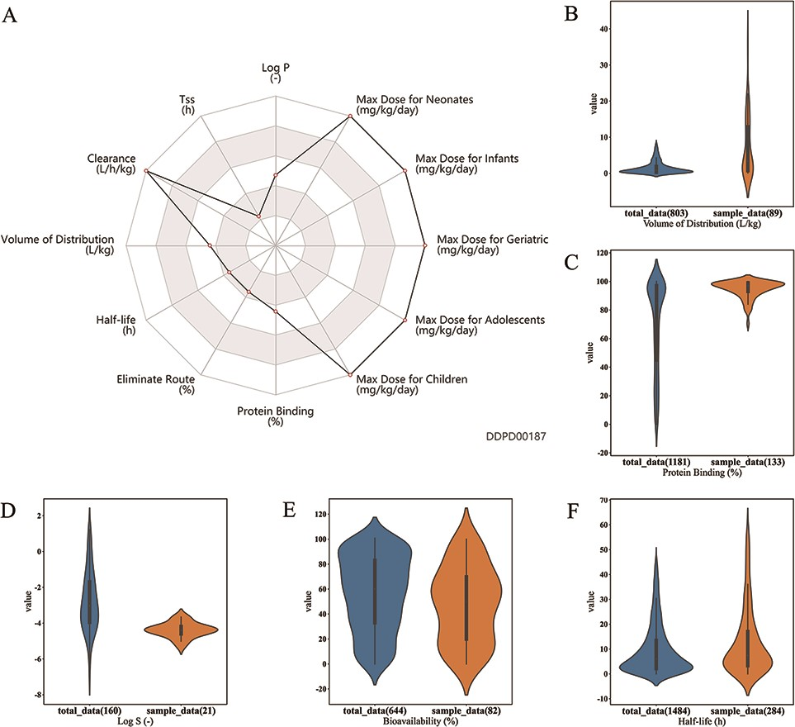
Figure 5. Case studies. (A) Case study 1. Radar chart for properties of esmolol. Property values related to maximum ...
Notes:
Figure 5. Case studies. (A) Case study 1. Radar chart for properties of esmolol. Property values related to maximum dosage and clearance are shown to be at the maximums of the corresponding ranges. (B, C, D, E). Case Study 2. Drugs with log P value greater than 4 are selected as the sample group; as shown, property value distributions for these drugs (orange plots) are significantly different from those of all approved small molecule drugs (blue plots): (B) Volume of distribution is significantly higher for the sample group (median 3.4 > 0.85, P-value = 3.1e–11); (C) Protein binding is significantly higher for the sample group (median 97 > 85, P-value = 9.8e-21); (D) Log S is significantly lower for the sample group (median −4.39 < −3.03, P-value= 1.6e-7); and (E) bioavailability is significantly lower for the sample group (median 50 6.04, P-value = 0.0003). All P-values are calculated using Mann–Whitney U Test performed by the developed analysis tool.
Unless provided in the caption above, the following copyright applies to the content of this slide: © The Author(s) 2022. Published by Oxford University Press.This is an Open Access article distributed under the terms of the Creative Commons Attribution License (https://creativecommons.org/licenses/by/4.0/), which permits unrestricted reuse, distribution, and reproduction in any medium, provided the original work is properly cited.

