Slide 1
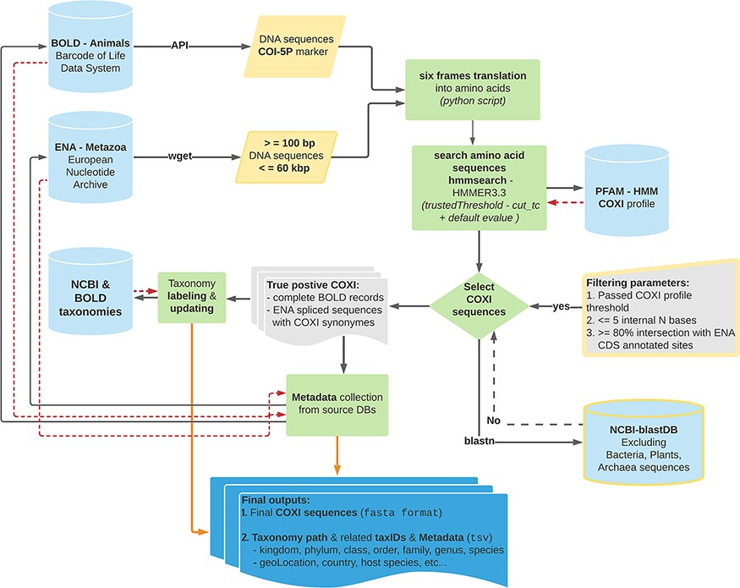
Figure 1. Schematic representation of the bioinformatics workflow used to build MetaCOXI. The whole process was ...
Notes:
Figure 1. Schematic representation of the bioinformatics workflow used to build MetaCOXI. The whole process was implemented and executed in Linux environment using bash shell commands in combination with custom python scripts to parse the intermediate results. ENA raw sequences were filtered according to their lengths. hmmsearch application was used to search the translated DNA sequences against COXI HMM PFAM reference profile. All matches satisfying the TC threshold were selected. The sequences were further validated using blastn to exclude bacterial, plants and Archaea sequences. Taxonomical classification of all entries was aligned to NCBI reference taxonomy. The final COXI sequences and their associated harmonized taxonomy paths and metadata are provided in ‘fasta’ and ‘tsv’ formats, respectively. Yellow color indicates filtering parameters. Green color denotes processing steps. Dashed red arrows illustrate the returning results from reference databases.
Unless provided in the caption above, the following copyright applies to the content of this slide: © The Author(s) 2022. Published by Oxford University Press.This is an Open Access article distributed under the terms of the Creative Commons Attribution License (https://creativecommons.org/licenses/by/4.0/), which permits unrestricted reuse, distribution, and reproduction in any medium, provided the original work is properly cited.

Slide 2
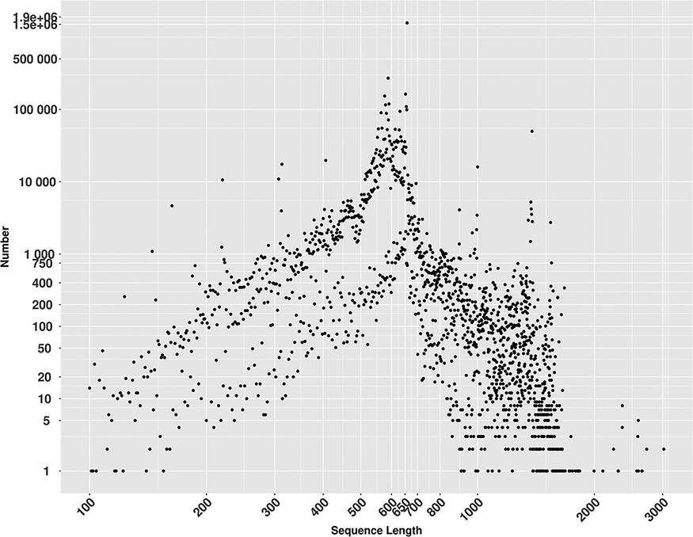
Figure 2. Lengths distribution of MetaCOXI sequences ranging from 100 to 3020 bp. The most frequent sequence length is ...
Notes:
Figure 2. Lengths distribution of MetaCOXI sequences ranging from 100 to 3020 bp. The most frequent sequence length is 658 bp represented by 1 573 982 sequences.
Unless provided in the caption above, the following copyright applies to the content of this slide: © The Author(s) 2022. Published by Oxford University Press.This is an Open Access article distributed under the terms of the Creative Commons Attribution License (https://creativecommons.org/licenses/by/4.0/), which permits unrestricted reuse, distribution, and reproduction in any medium, provided the original work is properly cited.

