Slide 1
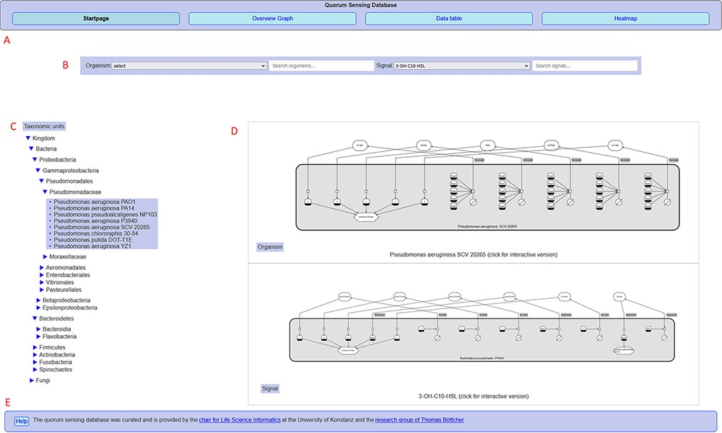
Figure 2. Overview of the QSDB user interface on the start page, showing (A) navigation menu to switch between the main ...
Notes:
Figure 2. Overview of the QSDB user interface on the start page, showing (A) navigation menu to switch between the main pages, (B) organism/signal search menu, (C) taxonomic hierarchy, (D) diagram previews and (E) footer with access to help page and further information.
Unless provided in the caption above, the following copyright applies to the content of this slide: © The Author(s) 2021. Published by Oxford University Press.This is an Open Access article distributed under the terms of the Creative Commons Attribution License (https://creativecommons.org/licenses/by/4.0/), which permits unrestricted reuse, distribution, and reproduction in any medium, provided the original work is properly cited.

