Slide 1
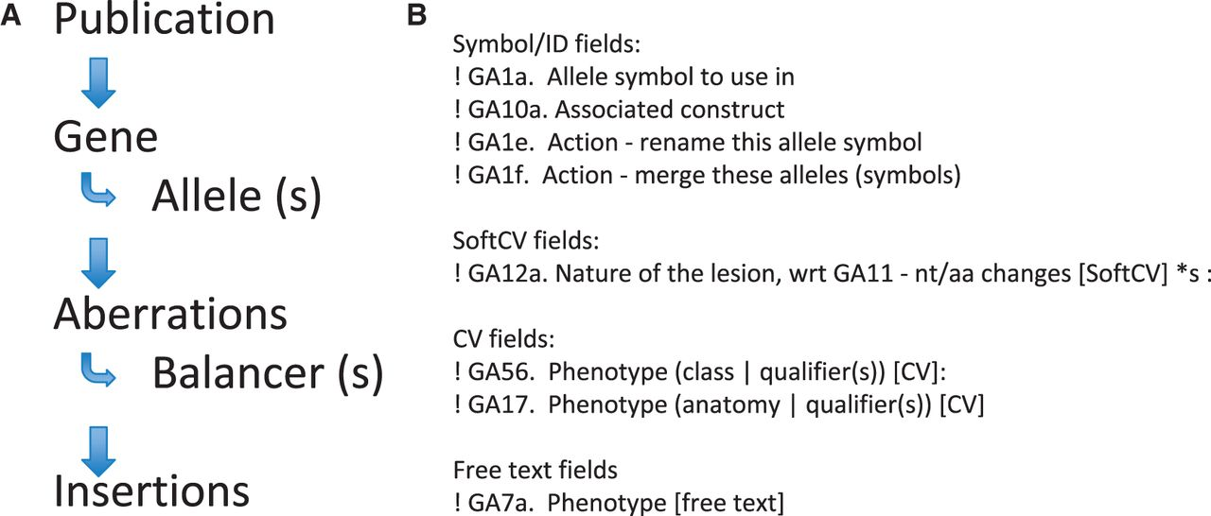
Figure 2 Literature curation into proformae. Text files composed of various proformae are used to capture data from ...
Notes:
Figure 2 Literature curation into proformae. Text files composed of various proformae are used to capture data from the literature. (A) The proformae are ordered such that each curation record has to start with a publication proforma, so all objects mentioned subsequently can be attributed to the relevant publication. Allele proformae are added underneath the parent gene proforma, so all allele information can be related back to the parent gene. (B) Proformae are split into four different types of fields. The fields start with an exclamation mark (for processing) and each field has a field code, e.g. GA1a is the allele symbol field (all fields in the allele proforma are coded GAx).
Unless provided in the caption above, the following copyright applies to the content of this slide: © The Author(s) 2012. Published by Oxford University Press.This is an Open Access article distributed under the terms of the Creative Commons Attribution License (http://creativecommons.org/licenses/by-nc/3.0/), which permits non-commercial reuse, distribution, and reproduction in any medium, provided the original work is properly cited. For commercial re-use, please contact journals.permissions@oup.com.

