Slide 1
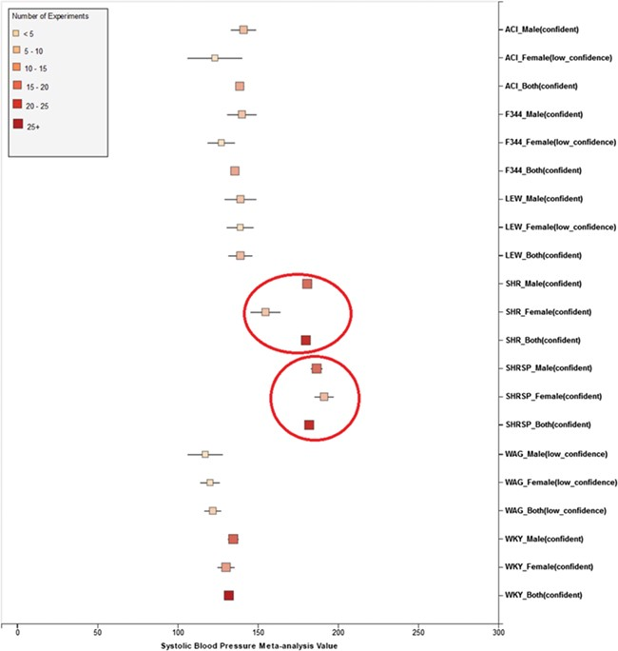
Figure 9 Summary for `Systolic Blood Pressure’ shows sex pattern does not always hold true: the sex specific pattern ...
Notes:
Figure 9 Summary for `Systolic Blood Pressure’ shows sex pattern does not always hold true: the sex specific pattern for SHRSP is opposite of the common pattern as female SHRSP rates have higher blood pressure. On the other hand, SHR exhibits the common pattern.
Unless provided in the caption above, the following copyright applies to the content of this slide: © The Author(s) 2019. Published by Oxford University Press.This is an Open Access article distributed under the terms of the Creative Commons Attribution License (http://creativecommons.org/licenses/by/4.0/), which permits unrestricted reuse, distribution, and reproduction in any medium, provided the original work is properly cited.

