Slide 1
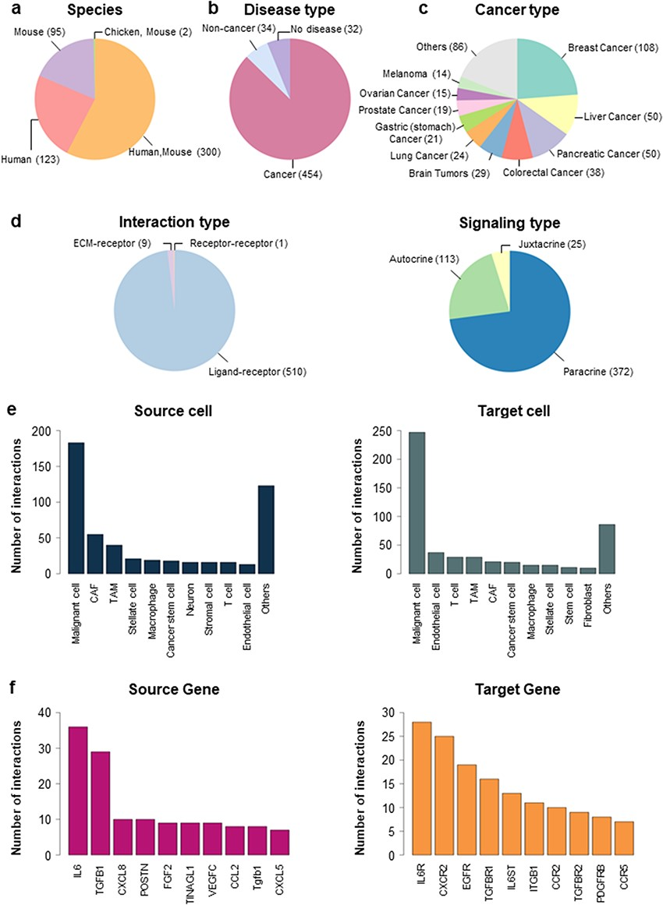
Figure 1. Distribution of CCIDB. (a–d) Pie plots showing the distribution of the features in CCIDB, including species ...
Notes:
Figure 1. Distribution of CCIDB. (a–d) Pie plots showing the distribution of the features in CCIDB, including species (a), disease type (b), cancer type (c), interaction type (d, left) and signaling type of the LR interactions (d, right). (e–f) Bar plots showing the top-ranked 10 frequent source cell types (e, left), target cell types (e, right), source genes (f, left) and target genes (f, right).
Unless provided in the caption above, the following copyright applies to the content of this slide: © The Author(s) 2023. Published by Oxford University Press.This is an Open Access article distributed under the terms of the Creative Commons Attribution License (https://creativecommons.org/licenses/by/4.0/), which permits unrestricted reuse, distribution, and reproduction in any medium, provided the original work is properly cited.

Slide 2
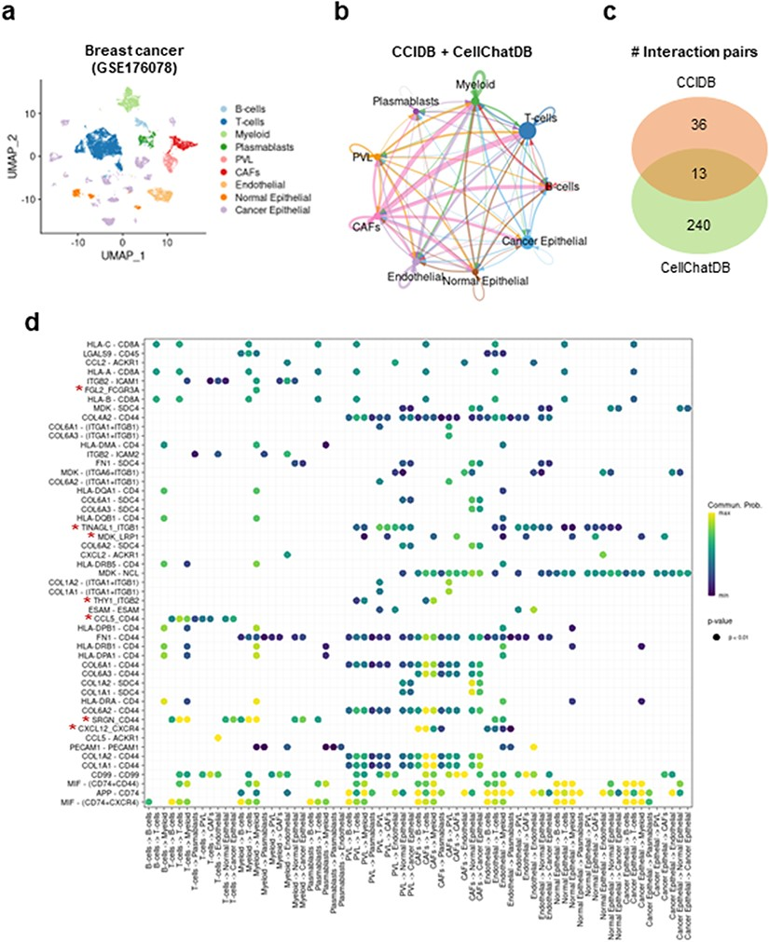
Figure 2. Intracellular communication network analysis using CCIDB in breast cancer. (a) Cell types of the 100,064 ...
Notes:
Figure 2. Intracellular communication network analysis using CCIDB in breast cancer. (a) Cell types of the 100,064 cells of breast cancer patients are indicated in a UMAP plot. (b) The inferred intracellular communication network across cell types. Circle size is proportional to the number of cells in each cell group and edge width represents the communication probability. (c) A Venn diagram shows the distribution of interaction pairs identified from CCIDB and CellChatDB. (d) A circle plot shows the interactions of top ranked source-target gene pairs across cell groups. The circle color and size represent the calculated communication probability and P-values, respectively. The red asterisks indicate the pairs found in CCIDB.
Unless provided in the caption above, the following copyright applies to the content of this slide: © The Author(s) 2023. Published by Oxford University Press.This is an Open Access article distributed under the terms of the Creative Commons Attribution License (https://creativecommons.org/licenses/by/4.0/), which permits unrestricted reuse, distribution, and reproduction in any medium, provided the original work is properly cited.

Slide 3
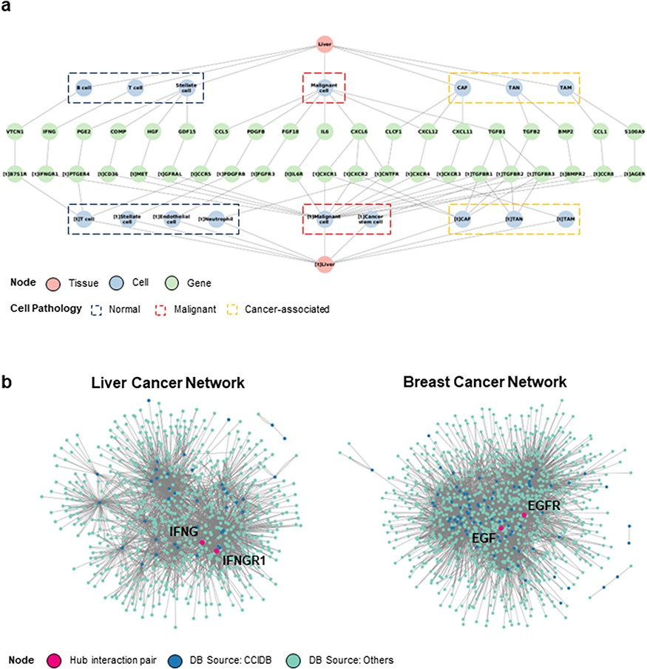
Figure 3. Construction of CCI network. (a) The liver cancer network (LCN) was constructed with six context features, ...
Notes:
Figure 3. Construction of CCI network. (a) The liver cancer network (LCN) was constructed with six context features, namely ‘source tissue’, ‘source cell type’, ‘source gene’, ‘target gene’, ‘target cell type’ and ‘target tissue’ using Cytoscape. (b) The LCN (left) and BCN (right) constructed by integrating CCIDB and previous four CCI databases are shown. The source databases of CCIDB (blue) and others (cyan) are indicated in different colors, and hub pair genes are indicated (red).
Unless provided in the caption above, the following copyright applies to the content of this slide: © The Author(s) 2023. Published by Oxford University Press.This is an Open Access article distributed under the terms of the Creative Commons Attribution License (https://creativecommons.org/licenses/by/4.0/), which permits unrestricted reuse, distribution, and reproduction in any medium, provided the original work is properly cited.

