Slide 1
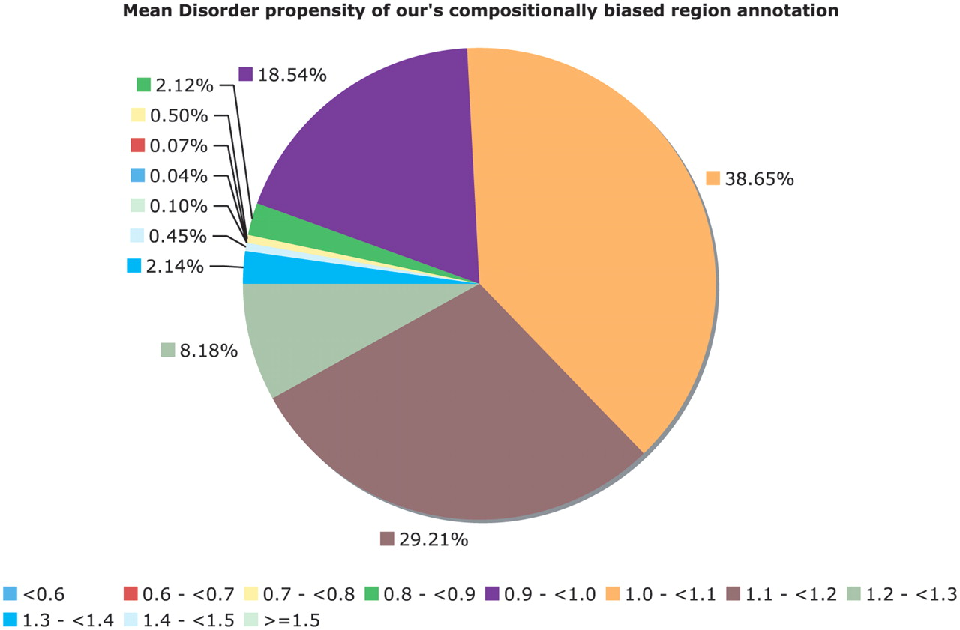
Figure 6. Mean disorder propensity of the CB regions. This is a pie chart for the mean disorder propensity of all CB ...
Notes:
Figure 6. Mean disorder propensity of the CB regions. This is a pie chart for the mean disorder propensity of all CB regions with P < 10−6, with any CB regions that correspond to globular or transmembrane domains removed. The mean disorder propensity is calculated as described in ‘Methods’ section.
Unless provided in the caption above, the following copyright applies to the content of this slide: © The Author(s) 2011. Published by Oxford University Press.This is Open Access article distributed under the terms of the Creative Commons Attribution Non-Commercial License (http://creativecommons.org/licenses/by-nc/2.5), which permits unrestricted non-commercial use, distribution, and reproduction in any medium, provided the original work is properly cited.

