Slide 1
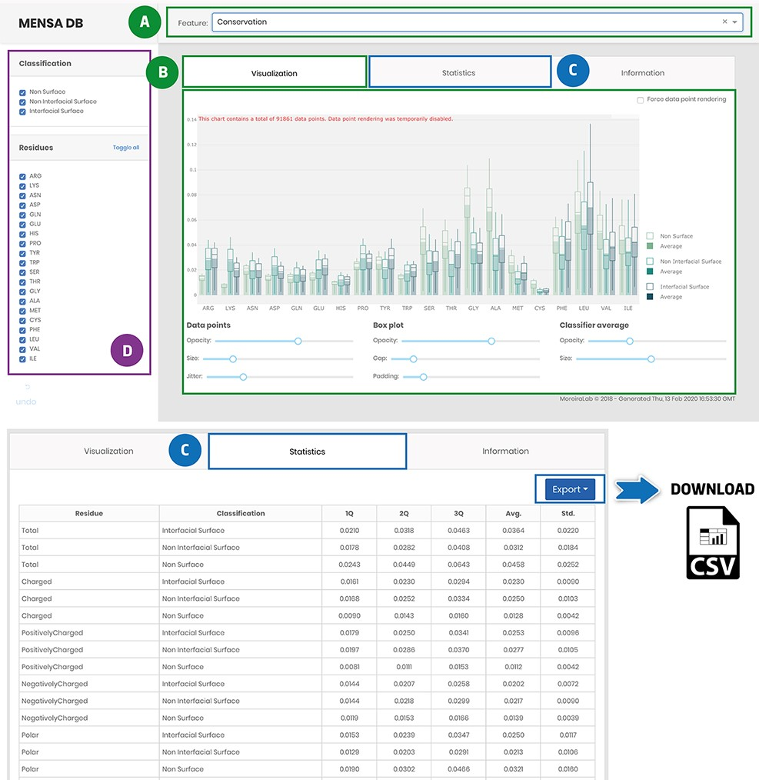
Figure 4. Main landing page of MENSAdb web server. Screenshot of the home page (A)—quickly query by evolutionary or ...
Notes:
Figure 4. Main landing page of MENSAdb web server. Screenshot of the home page (A)—quickly query by evolutionary or physicochemical features. (B)—In the visualization tab, the results are shown in a graphical format. Users can easily change visual properties (opacity, size, jitter, gap and padding) by interacting with the lower panel. (C)—Statistics tab displays the data in a tabular format with associated metrics (Q1, Q2, Q3, Average-Avg. and Standard Deviation-Std.). Stats and raw data can be downloaded using the Export button in the top right corner, as a .csv file. (D)—In the left panel, users can filter graphic data by classification and residue type.
Unless provided in the caption above, the following copyright applies to the content of this slide: © The Author(s) 2021. Published by Oxford University Press.This is an Open Access article distributed under the terms of the Creative Commons Attribution License (http://creativecommons.org/licenses/by/4.0/), which permits unrestricted reuse, distribution, and reproduction in any medium, provided the original work is properly cited.

