Slide 1
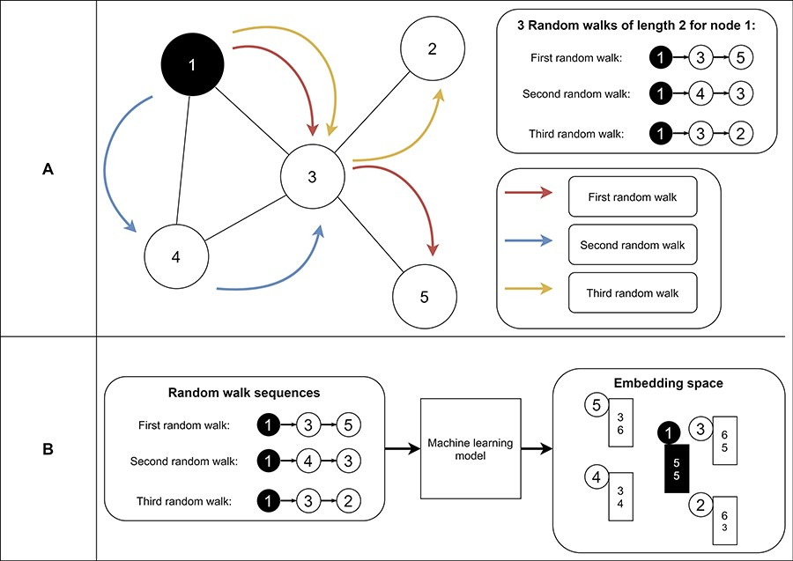
Figure 9. Example of random walks on a graph (A) and the transformation into node embeddings (B). In (A), three random ...
Notes:
Figure 9. Example of random walks on a graph (A) and the transformation into node embeddings (B). In (A), three random walks with length two are sampled from node 1 to receive node sequences as a result. These node sequences represent the neighborhood of node 1. Then, we aim to find node embeddings such that nodes that co-occur often on random walks are embedded closer to each other (B). Note that the sequences generated from the random walks and the numbers for representing the final node embeddings are fictitious to make the embedding generation clearer.
Unless provided in the caption above, the following copyright applies to the content of this slide: © The Author(s) 2024. Published by Oxford University Press.This is an Open Access article distributed under the terms of the Creative Commons Attribution License (https://creativecommons.org/licenses/by/4.0/), which permits unrestricted reuse, distribution, and reproduction in any medium, provided the original work is properly cited.

