Slide 1
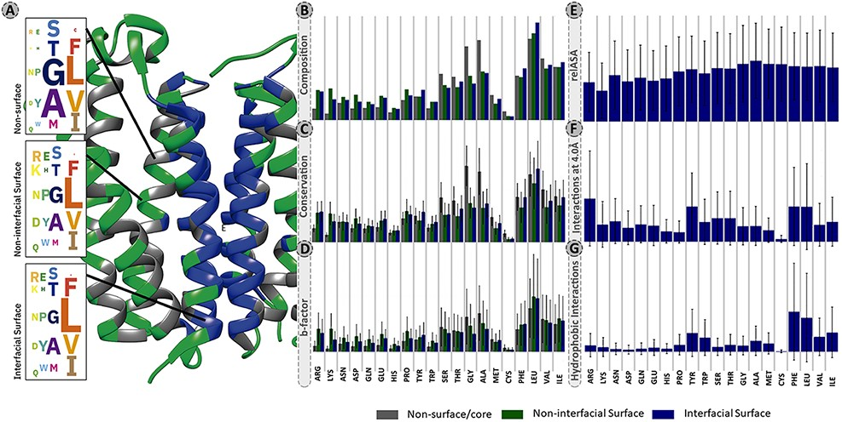
Figure 2. Panel of selected structural and physicochemical properties of MPs and their interactions. (A)—residue ...
Notes:
Figure 2. Panel of selected structural and physicochemical properties of MPs and their interactions. (A)—residue distribution of the translocator membrane protein (PDBid: 4UC1) from Rhodobacter sphaeroides (61). Amino acids are coloured according to the protein region within which they are embedded: grey—non-surface residues; green—non-interfacial surface residues; blue—interfacial surface residues. (B)—residue composition of the database. The correction factor described in section “Data treatment” of Material and methods was not applied here. (C)—normalized evolutionary conservation scores. (D)—normalized B-factor scores. (E)—normalized relASA. (F)—normalized intermolecular contacts at 4 Å. (G)—normalized hydrophobic contacts.
Unless provided in the caption above, the following copyright applies to the content of this slide: © The Author(s) 2021. Published by Oxford University Press.This is an Open Access article distributed under the terms of the Creative Commons Attribution License (http://creativecommons.org/licenses/by/4.0/), which permits unrestricted reuse, distribution, and reproduction in any medium, provided the original work is properly cited.

