Slide 1
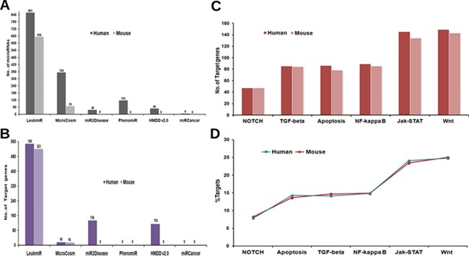
Figure 2 Contents of ‘LeukmiR’. Total number of (A) ALL miRNAs and (B) target genes for both human and mouse in ...
Notes:
Figure 2 Contents of ‘LeukmiR’. Total number of (A) ALL miRNAs and (B) target genes for both human and mouse in LeukmiR compared to MirCosm, miR2Disease, PhenomiR, HMDD v2.0 and miRCancer databases. (C) Total number of microRNA targets with respect to different pathways. (D) Percentage of the same available in different signaling pathways.
Unless provided in the caption above, the following copyright applies to the content of this slide: © The Author(s) 2020. Published by Oxford University Press.This is an Open Access article distributed under the terms of the Creative Commons Attribution License (http://creativecommons.org/licenses/by/4.0/), which permits unrestricted reuse, distribution, and reproduction in any medium, provided the original work is properly cited.

