Slide 1
Figure 1. AnABlast profile of a genomic region that contains a CRISPR sequence (CP001172.2: 1 057 766–1 068 943). The ...
Notes:
Figure 1. AnABlast profile of a genomic region that contains a CRISPR sequence (CP001172.2: 1 057 766–1 068 943). The profile shows accumulations of low-score sequence alignments between the genomic region and database protein sequences taken as protein-coding signals (called protomotifs). Green peaks correspond to accumulations in the forward strand, and red peaks correspond to accumulations in the reverse strand. Blue annotations represent ORFs, and red annotations are protein-coding genes predicted by a prokaryotic gene finder. Peaks above a height threshold, matching with predicted ORFs, stand for known protein-coding genes which are CRISPR-associated genes (cas) in this case (green peaks). But the strange profile at the end, which presents a series of both short peaks and ORFs in the two strands, including a putative gene in the reverse strand (gene7), is in fact a CRISPR sequence consisting of repeats (peaks) and spacers (valleys).
Unless provided in the caption above, the following copyright applies to the content of this slide: © The Author(s) 2020. Published by Oxford University Press.This is an Open Access article distributed under the terms of the Creative Commons Attribution License (http://creativecommons.org/licenses/by/4.0/), which permits unrestricted reuse, distribution, and reproduction in any medium, provided the original work is properly cited.

Slide 2
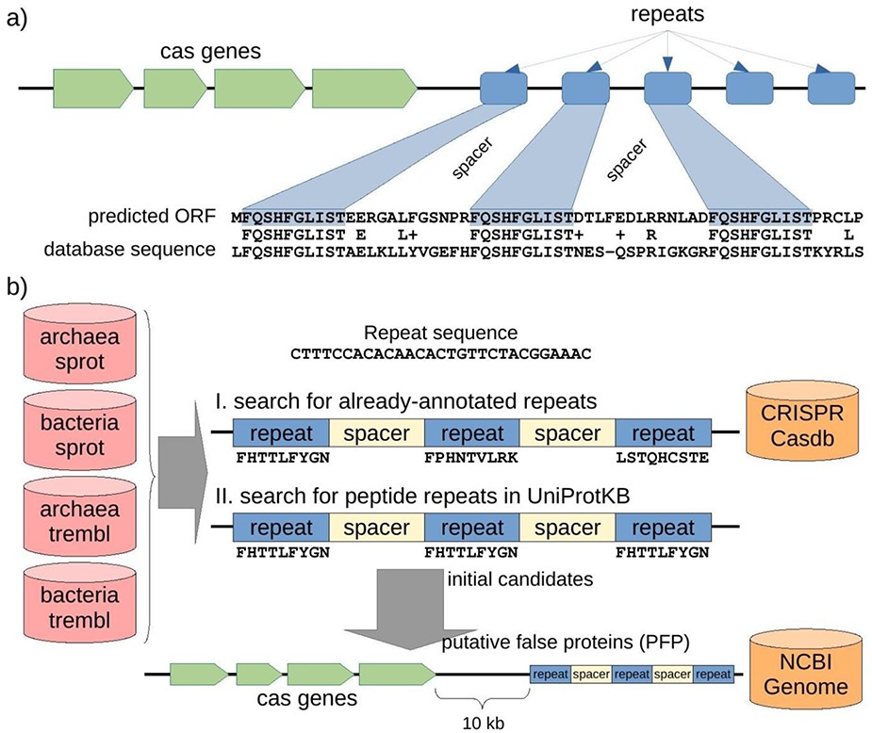
Figure 2. Structure of a CRISPR-Cas locus and its appearance when it is translated, and protocol to discover ...
Notes:
Figure 2. Structure of a CRISPR-Cas locus and its appearance when it is translated, and protocol to discover misannotated CRISPR sequences in protein databases. (a) A CRISPR-Cas locus includes a series of cas protein-coding genes followed by short nucleotide repeats surrounding heterogeneous sequences of a similar length called spacers. When a CRISPR sequence is erroneously translated, the corresponding amino acid sequence could present repeats separated by uniform spacers, and this protein would show similarity of 50% (centered in the repeat region) with other spurious proteins. (b) Searching for putative spurious sequences originating from translated CRISPR in four subsets of the UniProtKB protein database. The first approach (I) consisted in searching for translations of repeat sequences from the CRISPRCasdb database separated by putative spacers. The second approach (II) consisted in searching for amino acid repeats separated by putative spacers directly in the protein sequences. Finally, the initial candidates from the two approaches were mapped to their corresponding genomic sequences, and cas genes were searched within 10 kb around the candidate (see Methods for details). Proteins with both, repeats and cas genes nearby, are expected to be originating from the translation of spurious ORFs from CRISPR sequences, so called putative false proteins (PFP). Note that the first approach can take into account three different peptide sequences (drawn from the three possible reading frames of the nucleotide repeat sequence), while the second approach can only take into account one peptide sequence for all the possible repeats but can potentially discover new CRISPR repeats other than those already-annotated in the CRISPR database.
Unless provided in the caption above, the following copyright applies to the content of this slide: © The Author(s) 2020. Published by Oxford University Press.This is an Open Access article distributed under the terms of the Creative Commons Attribution License (http://creativecommons.org/licenses/by/4.0/), which permits unrestricted reuse, distribution, and reproduction in any medium, provided the original work is properly cited.

Slide 3
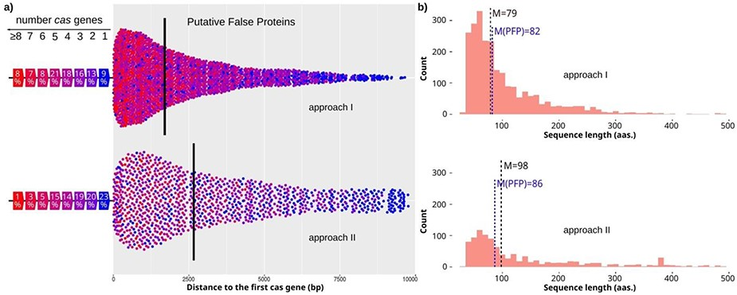
Figure 3. Characteristics of candidates with cas genes nearby. (a) Distances from candidates to the closest cas gene ...
Notes:
Figure 3. Characteristics of candidates with cas genes nearby. (a) Distances from candidates to the closest cas gene for approach I and II (top and bottom, respectively). The color of the dot shows the number of cas genes found close to the candidate. The percentage of candidates found close to a specific number of cas genes is shown on the left. Median value is shown by a vertical line. (b) Length distribution of candidates for approach I and II (top and bottom, respectively). The median value is highlighted for all candidates with one or more cas genes (M), and for the final PFPs (M(PFP) in blue color).
Unless provided in the caption above, the following copyright applies to the content of this slide: © The Author(s) 2020. Published by Oxford University Press.This is an Open Access article distributed under the terms of the Creative Commons Attribution License (http://creativecommons.org/licenses/by/4.0/), which permits unrestricted reuse, distribution, and reproduction in any medium, provided the original work is properly cited.

Slide 4
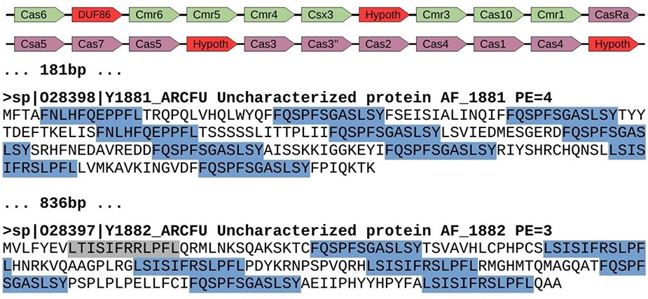
Figure 4. Genomic region of Archaeoglobus fulgidus with several spurious CRISPR sequences (AE000782.1: ...
Notes:
Figure 4. Genomic region of Archaeoglobus fulgidus with several spurious CRISPR sequences (AE000782.1: 1 671 367–1 694 202). This region contains a cluster of cas genes for CRISPR-Cas system class III-B (green color), followed by another cluster of genes for CRISPR-Cas system class I-A (purple color). They appear next to two spurious proteins with repeats arisen from three different reading frames. Red color shows uncharacterized or hypothetical proteins inside the cas clusters. Repeats are highlighted in blue color, with one of them in gray color because it represents a degenerated sequence. The distance between elements is shown in bp, and proteins from Swiss-Prot show the accession number, the identifier, the functional annotation (Uncharacterized protein), the gene name and the protein existence (PE), which represents the evidence that supports the existence of the protein (4 = protein predicted, and 3 = protein inferred from homology).
Unless provided in the caption above, the following copyright applies to the content of this slide: © The Author(s) 2020. Published by Oxford University Press.This is an Open Access article distributed under the terms of the Creative Commons Attribution License (http://creativecommons.org/licenses/by/4.0/), which permits unrestricted reuse, distribution, and reproduction in any medium, provided the original work is properly cited.

Slide 5
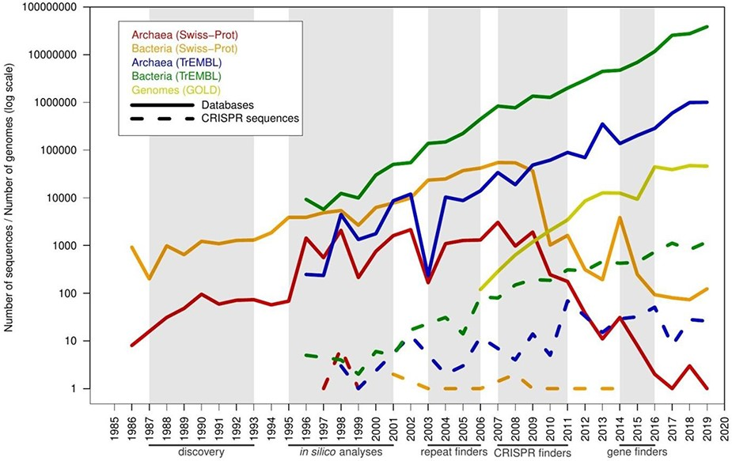
Figure 5. Timeline with the number of predicted spurious proteins by year of creation, compared with the pace of new ...
Notes:
Figure 5. Timeline with the number of predicted spurious proteins by year of creation, compared with the pace of new proteins and genomes in the databases. The x-axis shows years from 1985 to 2019. A series of milestones are highlighted below the x-axis (and shaded in gray color): discovery of CRISPR sequences (discovery), initial computational analyses of these sequences (in silico analyses), prediction of CRISPR sequences using unspecific computational tools designed for searching tandem repeats (repeat finders), CRISPR-specific computational tools such as CRT and CRISPRFinder (CRISPR finders) and inclusion of CRISPR prediction in genomic gene finders such as Prokka, PGAP and RAST (gene finders). Solid lines represent database growth, and dashed lines represent misannotated sequences.
Unless provided in the caption above, the following copyright applies to the content of this slide: © The Author(s) 2020. Published by Oxford University Press.This is an Open Access article distributed under the terms of the Creative Commons Attribution License (http://creativecommons.org/licenses/by/4.0/), which permits unrestricted reuse, distribution, and reproduction in any medium, provided the original work is properly cited.

