Slide 1
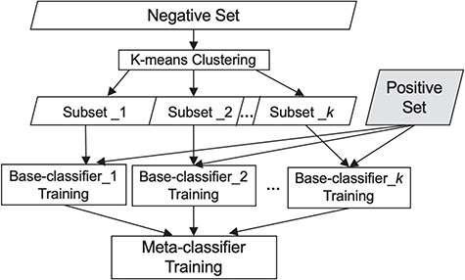
Figure 1 Our classification scheme, combining clustering and meta-classification. The irrelevant training set is ...
Notes:
Figure 1 Our classification scheme, combining clustering and meta-classification. The irrelevant training set is partitioned into K subsets via K-means clustering. Each of the K base-classifiers is trained using one of these K irrelevant subsets along with the relevant training set.
Unless provided in the caption above, the following copyright applies to the content of this slide: © The Author(s) 2019. Published by Oxford University Press.This is an Open Access article distributed under the terms of the Creative Commons Attribution License (http://creativecommons.org/licenses/by/4.0/), which permits unrestricted reuse, distribution, and reproduction in any medium, provided the original work is properly cited.

Slide 2
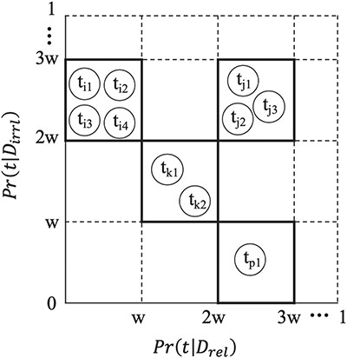
Figure 2 Feature Binning. To bin a set of terms, we first partition the continuous probability interval [0,1] into ...
Notes:
Figure 2 Feature Binning. To bin a set of terms, we first partition the continuous probability interval [0,1] into equal-spaced sub-intervals, each of width w. Two terms ${\mathrm{t}}_{\mathrm{p}}$ and ${\mathrm{t}}_{\mathrm{q}}$ are grouped into one bin if and only if the probability $Pr ({\mathrm{t}}_{\mathrm{p}}|{\mathrm{D}}_{r\mathrm{el}})$ falls into the same probability sub-interval as $P\mathrm{r}({t}_q|{D}_{r\mathrm{el}})$, and $P\mathrm{r}({t}_p|{D}_{i\mathrm{rrl}})$falls into the same probability sub-interval as $P\mathrm{r}({t}_q|{D}_{i\mathrm{rrl}})$.
Unless provided in the caption above, the following copyright applies to the content of this slide: © The Author(s) 2019. Published by Oxford University Press.This is an Open Access article distributed under the terms of the Creative Commons Attribution License (http://creativecommons.org/licenses/by/4.0/), which permits unrestricted reuse, distribution, and reproduction in any medium, provided the original work is properly cited.

Slide 3
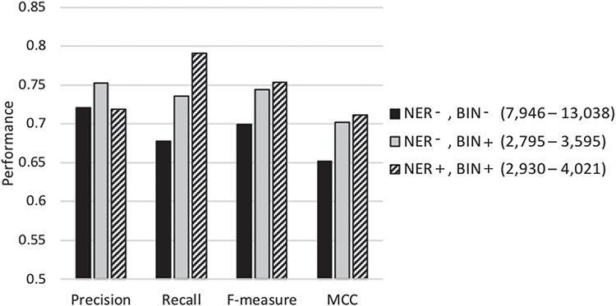
Figure 3 Performance of our classification scheme under different feature selection settings using 5-fold cross ...
Notes:
Figure 3 Performance of our classification scheme under different feature selection settings using 5-fold cross validation denotes the biochemical/genomic named entity recognition step and BIN represents the feature binning step. A ‘+’ sign represents employing the respective selection step, while a ‘−’ denotes its exclusion. The range of the number of features selected for the base-classifiers learning across the cross-validation runs is shown in parentheses.
Unless provided in the caption above, the following copyright applies to the content of this slide: © The Author(s) 2019. Published by Oxford University Press.This is an Open Access article distributed under the terms of the Creative Commons Attribution License (http://creativecommons.org/licenses/by/4.0/), which permits unrestricted reuse, distribution, and reproduction in any medium, provided the original work is properly cited.

