Slide 1
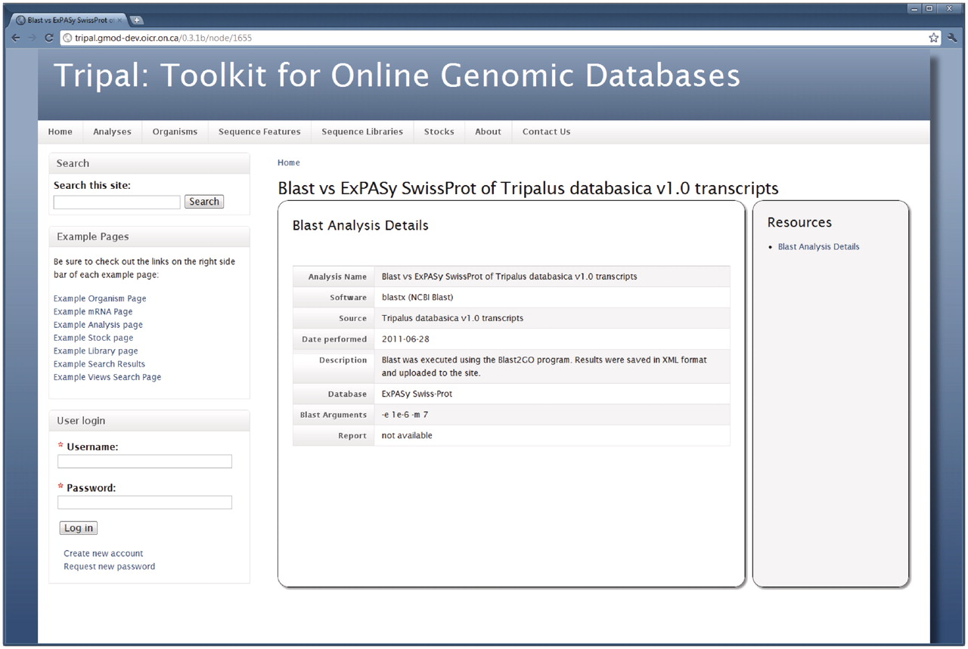
Figure 6. The Analysis page. When adding results from an analysis, content managers may provide specific details about ...
Notes:
Figure 6. The Analysis page. When adding results from an analysis, content managers may provide specific details about the analysis including the software used, the date the analysis was performed, parameters used and the data source used. This example shows information for a BLAST homology analysis, specifically the BLAST homology results shown in Figure 5.
Unless provided in the caption above, the following copyright applies to the content of this slide: © The Author(s) 2011. Published by Oxford University Press.This is an Open Access article distributed under the terms of the Creative Commons Attribution Non-Commercial License (http://creativecommons.org/licenses/by-nc/3.0), which permits unrestricted non-commercial use, distribution, and reproduction in any medium, provided the original work is properly cited.

