Slide 1
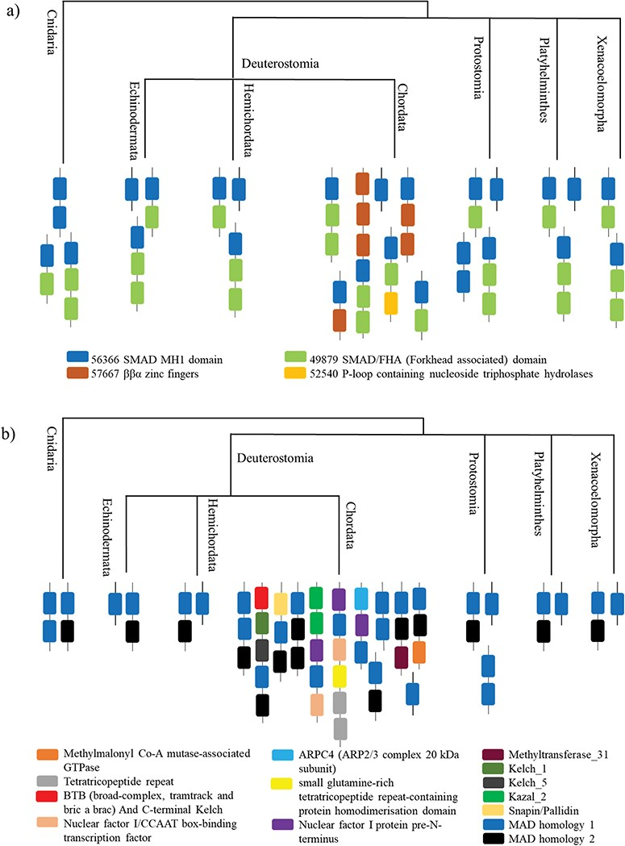
Figure 5 A case study of Smad protein MH1 superfamily. (a) The phylogenetic distribution of the SCOP-DA is ...
Notes:
Figure 5 A case study of Smad protein MH1 superfamily. (a) The phylogenetic distribution of the SCOP-DA is represented, across different taxa in Cnidaria and Bilateria. As shown, the single-domain form and the combination with SMAD/FHA are prevalent in all orders while the other domain combinations occur only in certain taxa. (b) The phylogenetic representation of Pfam DA indicates that there is a correspondence between DA predictions by both methods in spite of using differently derived HMM libraries.
Unless provided in the caption above, the following copyright applies to the content of this slide: © The Author(s) 2019. Published by Oxford University Press.This is an Open Access article distributed under the terms of the Creative Commons Attribution License (http://creativecommons.org/licenses/by/4.0/), which permits unrestricted reuse, distribution, and reproduction in any medium, provided the original work is properly cited.

