Slide 1
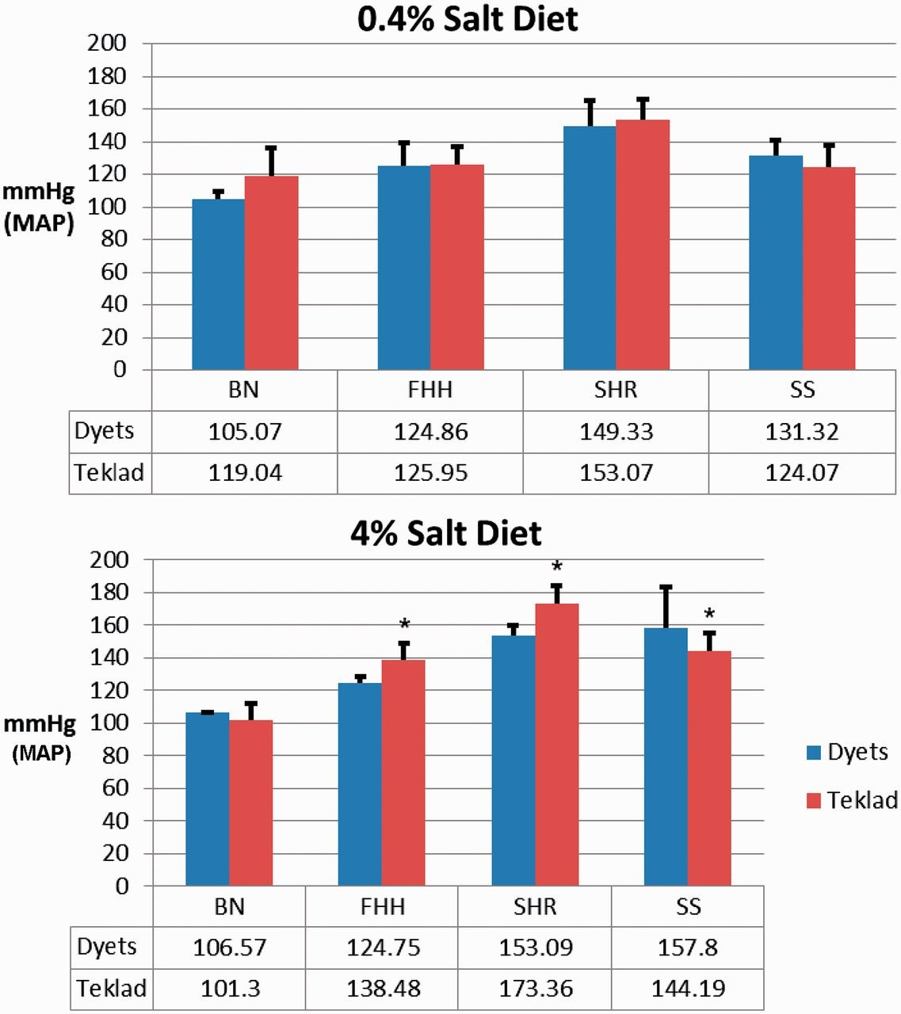
Figure 2. Effect of diet sources on MAP in four rat strains: BN, FHH, SHR and SS. Top: MAP was measured in rats on ...
Notes:
Figure 2. Effect of diet sources on MAP in four rat strains: BN, FHH, SHR and SS. Top: MAP was measured in rats on 0.4% salt-containing chows from Dyets or Teklad. Bottom: MAP was measured in rats on 4% salt-containing chows from Dyets or Teklad. Data for each strain were downloaded from PhenoMiner. The official nomenclature for the rat strains shown are BN/NHsdMcwi (BN), FHH/EurMcwi (FHH), SHR/NCrl (SHR) and SS/JrHsdMcwi (SS). Data tables underneath the charts show the mean values of each group. * P < 0.05 vs. same strain on Dyets chow.
Unless provided in the caption above, the following copyright applies to the content of this slide: © The Author(s) 2015. Published by Oxford University Press.This is an Open Access article distributed under the terms of the Creative Commons Attribution License (http://creativecommons.org/licenses/by/4.0/), which permits unrestricted reuse, distribution, and reproduction in any medium, provided the original work is properly cited.

