Slide 1
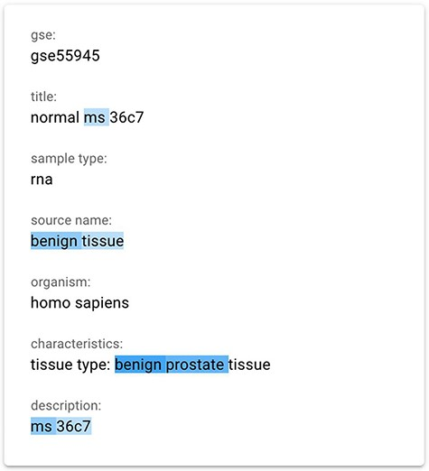
Figure 3. The gradient-based saliency map implemented in the GeMI tool. The words referring to the prediction of the ...
Notes:
Figure 3. The gradient-based saliency map implemented in the GeMI tool. The words referring to the prediction of the ‘Sex’ attribute for the GSM1348947, ‘ms’, ‘benign tissue’, ‘benign prostate’ and ‘ms 36c7’ are highlighted because they are used by the model to predict the necessary fields.
Unless provided in the caption above, the following copyright applies to the content of this slide: © The Author(s) 2022. Published by Oxford University Press.This is an Open Access article distributed under the terms of the Creative Commons Attribution License (https://creativecommons.org/licenses/by/4.0/), which permits unrestricted reuse, distribution, and reproduction in any medium, provided the original work is properly cited.

