Slide 1
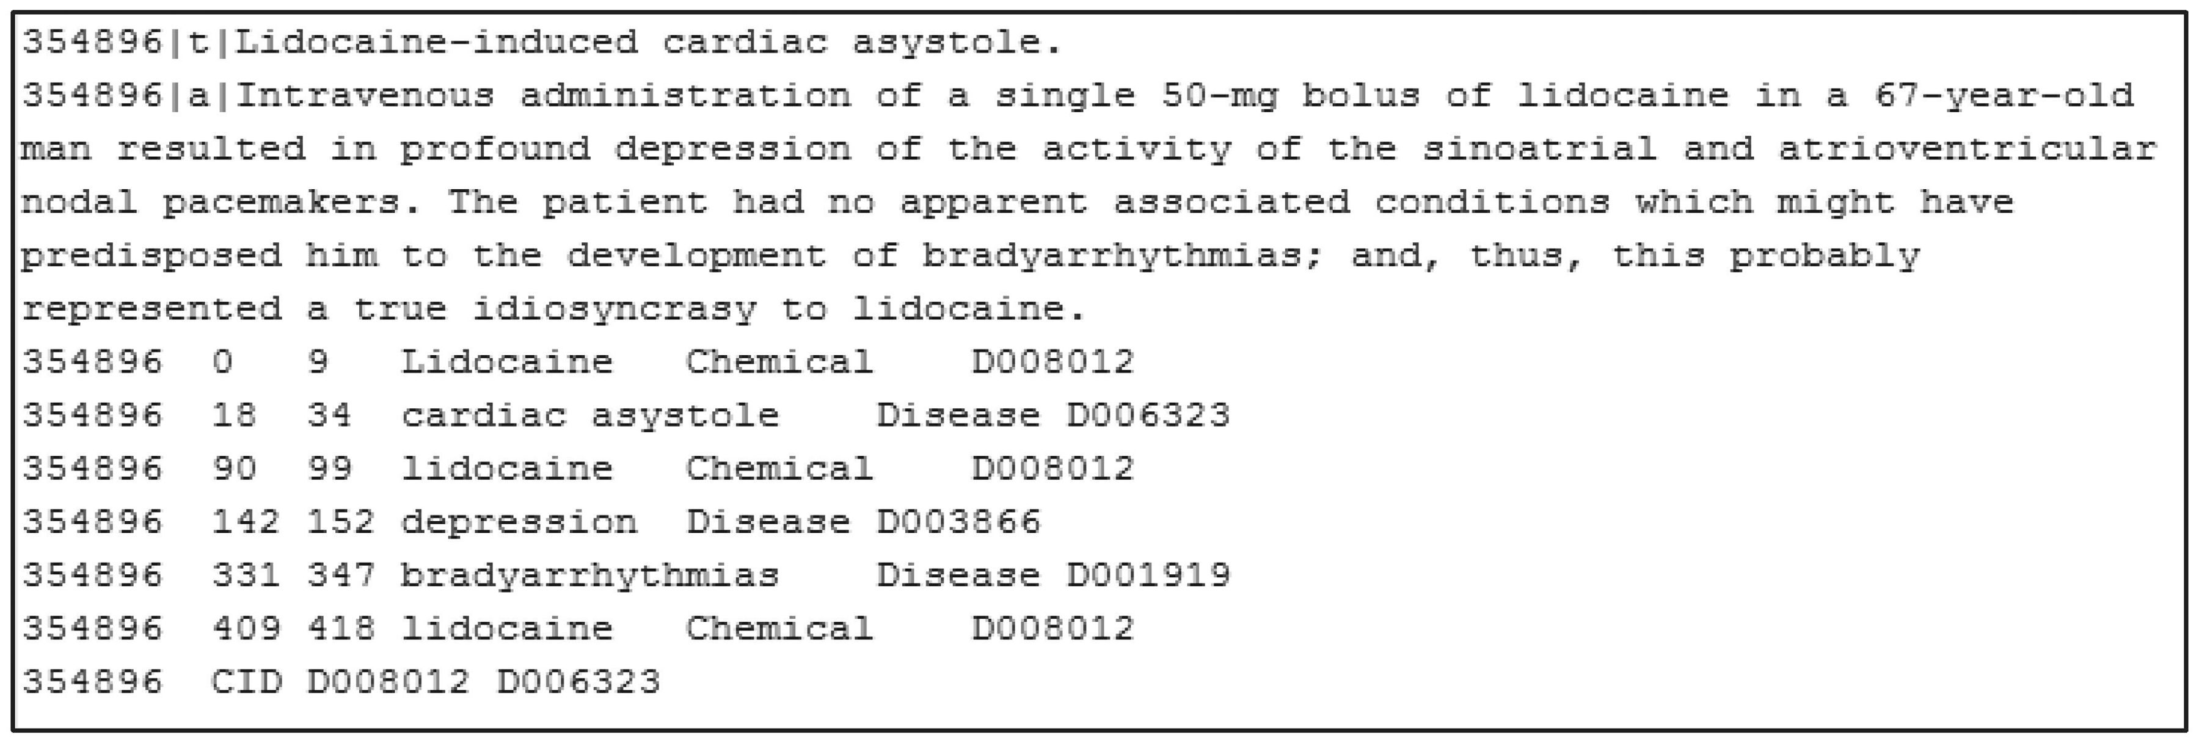
Figure 2. PubTator format annotation (PMID: 354896).
Notes:
Figure 2. PubTator format annotation (PMID: 354896).
Unless provided in the caption above, the following copyright applies to the content of this slide: Published by Oxford University Press 2016. This work is written by US Government employees and is in the public domain in the United States.

