Slide 1
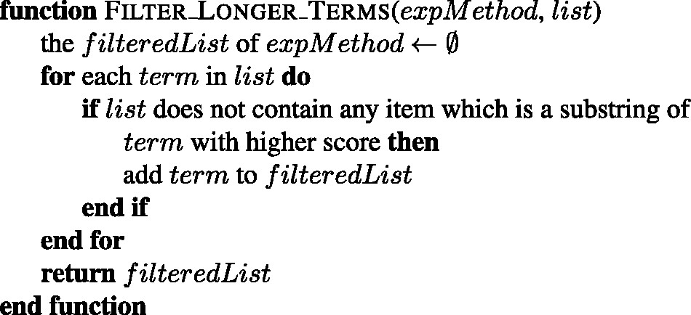
Figure 6. The algorithm for filtering the longer terms with lower scores from the given list of an experimental ...
Notes:
Figure 6. The algorithm for filtering the longer terms with lower scores from the given list of an experimental method.
Unless provided in the caption above, the following copyright applies to the content of this slide: © The Author(s) 2017. Published by Oxford University Press.This is an Open Access article distributed under the terms of the Creative Commons Attribution License (http://creativecommons.org/licenses/by/4.0/), which permits unrestricted reuse, distribution, and reproduction in any medium, provided the original work is properly cited.

