Slide 1
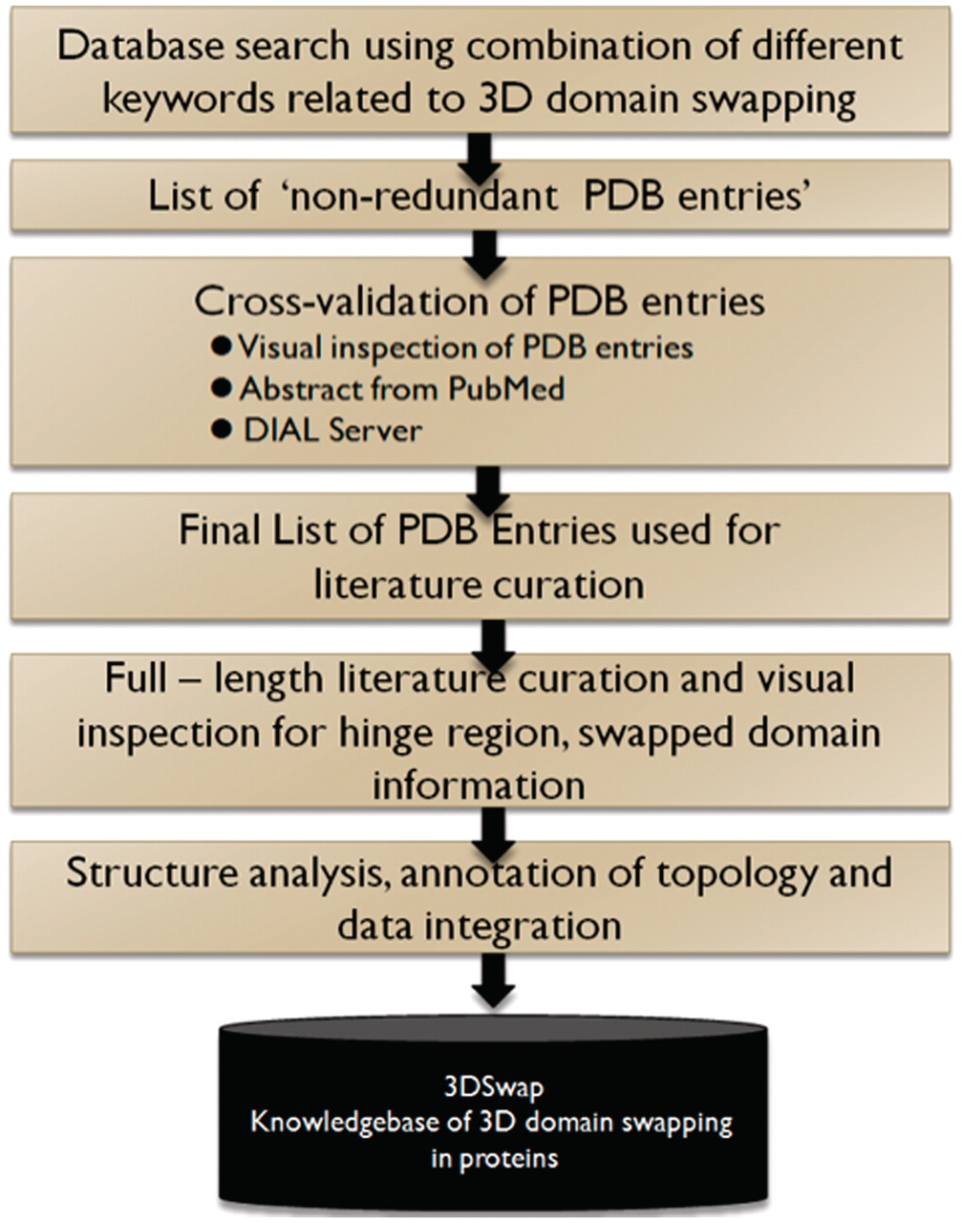
Figure 6. A schematic representation of curation steps involved in the development of 3DSwap knowledgebase.
Notes:
Figure 6. A schematic representation of curation steps involved in the development of 3DSwap knowledgebase.
Unless provided in the caption above, the following copyright applies to the content of this slide: © The Author(s) 2011. Published by Oxford University Press.This is Open Access article distributed under the terms of the Creative Commons Attribution Non-Commercial License (http://creativecommons.org/licenses/by-nc/2.5), which permits unrestricted non-commercial use, distribution, and reproduction in any medium, provided the original work is properly cited.

