Slide 1
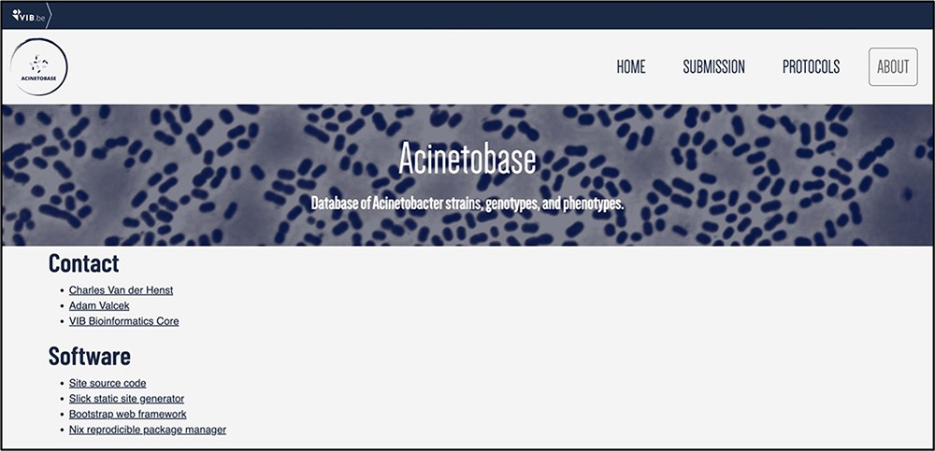
Figure 1. ‘About’ page of Acinetobase.
Notes:
Figure 1. ‘About’ page of Acinetobase.
Unless provided in the caption above, the following copyright applies to the content of this slide: © The Author(s) 2022. Published by Oxford University Press.This is an Open Access article distributed under the terms of the Creative Commons Attribution-NonCommercial License (https://creativecommons.org/licenses/by-nc/4.0/), which permits non-commercial re-use, distribution, and reproduction in any medium, provided the original work is properly cited. For commercial re-use, please contact journals.permissions@oup.com

Slide 2
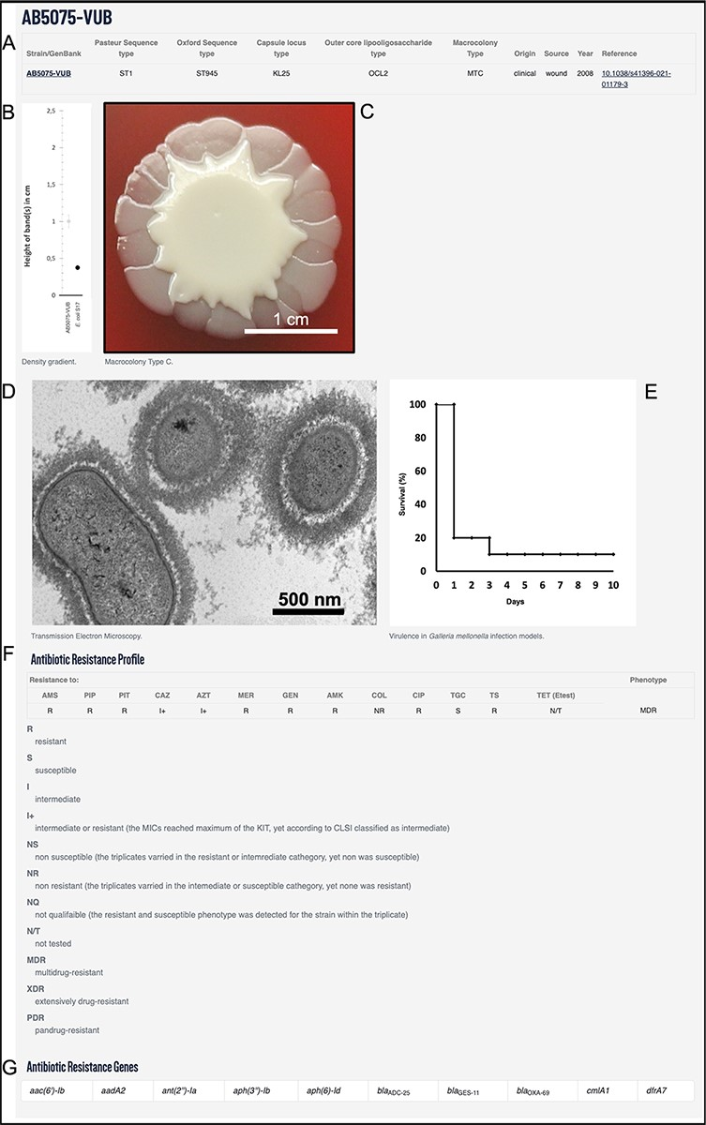
Figure 2. Example using AB5075-VUB entry depicting: (A) description of the genotype (KL, STOx/Pas and OCL), origin, ...
Notes:
Figure 2. Example using AB5075-VUB entry depicting: (A) description of the genotype (KL, STOx/Pas and OCL), origin, source and year of isolation with a hyperlink for the complete chromosomal sequence and a reference publication; (B) quantification of the capsule; (C) macrocolony type; (D) TEM micrograph of the capsule; (E) virulence in G. mellonella infection model; (F) antibiotic resistance profile and (G) ARGs.
Unless provided in the caption above, the following copyright applies to the content of this slide: © The Author(s) 2022. Published by Oxford University Press.This is an Open Access article distributed under the terms of the Creative Commons Attribution-NonCommercial License (https://creativecommons.org/licenses/by-nc/4.0/), which permits non-commercial re-use, distribution, and reproduction in any medium, provided the original work is properly cited. For commercial re-use, please contact journals.permissions@oup.com

Slide 3
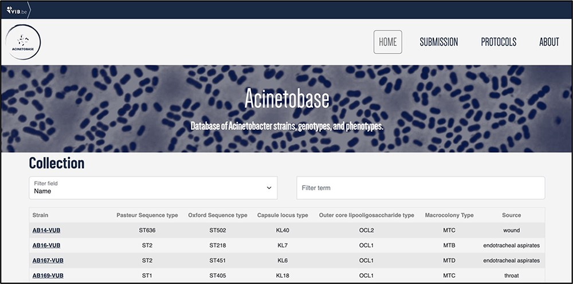
Figure 3. ‘Collection’ page depicting the name, Pasteur and Oxford STs, KL, OCL, macrocolony types and source of each ...
Notes:
Figure 3. ‘Collection’ page depicting the name, Pasteur and Oxford STs, KL, OCL, macrocolony types and source of each isolate.
Unless provided in the caption above, the following copyright applies to the content of this slide: © The Author(s) 2022. Published by Oxford University Press.This is an Open Access article distributed under the terms of the Creative Commons Attribution-NonCommercial License (https://creativecommons.org/licenses/by-nc/4.0/), which permits non-commercial re-use, distribution, and reproduction in any medium, provided the original work is properly cited. For commercial re-use, please contact journals.permissions@oup.com

Slide 4
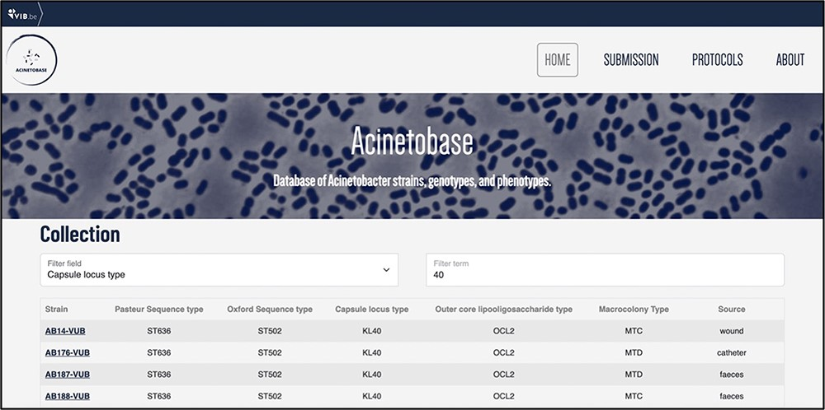
Figure 4. Example of entries filtering based on the KL type 40.
Notes:
Figure 4. Example of entries filtering based on the KL type 40.
Unless provided in the caption above, the following copyright applies to the content of this slide: © The Author(s) 2022. Published by Oxford University Press.This is an Open Access article distributed under the terms of the Creative Commons Attribution-NonCommercial License (https://creativecommons.org/licenses/by-nc/4.0/), which permits non-commercial re-use, distribution, and reproduction in any medium, provided the original work is properly cited. For commercial re-use, please contact journals.permissions@oup.com

