Slide 1
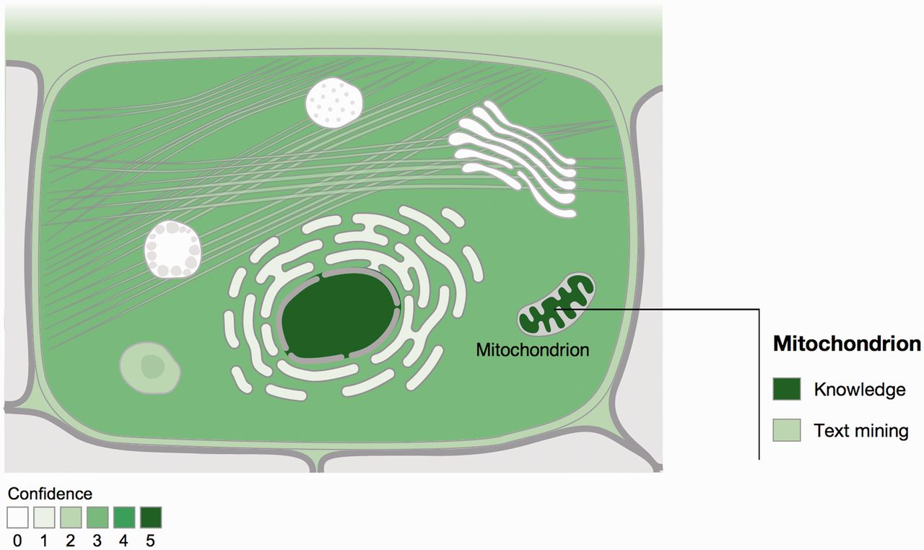
Figure 1. Visualization of localization evidence. When querying the database for a protein, its localization is ...
Notes:
Figure 1. Visualization of localization evidence. When querying the database for a protein, its localization is visualized on a schematic of a cell. When the user hovers the cursor over a compartment, we also graphically summarize the types of evidence supporting this localization. The confidence of the evidence is color coded, ranging from light green for low confidence to dark green for high confidence. White indicates an absence of localization evidence.
Unless provided in the caption above, the following copyright applies to the content of this slide: © The Author(s) 2014. Published by Oxford University Press.This is an Open Access article distributed under the terms of the Creative Commons Attribution License (http://creativecommons.org/licenses/by/3.0/), which permits unrestricted reuse, distribution, and reproduction in any medium, provided the original work is properly cited.

Slide 2
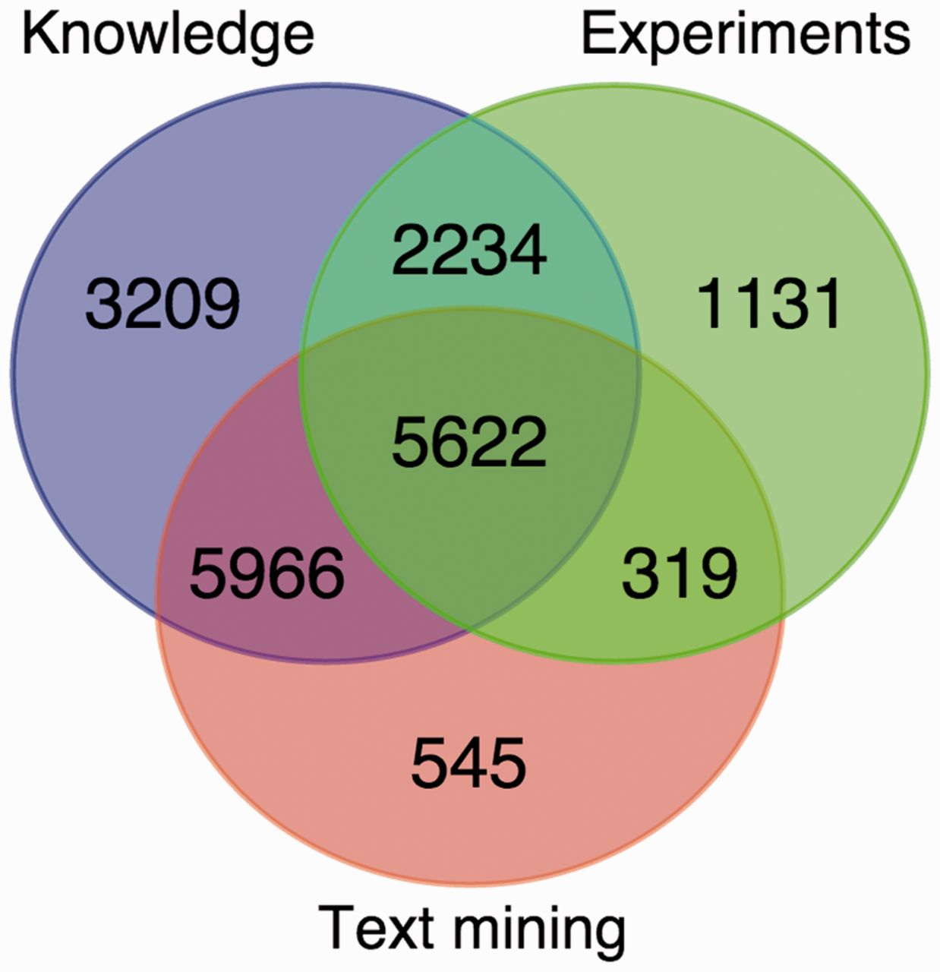
Figure 2. Overlap between the knowledge, experimental and text-mining evidence for human proteins. The Venn diagram ...
Notes:
Figure 2. Overlap between the knowledge, experimental and text-mining evidence for human proteins. The Venn diagram shows the number of proteins with localization evidence from one or more of the three types of evidence. The two sequence-based prediction methods are not included as they are able to provide a prediction for any protein sequence.
Unless provided in the caption above, the following copyright applies to the content of this slide: © The Author(s) 2014. Published by Oxford University Press.This is an Open Access article distributed under the terms of the Creative Commons Attribution License (http://creativecommons.org/licenses/by/3.0/), which permits unrestricted reuse, distribution, and reproduction in any medium, provided the original work is properly cited.

Slide 3
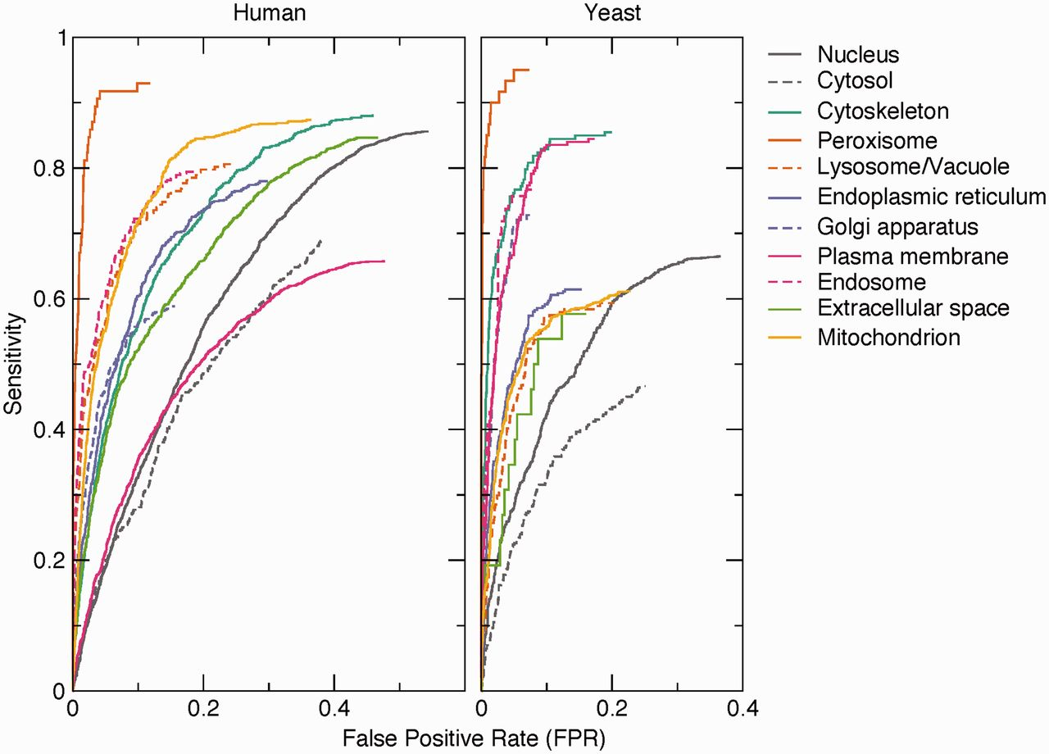
Figure 3. Benchmark of text-mining results. The performance of the text-mining pipeline on human and yeast proteins is ...
Notes:
Figure 3. Benchmark of text-mining results. The performance of the text-mining pipeline on human and yeast proteins is shown as receiver operating characteristics (ROC) curves for each of 11 compartments. The curves do not intercept sensitivity = 1.0 and FPR = 1.0 because many of the protein–compartment pairs in the benchmark set are never found mentioned together in Medline, for which reason they have no text-mining score.
Unless provided in the caption above, the following copyright applies to the content of this slide: © The Author(s) 2014. Published by Oxford University Press.This is an Open Access article distributed under the terms of the Creative Commons Attribution License (http://creativecommons.org/licenses/by/3.0/), which permits unrestricted reuse, distribution, and reproduction in any medium, provided the original work is properly cited.

Slide 4
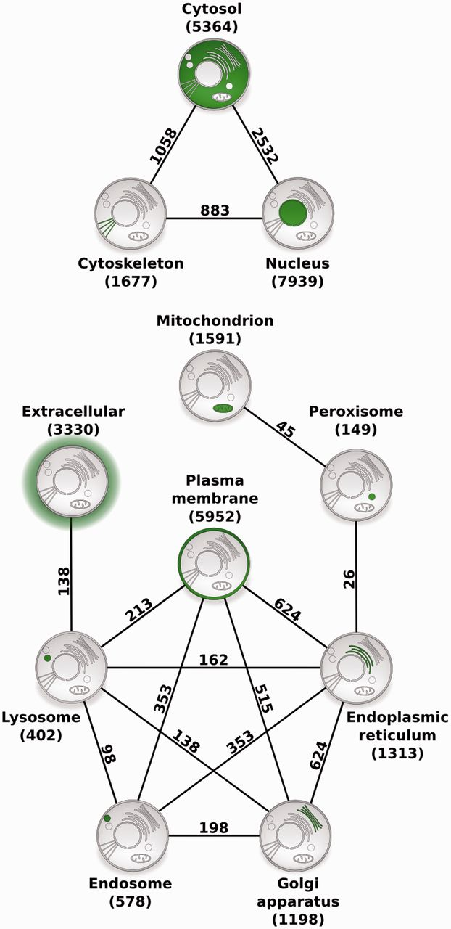
Figure 4. Compartment relationships derived from shared proteins. Illustrating the usefulness of COMPARTMENTS for ...
Notes:
Figure 4. Compartment relationships derived from shared proteins. Illustrating the usefulness of COMPARTMENTS for global analysis of protein localization, we studied relationships between compartments. Each node represents a single compartment, which is highlighted in green. The number of proteins in the compartment is shown in parenthesis. We show an edge between two compartments whenever they share more proteins than expected at random (false discovery rate <0.1%). The number of proteins co-localized to the two compartments is shown next to the edge.
Unless provided in the caption above, the following copyright applies to the content of this slide: © The Author(s) 2014. Published by Oxford University Press.This is an Open Access article distributed under the terms of the Creative Commons Attribution License (http://creativecommons.org/licenses/by/3.0/), which permits unrestricted reuse, distribution, and reproduction in any medium, provided the original work is properly cited.

