Slide 1
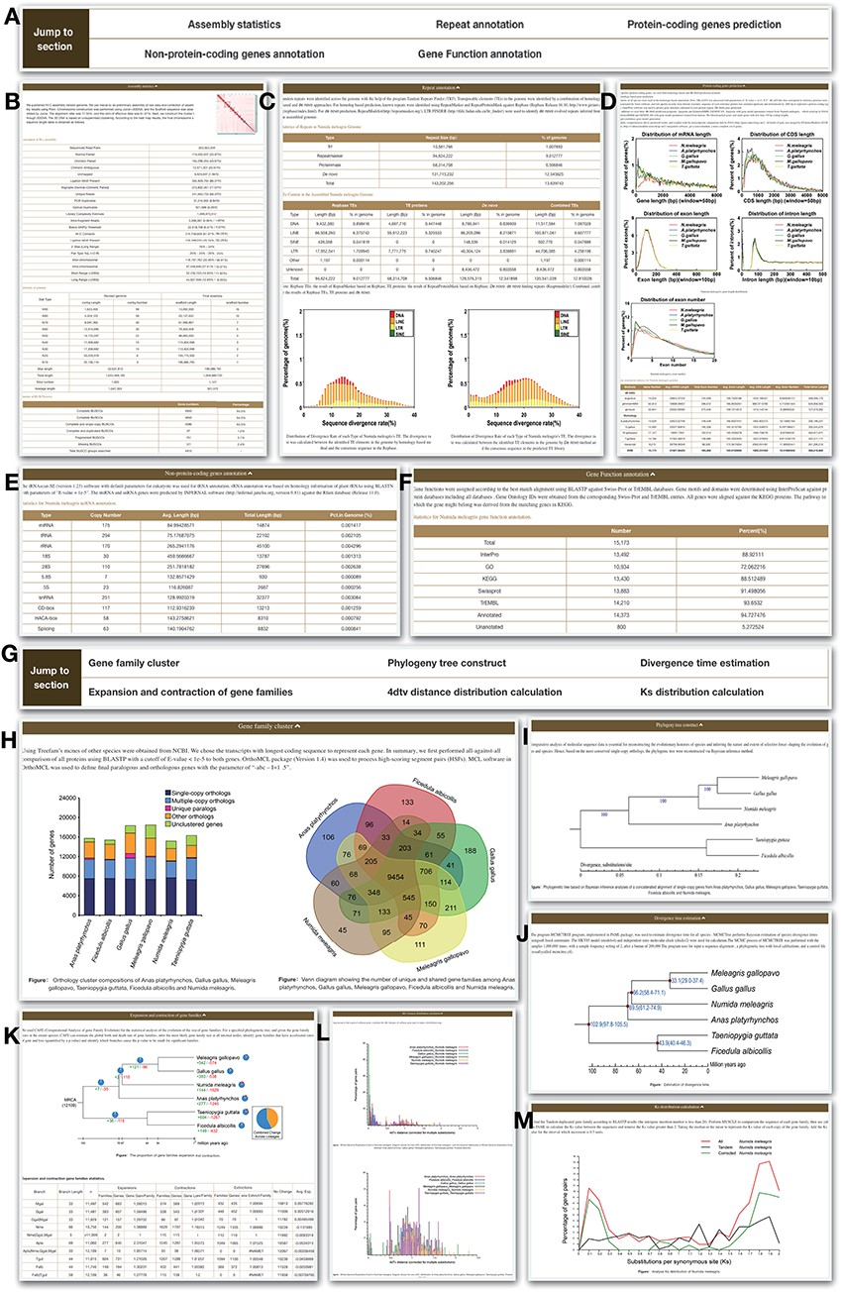
Figure 2. Genome module. Genome module has subpages, which are Statistics (A–F) and Analysis pages (G–M). (A) ...
Notes:
Figure 2. Genome module. Genome module has subpages, which are Statistics (A–F) and Analysis pages (G–M). (A) Navigation bar of the Statistics page, which provides a quick access to each section. (B) Assembly statistics. (C) Repeat annotation. (D) Protein-coding genes prediction. (E) Non-protein-coding genes annotation. (F) Functional annotation. (G) Navigation bar of the Analysis page. (H) Gene family cluster. (I) Phylogeny tree. (J) Divergence time. (K) Expansion and contraction of gene families. (L) 4dtv distance distribution. (M) Ks distribution.
Unless provided in the caption above, the following copyright applies to the content of this slide: © The Author(s) 2021. Published by Oxford University Press.This is an Open Access article distributed under the terms of the Creative Commons Attribution License (http://creativecommons.org/licenses/by/4.0/), which permits unrestricted reuse, distribution, and reproduction in any medium, provided the original work is properly cited.

