Slide 1
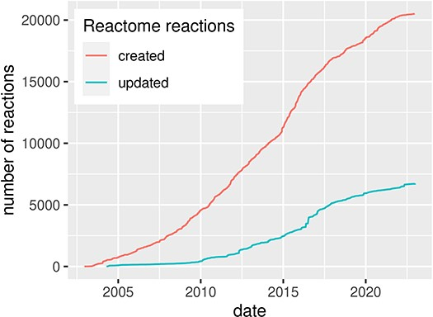
Figure 1. Evolution of the Reactome pathway database, illustrated by the number of created and updated reactions over ...
Notes:
Figure 1. Evolution of the Reactome pathway database, illustrated by the number of created and updated reactions over time, for human pathways. Source: reactome.org (4).
Unless provided in the caption above, the following copyright applies to the content of this slide: © The Author(s) 2024. Published by Oxford University Press.This is an Open Access article distributed under the terms of the Creative Commons Attribution License (https://creativecommons.org/licenses/by/4.0/), which permits unrestricted reuse, distribution, and reproduction in any medium, provided the original work is properly cited.

Slide 2
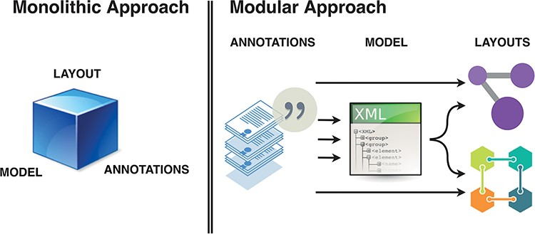
Figure 2. Monolithic vs modular approach to systems biology diagram building. Separation of roles and functions ...
Notes:
Figure 2. Monolithic vs modular approach to systems biology diagram building. Separation of roles and functions requires interoperability, but offers efficiency of dedicated tools. BioKC supports the first step and modelling interoperability—curation of annotated content compatible with SBML.
Unless provided in the caption above, the following copyright applies to the content of this slide: © The Author(s) 2024. Published by Oxford University Press.This is an Open Access article distributed under the terms of the Creative Commons Attribution License (https://creativecommons.org/licenses/by/4.0/), which permits unrestricted reuse, distribution, and reproduction in any medium, provided the original work is properly cited.

Slide 3
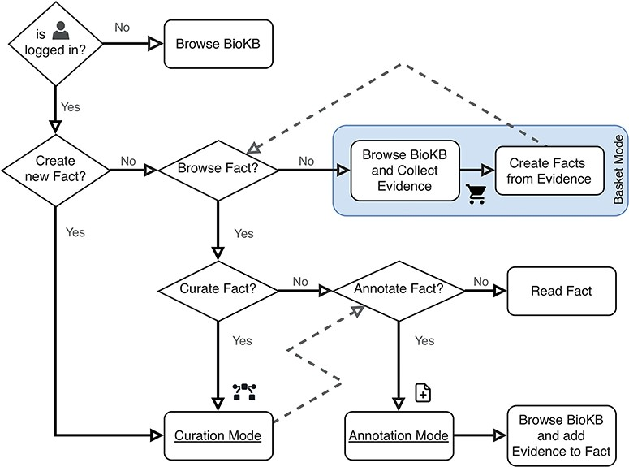
Figure 3. Flowchart describing the user operation flow and the different operation modes. The box shows the basket ...
Notes:
Figure 3. Flowchart describing the user operation flow and the different operation modes. The box shows the basket mode, which is the default operation mode when both curation and annotation modes are disabled.
Unless provided in the caption above, the following copyright applies to the content of this slide: © The Author(s) 2024. Published by Oxford University Press.This is an Open Access article distributed under the terms of the Creative Commons Attribution License (https://creativecommons.org/licenses/by/4.0/), which permits unrestricted reuse, distribution, and reproduction in any medium, provided the original work is properly cited.

Slide 4
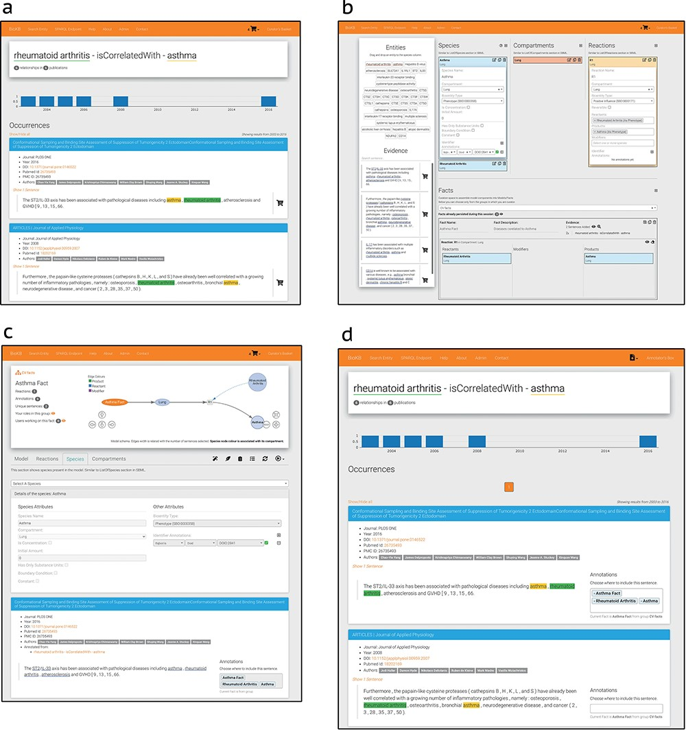
Figure 4. BioKC interface and functionalities. (a) BioKB relationship view showing sentences for a given entity ...
Notes:
Figure 4. BioKC interface and functionalities. (a) BioKB relationship view showing sentences for a given entity relationship, and the sentences can be added to the basket. (b) Basket checkout redirects to the basket view where facts and their elements can be composed. (c) The ‘Fact view’ is where facts can be edited, either from scratch or after being persisted in the basket view. (d) The annotation mode enables annotation capabilities in BioKB to assign supporting evidence to one or multiple elements of a fact.
Unless provided in the caption above, the following copyright applies to the content of this slide: © The Author(s) 2024. Published by Oxford University Press.This is an Open Access article distributed under the terms of the Creative Commons Attribution License (https://creativecommons.org/licenses/by/4.0/), which permits unrestricted reuse, distribution, and reproduction in any medium, provided the original work is properly cited.

Slide 5
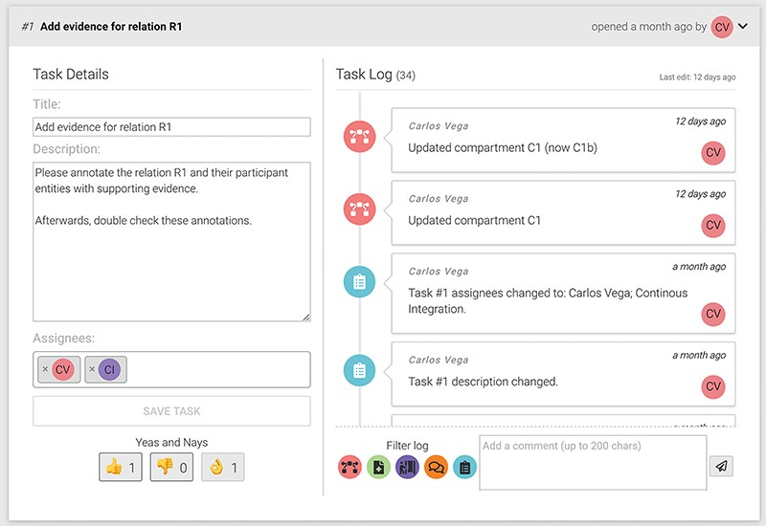
Figure 5. An example of a task showing the title, description, assigned users and cast votes on the left. The right ...
Notes:
Figure 5. An example of a task showing the title, description, assigned users and cast votes on the left. The right side shows the task log and the comment input box.
Unless provided in the caption above, the following copyright applies to the content of this slide: © The Author(s) 2024. Published by Oxford University Press.This is an Open Access article distributed under the terms of the Creative Commons Attribution License (https://creativecommons.org/licenses/by/4.0/), which permits unrestricted reuse, distribution, and reproduction in any medium, provided the original work is properly cited.

Slide 6
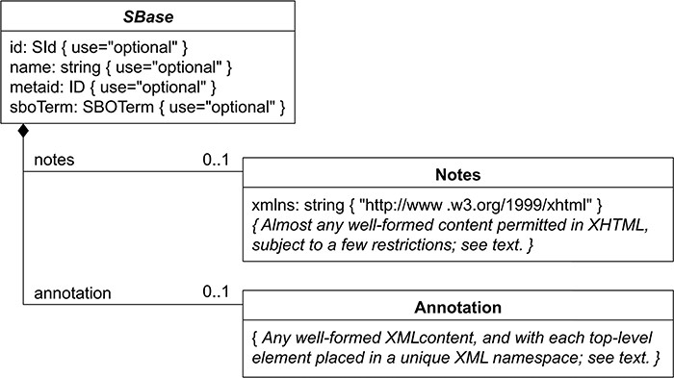
Figure 6. Nearly every object composing an SBML Level 3 model definition has a specific data type that is derived ...
Notes:
Figure 6. Nearly every object composing an SBML Level 3 model definition has a specific data type that is derived directly or indirectly from a single abstract type called SBase. See Section 3.2 from SBML Specification for Level 3 Version 2 Core. BioKC follows the same structure for all SBML elements composing a fact so that they can be annotated.
Unless provided in the caption above, the following copyright applies to the content of this slide: © The Author(s) 2024. Published by Oxford University Press.This is an Open Access article distributed under the terms of the Creative Commons Attribution License (https://creativecommons.org/licenses/by/4.0/), which permits unrestricted reuse, distribution, and reproduction in any medium, provided the original work is properly cited.

