Slide 1
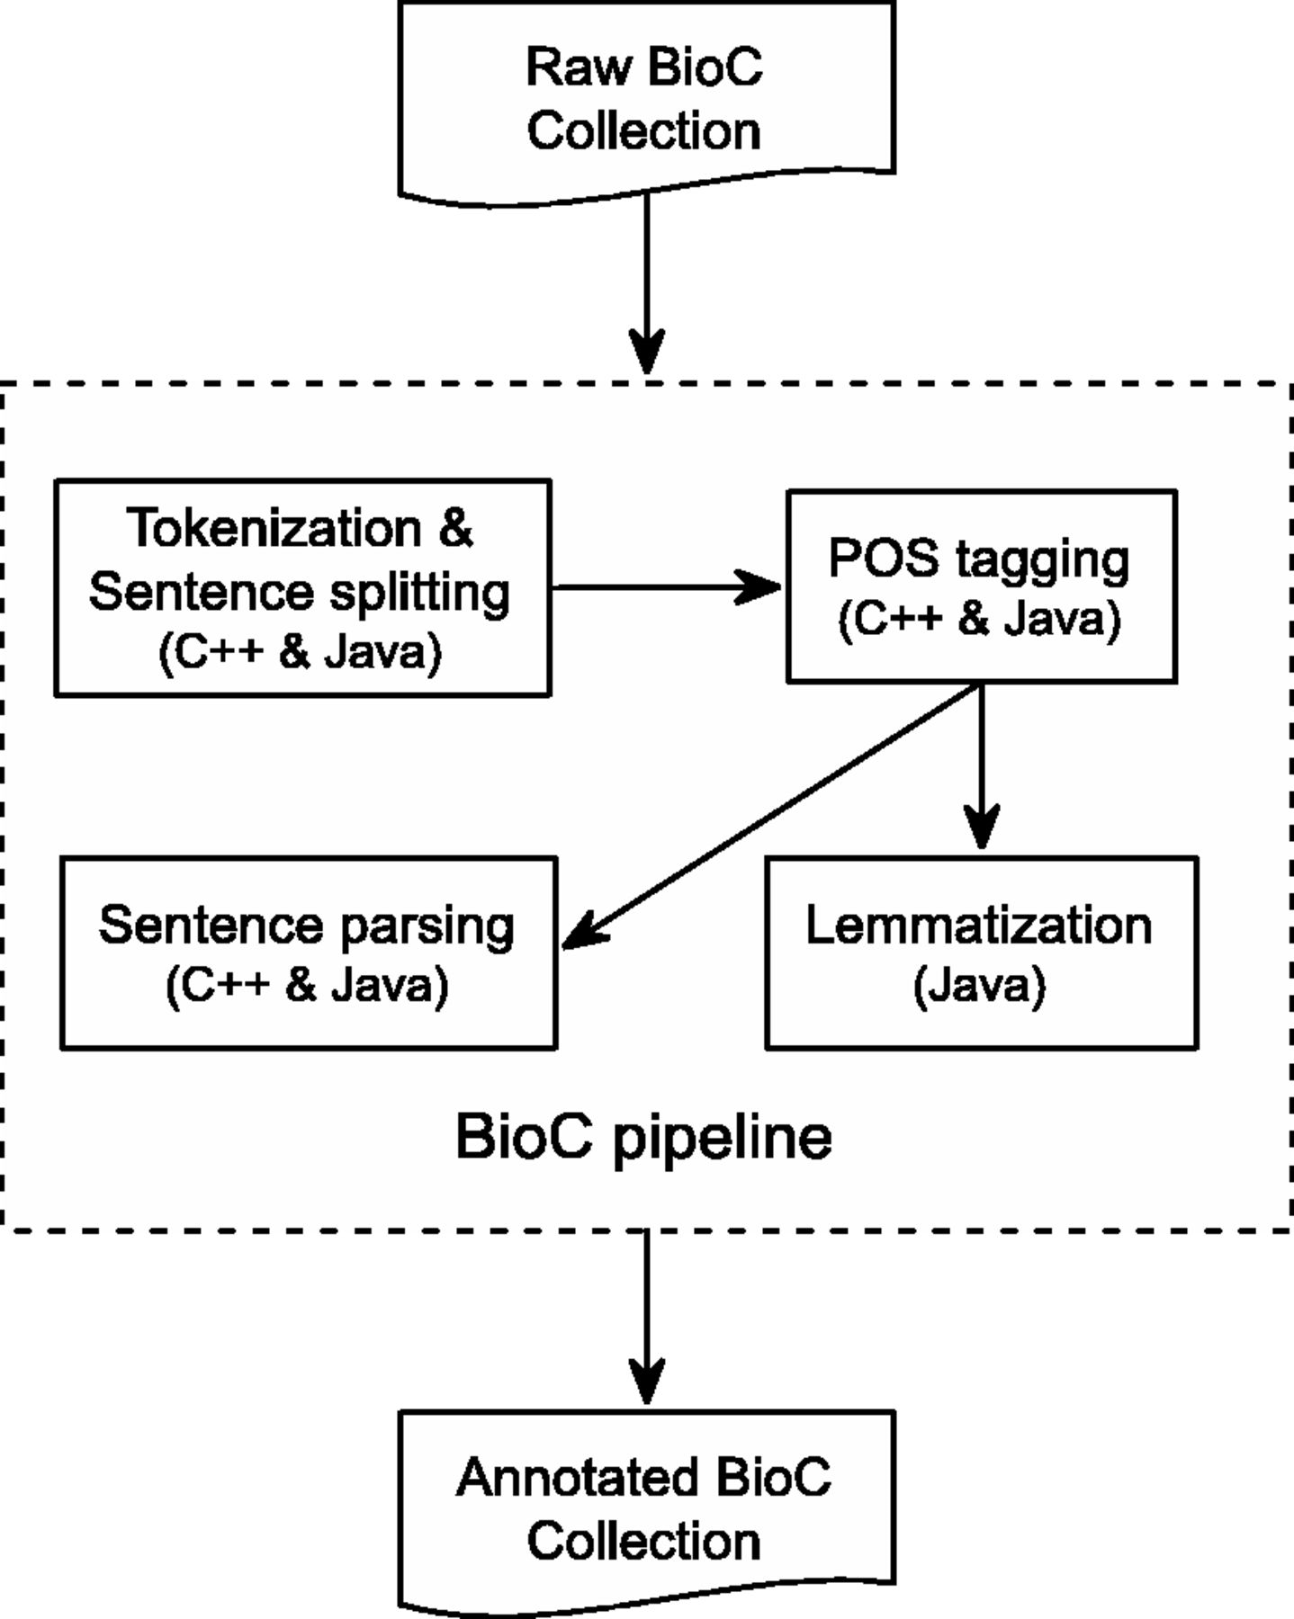
Figure 1. BioC Text-preprocessing Pipeline. All components are available in both C++ and Java, except for ...
Notes:
Figure 1. BioC Text-preprocessing Pipeline. All components are available in both C++ and Java, except for Lemmatization, which is only available in Java.
Unless provided in the caption above, the following copyright applies to the content of this slide: Published by Oxford University Press. This work is written by US Government employees and is in the public domain in the US.

