Slide 1
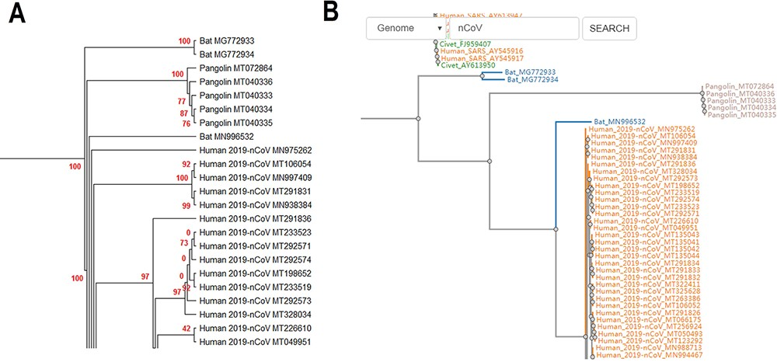
Figure 2. (A) Partial display of the phylogenetic tree built by all coronavirus genomes documented in CoVdb. Red ...
Notes:
Figure 2. (A) Partial display of the phylogenetic tree built by all coronavirus genomes documented in CoVdb. Red numbers are marginal likelihoods. (B) Snapshot showing that users can search a strain by name in a phylogenetic tree. Both A and B center on the split of Bat_MN996532 and 2019-nCoV (SARS-CoV-2).
Unless provided in the caption above, the following copyright applies to the content of this slide: © The Author(s) 2020. Published by Oxford University Press.This is an Open Access article distributed under the terms of the Creative Commons Attribution License (http://creativecommons.org/licenses/by/4.0/), which permits unrestricted reuse, distribution, and reproduction in any medium, provided the original work is properly cited.

