Slide 1
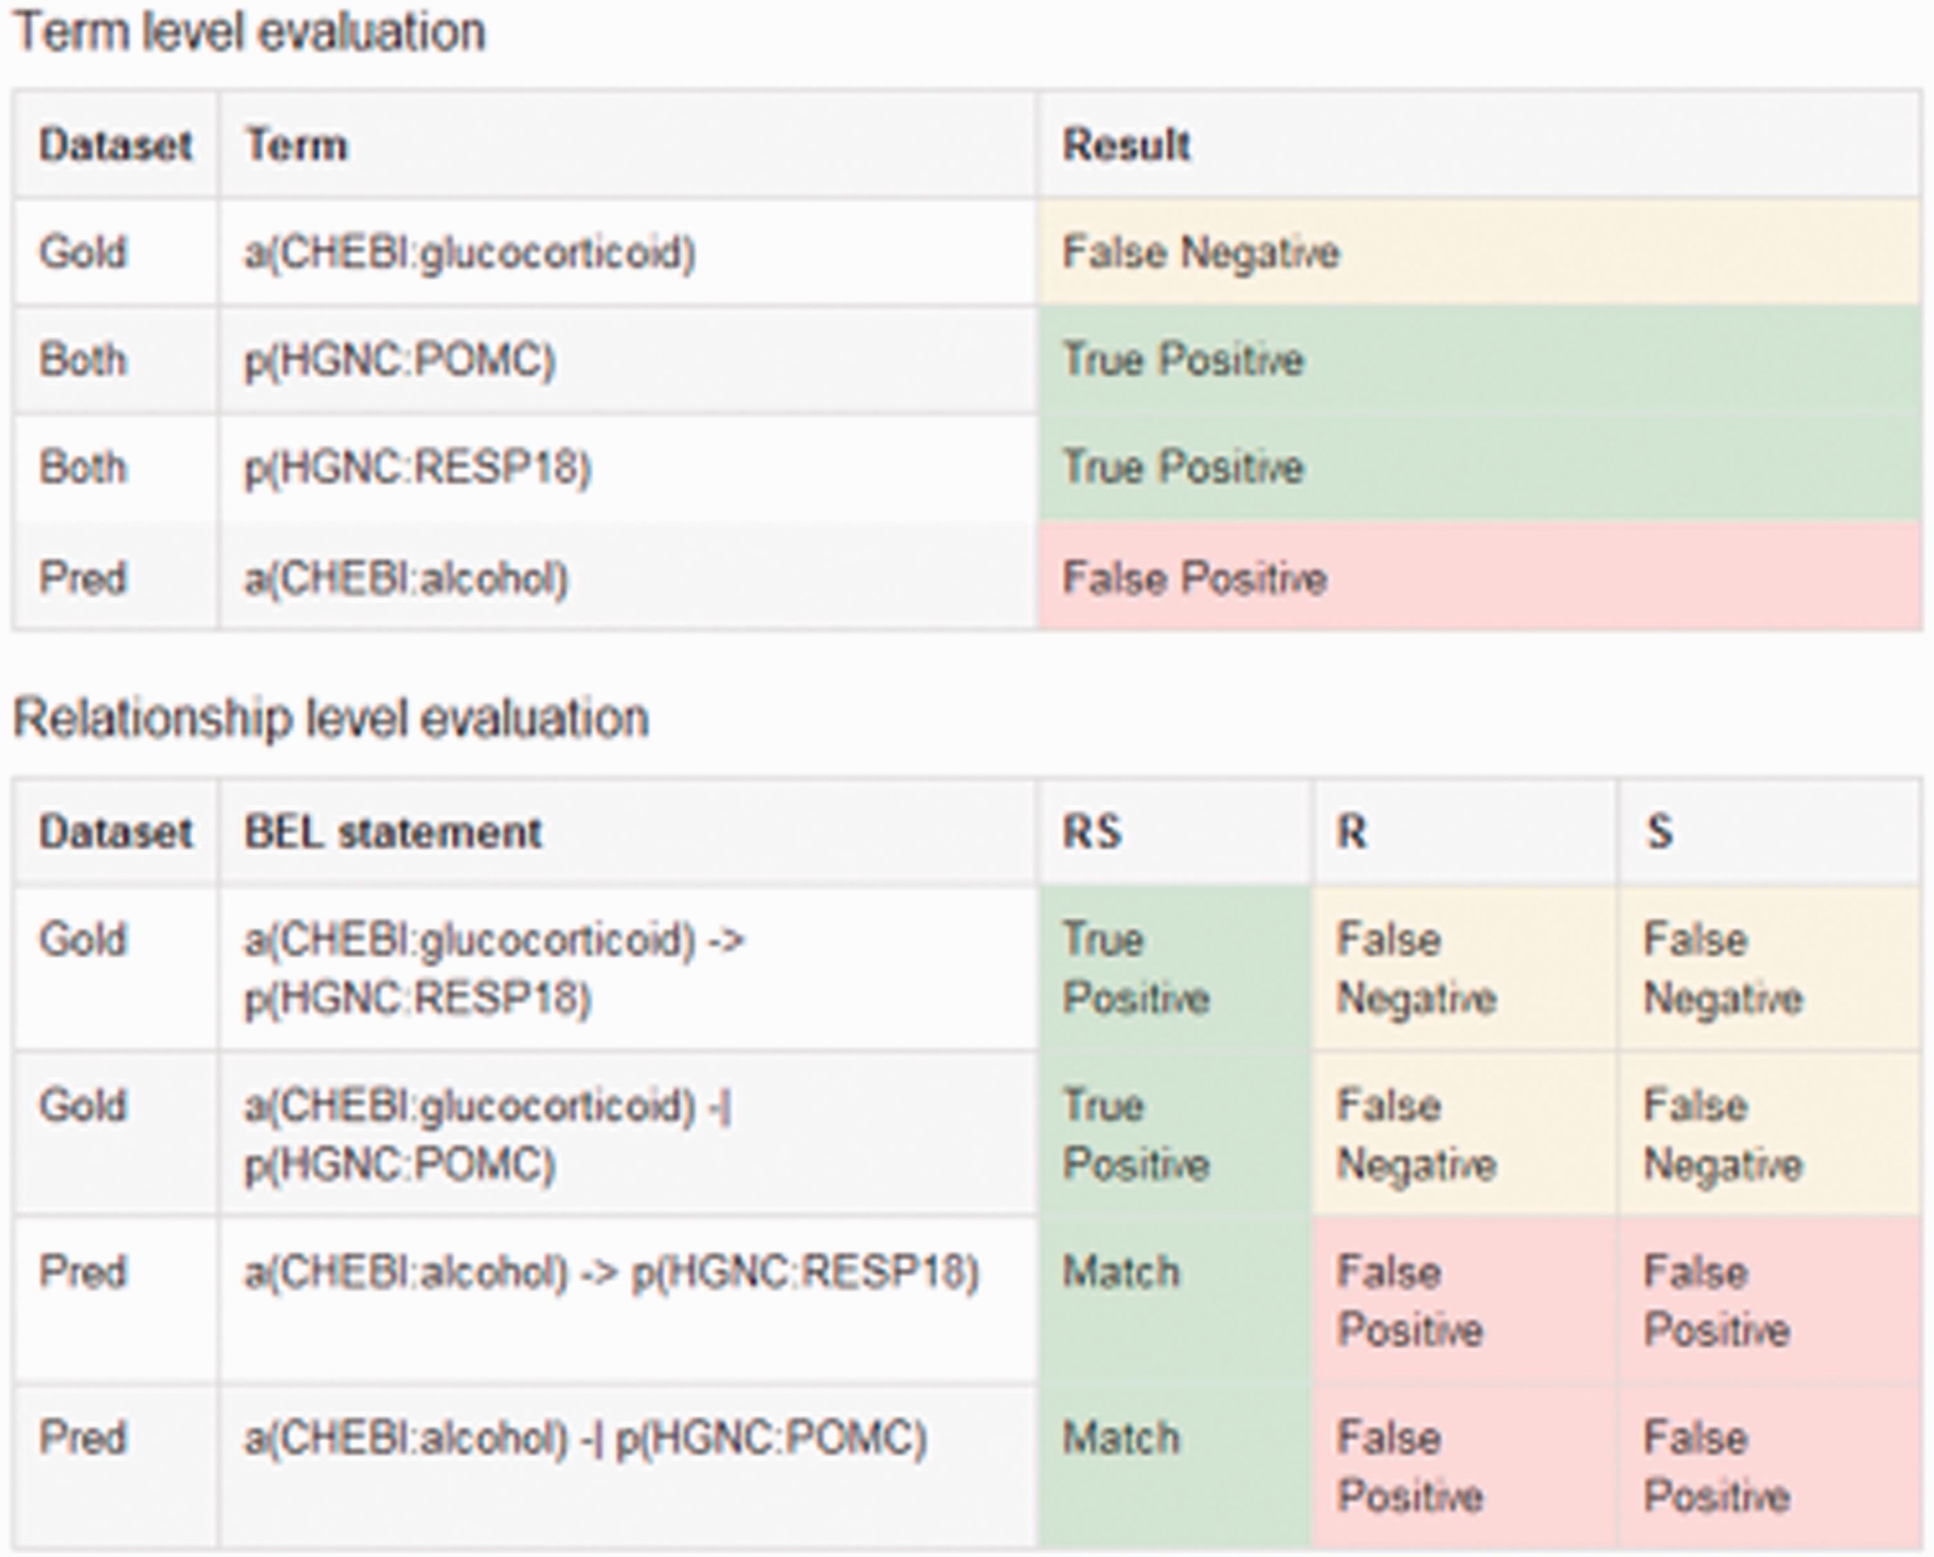
Figure 5 An example output of the sentence-based evaluation. The screenshot contains the detected true positive ...
Notes:
Figure 5 An example output of the sentence-based evaluation. The screenshot contains the detected true positive (green), false positive (red) and false negatives (yellow) entries for the term and relationship level.
Unless provided in the caption above, the following copyright applies to the content of this slide: © The Author(s) 2016. Published by Oxford University Press. This is an Open Access article distributed under the terms of the Creative Commons Attribution License ( http://creativecommons.org/licenses/by/4.0/ ), which permits unrestricted reuse, distribution, and reproduction in any medium, provided the original work is properly cited.

