Slide 1
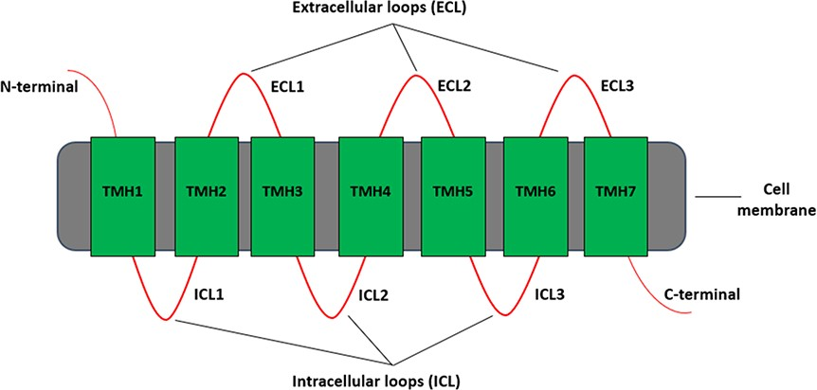
Figure 1. Different regions of a typical GPCR molecule. GPCR consists of a single polypeptide chain of amino acids ...
Notes:
Figure 1. Different regions of a typical GPCR molecule. GPCR consists of a single polypeptide chain of amino acids folded into seven transmembrane helices (TMH1–7) between an extracellular N-terminal and an intracellular C-terminal. The seven transmembrane helices are connected by three extracellular loops (ECL1–3) and three intracellular loops (ICL1–3).
Unless provided in the caption above, the following copyright applies to the content of this slide: © The Author(s) 2020. Published by Oxford University Press.This is an Open Access article distributed under the terms of the Creative Commons Attribution License (http://creativecommons.org/licenses/by/4.0/), which permits unrestricted reuse, distribution, and reproduction in any medium, provided the original work is properly cited.

