Slide 1
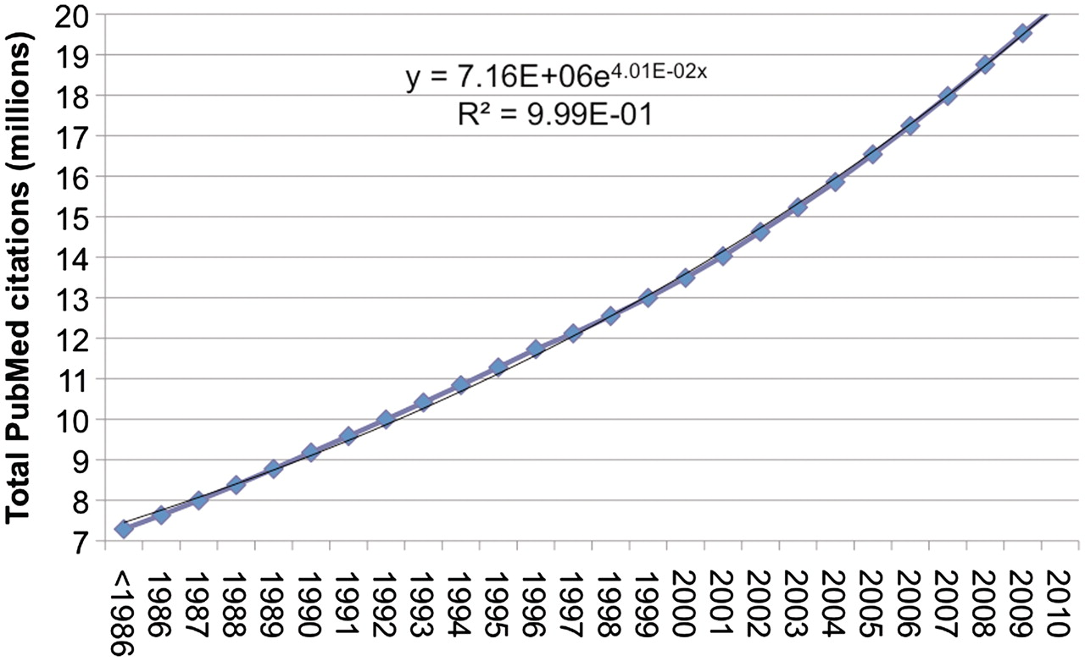
Figure 1. Growth of PubMed citations from 1986 to 2010. Over the past 20 years, the total number of citations in PubMed ...
Notes:
Figure 1. Growth of PubMed citations from 1986 to 2010. Over the past 20 years, the total number of citations in PubMed has increased at a ∼4% growth rate. There are currently over 20-million citations in PubMed. 2010 is partial data (through December 1).
Unless provided in the caption above, the following copyright applies to the content of this slide: © The Author(s) 2011. Published by Oxford University Press.This is Open Access article distributed under the terms of the Creative Commons Attribution Non-Commercial License (http://creativecommons.org/licenses/by-nc/2.5), which permits unrestricted non-commercial use, distribution, and reproduction in any medium, provided the original work is properly cited.

Slide 2
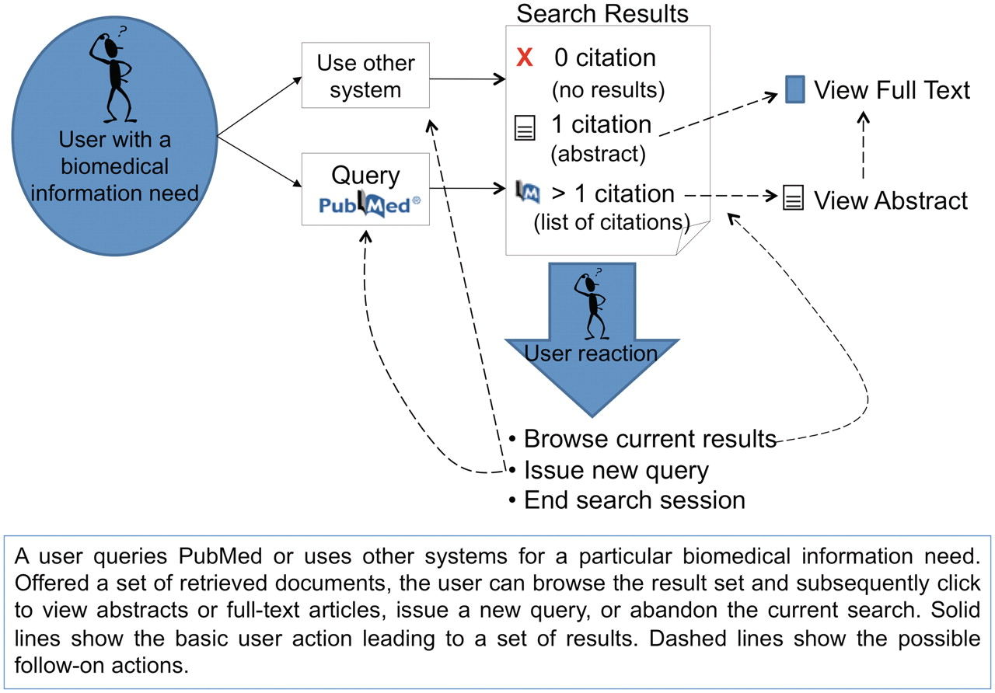
Figure 2. Overview of general user interactions with PubMed (or similar systems) for searching biomedical literature. ...
Notes:
Figure 2. Overview of general user interactions with PubMed (or similar systems) for searching biomedical literature. Adapted from Islamaj Dogan et al., (3).
Unless provided in the caption above, the following copyright applies to the content of this slide: © The Author(s) 2011. Published by Oxford University Press.This is Open Access article distributed under the terms of the Creative Commons Attribution Non-Commercial License (http://creativecommons.org/licenses/by-nc/2.5), which permits unrestricted non-commercial use, distribution, and reproduction in any medium, provided the original work is properly cited.

Slide 3
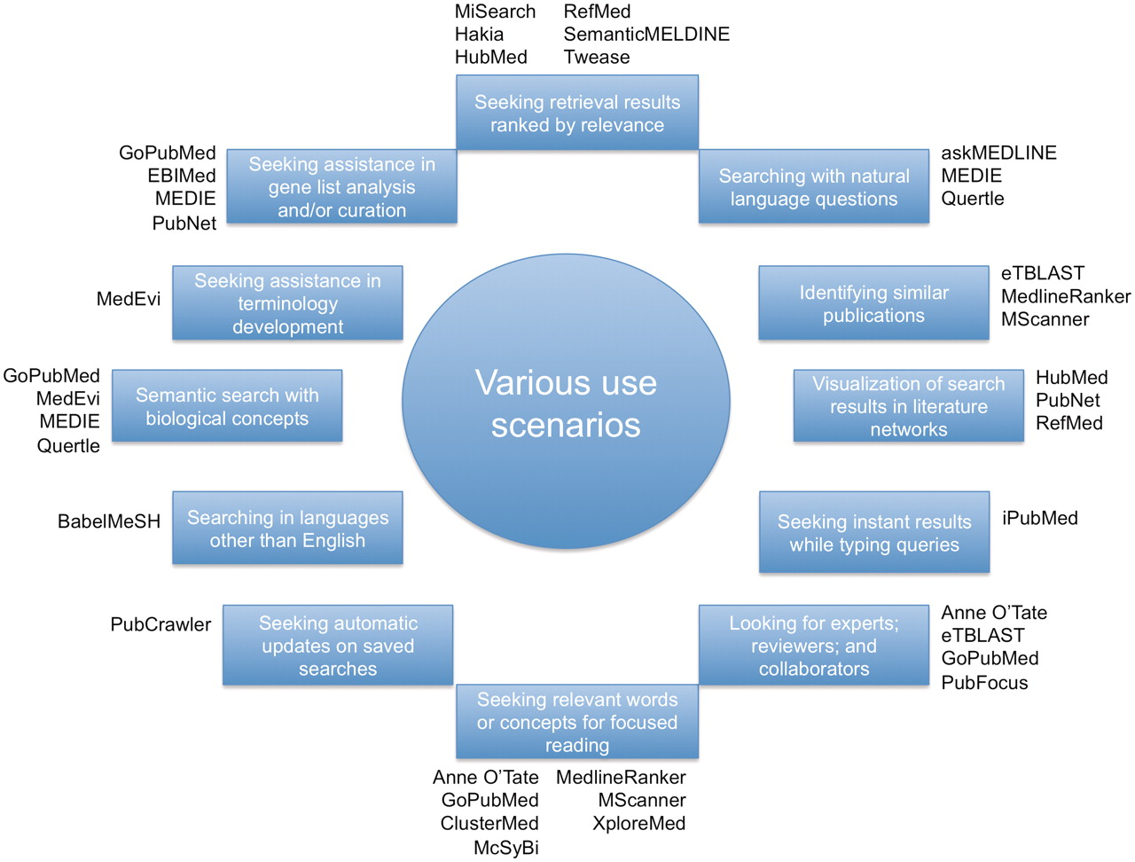
Figure 3. A diverse set of use cases in which different tools may be used.
Notes:
Figure 3. A diverse set of use cases in which different tools may be used.
Unless provided in the caption above, the following copyright applies to the content of this slide: © The Author(s) 2011. Published by Oxford University Press.This is Open Access article distributed under the terms of the Creative Commons Attribution Non-Commercial License (http://creativecommons.org/licenses/by-nc/2.5), which permits unrestricted non-commercial use, distribution, and reproduction in any medium, provided the original work is properly cited.

Slide 4
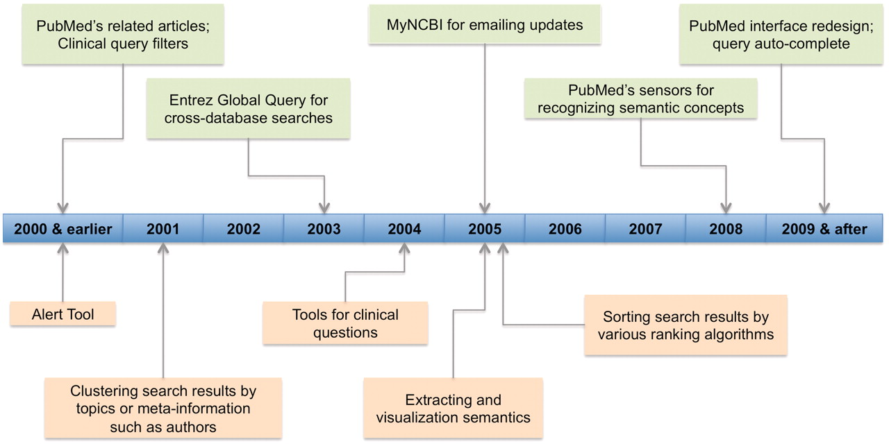
Figure 4. Technology development timeline for PubMed (in light green color) and other biomedical literature search ...
Notes:
Figure 4. Technology development timeline for PubMed (in light green color) and other biomedical literature search tools (in light orange color). For PubMed, it shows the staring year when various recent changes (limited to those mentioned in ‘Changes to PubMed and looking into the future’ section) were introduced. For other tools, we show the time period in which tools of various features were first appeared.
Unless provided in the caption above, the following copyright applies to the content of this slide: © The Author(s) 2011. Published by Oxford University Press.This is Open Access article distributed under the terms of the Creative Commons Attribution Non-Commercial License (http://creativecommons.org/licenses/by-nc/2.5), which permits unrestricted non-commercial use, distribution, and reproduction in any medium, provided the original work is properly cited.

