Slide 1
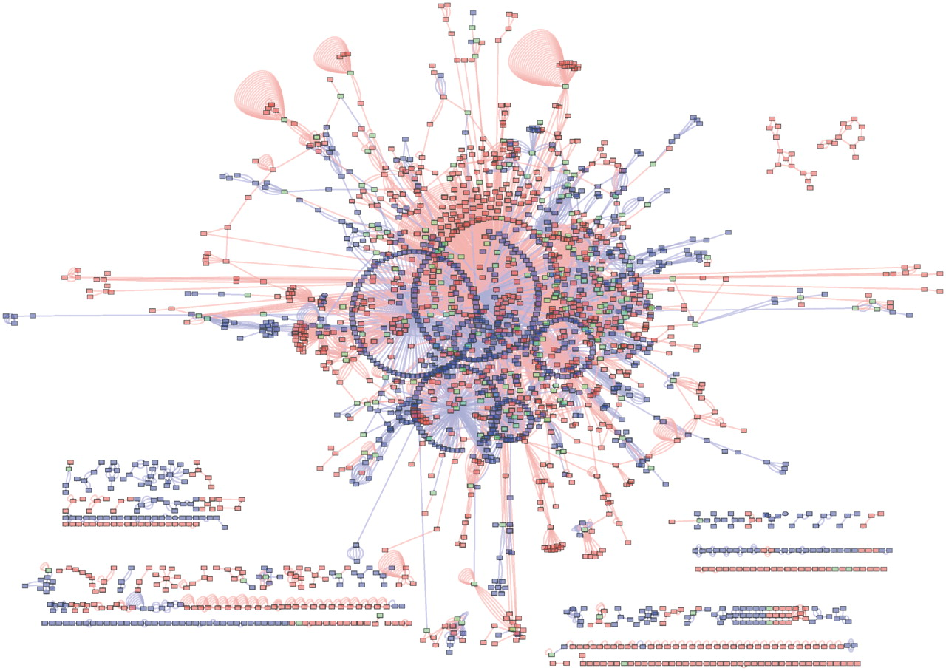
Figure 3. Union of BIND and IntAct interactions for species Rattus norvegicus (taxid: 10 116) as extracted using the ...
Notes:
Figure 3. Union of BIND and IntAct interactions for species Rattus norvegicus (taxid: 10 116) as extracted using the PSICQUIC plugin for Cytoscape. Blue edges are interactions from IntAct, red edges are interactions from BIND. Blue nodes are interactors in IntAct only, red nodes are interactors in BIND only and green nodes are interactors shared by the two networks. BIND contains 1103 nodes not in IntAct. IntAct contain 984 nodes not in BIND. The two interaction networks share 217 nodes.
Unless provided in the caption above, the following copyright applies to the content of this slide: © The Author(s) 2011. Published by Oxford University Press.This is Open Access article distributed under the terms of the Creative Commons Attribution Non-Commercial License (http://creativecommons.org/licenses/by-nc/2.5), which permits unrestricted non-commercial use, distribution, and reproduction in any medium, provided the original work is properly cited.

