Slide 1
Figure 1 iTextMine system overview.
Notes:
Figure 1 iTextMine system overview.
Unless provided in the caption above, the following copyright applies to the content of this slide: © The Author(s) 2018. Published by Oxford University Press.This is an Open Access article distributed under the terms of the Creative Commons Attribution License (http://creativecommons.org/licenses/by/4.0/), which permits unrestricted reuse, distribution, and reproduction in any medium, provided the original work is properly cited.

Slide 2
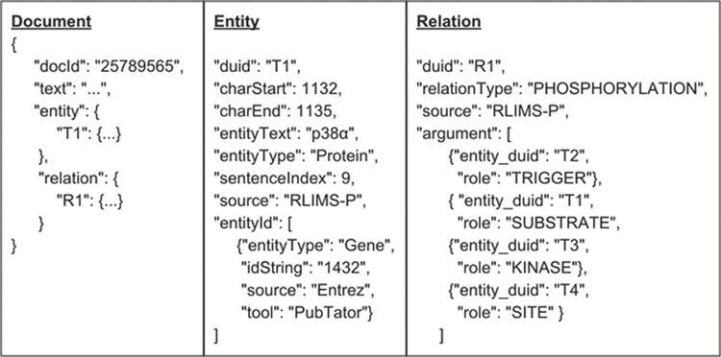
Figure 2 Standardized JSON format.
Notes:
Figure 2 Standardized JSON format.
Unless provided in the caption above, the following copyright applies to the content of this slide: © The Author(s) 2018. Published by Oxford University Press.This is an Open Access article distributed under the terms of the Creative Commons Attribution License (http://creativecommons.org/licenses/by/4.0/), which permits unrestricted reuse, distribution, and reproduction in any medium, provided the original work is properly cited.

Slide 3
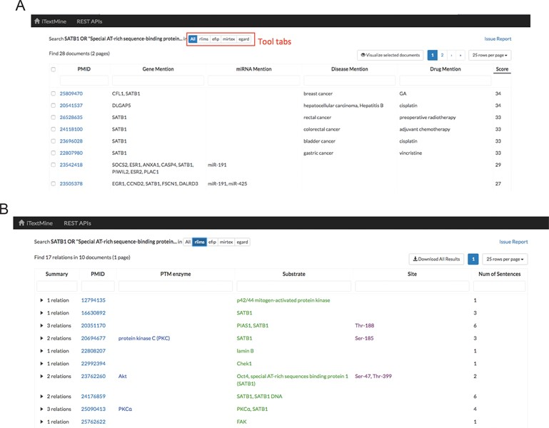
Figure 3 Tabular view of text-mining results. (A) Summarized results for query: SATB1 OR ‘Special AT-rich ...
Notes:
Figure 3 Tabular view of text-mining results. (A) Summarized results for query: SATB1 OR ‘Special AT-rich sequence-binding protein 1’. (B) Search result for RLIMS-P.
Unless provided in the caption above, the following copyright applies to the content of this slide: © The Author(s) 2018. Published by Oxford University Press.This is an Open Access article distributed under the terms of the Creative Commons Attribution License (http://creativecommons.org/licenses/by/4.0/), which permits unrestricted reuse, distribution, and reproduction in any medium, provided the original work is properly cited.

Slide 4
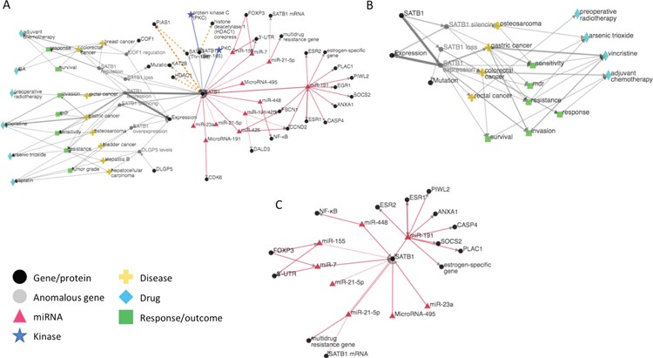
Figure 4 (A) iTextMine network for human SATB1. (B) Sub-network of the human SATB1 network focusing on therapeutic ...
Notes:
Figure 4 (A) iTextMine network for human SATB1. (B) Sub-network of the human SATB1 network focusing on therapeutic response. (C) Sub-network highlighting the SATB1 regulation by miRNAs.
Unless provided in the caption above, the following copyright applies to the content of this slide: © The Author(s) 2018. Published by Oxford University Press.This is an Open Access article distributed under the terms of the Creative Commons Attribution License (http://creativecommons.org/licenses/by/4.0/), which permits unrestricted reuse, distribution, and reproduction in any medium, provided the original work is properly cited.

Slide 5
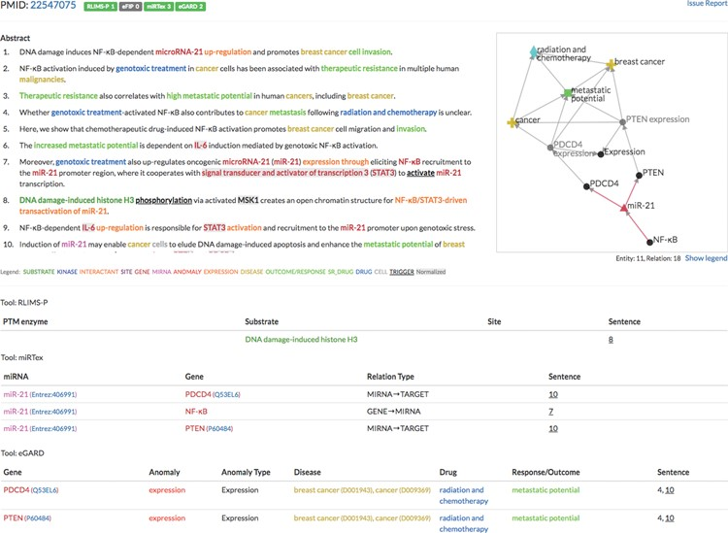
Figure 5 Example of the integration of multiple text-mining tools (PMID: 22547075).
Notes:
Figure 5 Example of the integration of multiple text-mining tools (PMID: 22547075).
Unless provided in the caption above, the following copyright applies to the content of this slide: © The Author(s) 2018. Published by Oxford University Press.This is an Open Access article distributed under the terms of the Creative Commons Attribution License (http://creativecommons.org/licenses/by/4.0/), which permits unrestricted reuse, distribution, and reproduction in any medium, provided the original work is properly cited.

