Slide 1
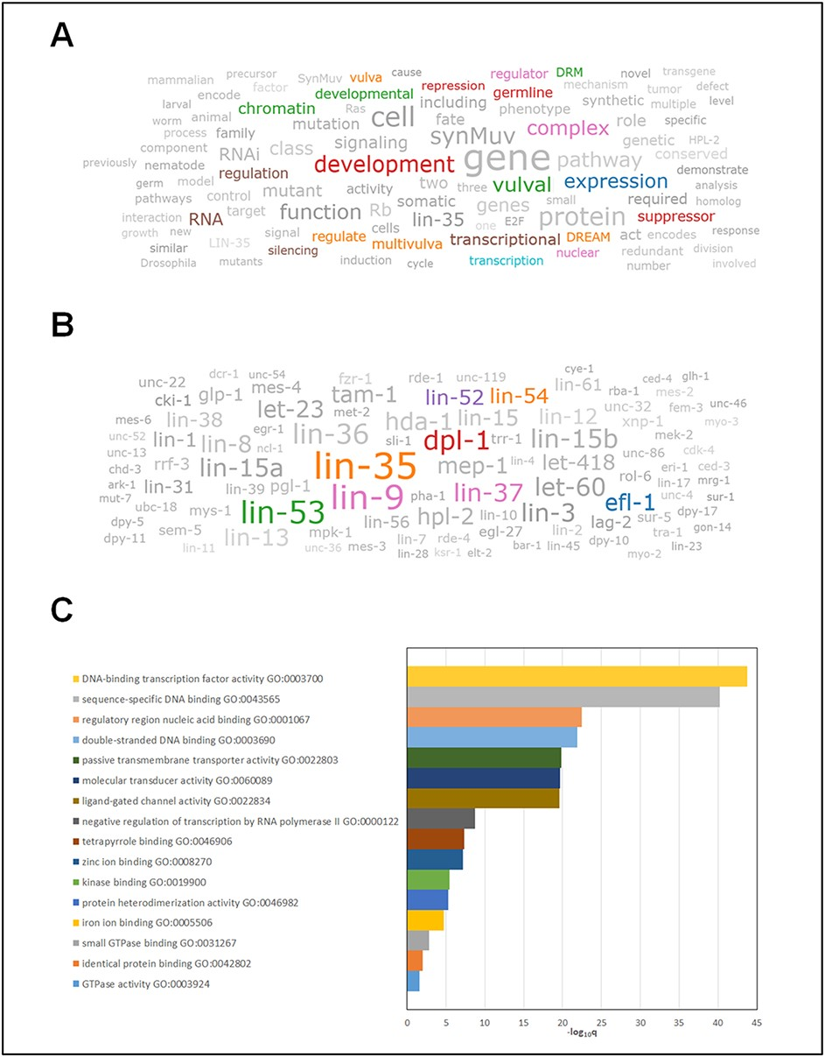
Figure 7. Use cases of Wormicloud in mining complex data from literature and its analysis. (A) keyword cloud obtained ...
Notes:
Figure 7. Use cases of Wormicloud in mining complex data from literature and its analysis. (A) keyword cloud obtained by entering the keywords ‘lin-9’ and ‘lin-35’ in the Wormicloud search interface. Color highlighted entities show the biological function of lin-9 and lin-35. (B) Gene name cloud for ‘lin-9’ and ‘lin-35’ captures all the essential components in the DREAM complex, which are highlighted in color. (C) Gene ontology enrichment analysis of all genes obtained from the gene name word cloud in Figure 7B recapitulates the major information captured in Figure 7A. (Note that we have manually grayed out terms from Figure 7A and B to highlight the importance of some of the remaining terms in color and to improve readability, but since Wormicloud does not have a measure of ‘biological relevance’ of terms the results in the word clouds generated by the tool are all in color.)
Unless provided in the caption above, the following copyright applies to the content of this slide: Published by Oxford University Press 2021. This work is written by (a) US Government employee(s) and is in the public domain in the US.This work is written by (a) US Government employee(s) and is in the public domain in the US.

