Slide 1
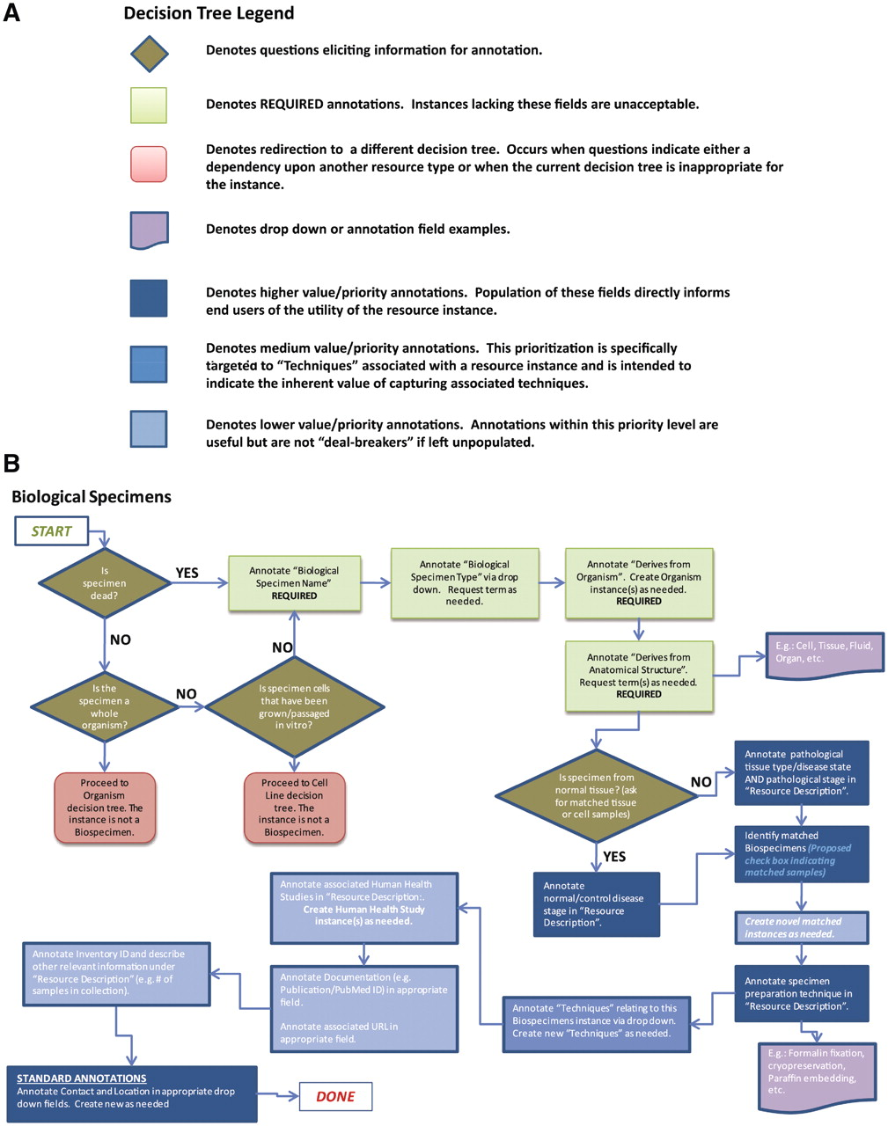
Figure 3. Decision trees were used to assist with data collection and curation. (A) Decision tree legend. (B) The ...
Notes:
Figure 3. Decision trees were used to assist with data collection and curation. (A) Decision tree legend. (B) The decision tree for biological specimens. Required and highly desired fields are indicated by green and blue colors, respectively. Each resource type had 2–3 required fields, between 4–8 highly desired fields and the other fields were considered optional or applied only to specific subtypes of resources.
Unless provided in the caption above, the following copyright applies to the content of this slide: © The Author(s) 2012. Published by Oxford University Press.This is an Open Access article distributed under the terms of the Creative Commons Attribution Non-Commercial License (http://creativecommons.org/licenses/by-nc/3.0), which permits unrestricted non-commercial use, distribution, and reproduction in any medium, provided the original work is properly cited.

