Slide 1
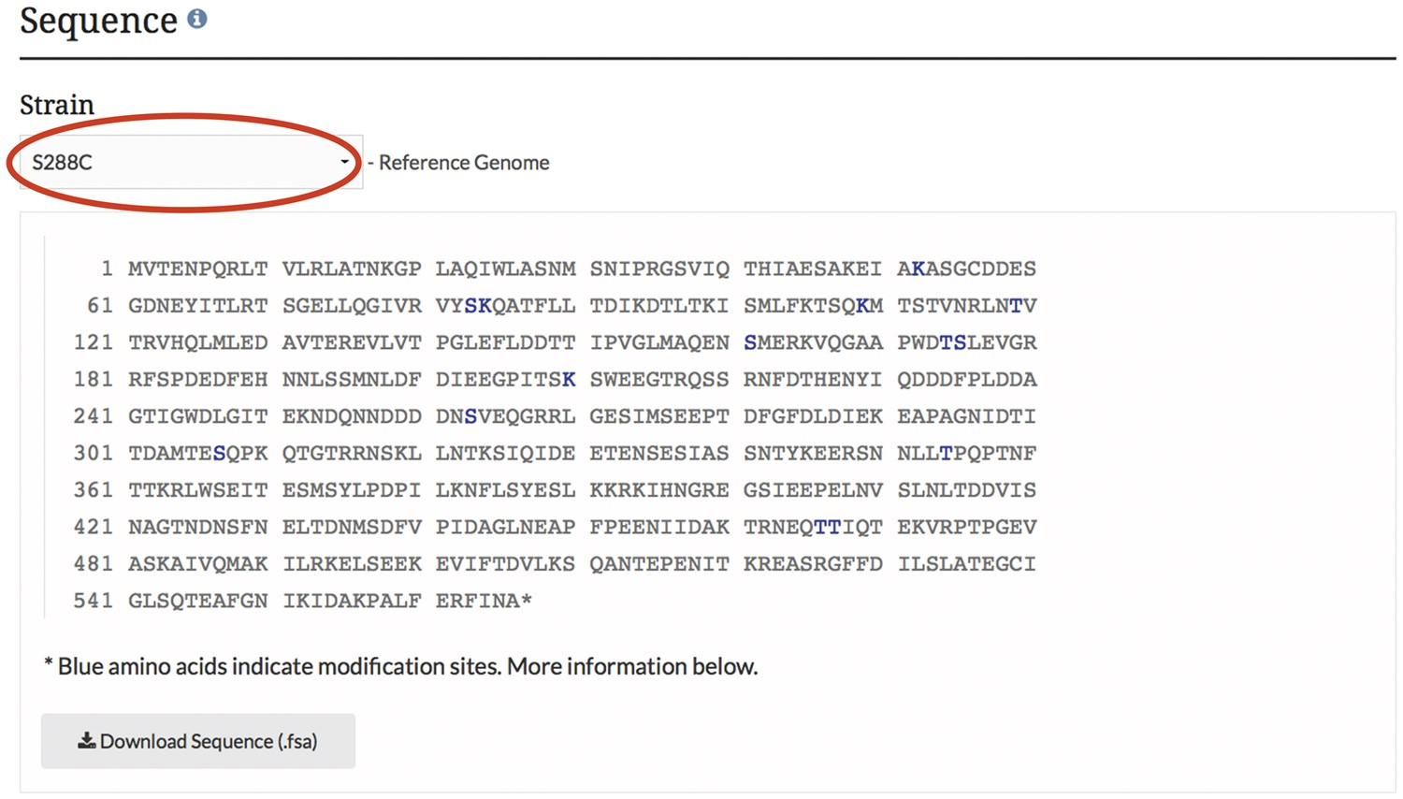
Figure 3. PTM information is integrated into the SGD and displayed on protein pages as highlighted residues overlaid on ...
Notes:
Figure 3. PTM information is integrated into the SGD and displayed on protein pages as highlighted residues overlaid on the protein sequence. The example shown here is from the MCD1 protein page.
Unless provided in the caption above, the following copyright applies to the content of this slide: © The Author(s) 2017. Published by Oxford University Press.This is an Open Access article distributed under the terms of the Creative Commons Attribution License (http://creativecommons.org/licenses/by/4.0/), which permits unrestricted reuse, distribution, and reproduction in any medium, provided the original work is properly cited.

