Slide 1
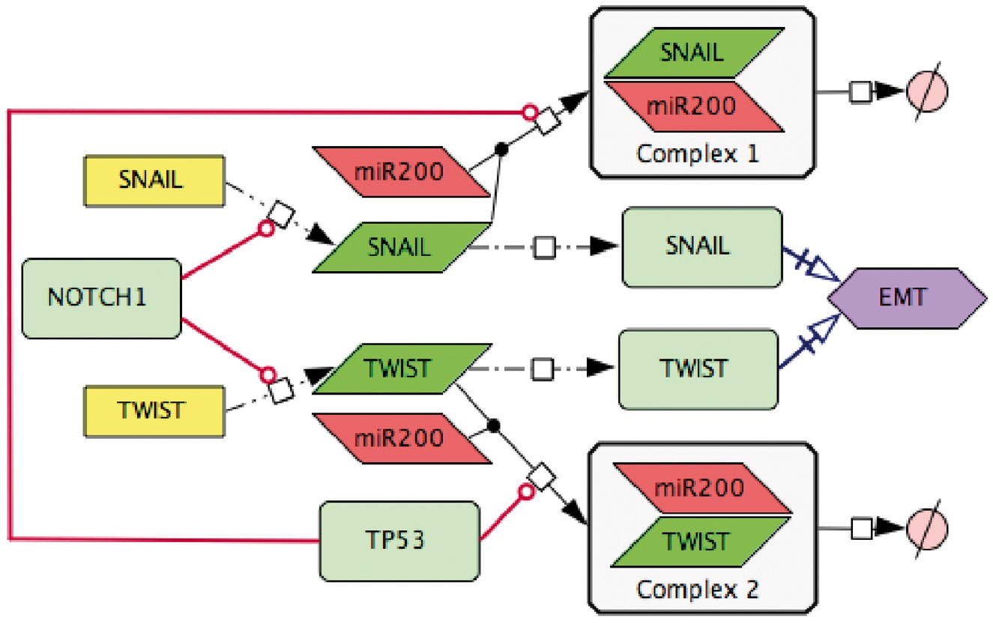
Figure 4. Transforming text to diagram: role of p53 and NOTCH in induction of EMT. The following statements were used ...
Notes:
Figure 4. Transforming text to diagram: role of p53 and NOTCH in induction of EMT. The following statements were used for diagram construction: (1). Control of EMT program is performed by SNAIL and TWIST, the major transcription factors that can induce the executors EMT program (49). These transcription factors are under the control of several upstream mechanisms. (2) SNAIL and TWIST are inhibited by the p53 protein via a variety of microRNAs, including miR200 (50) (3) miR20 binds to the mRNAs of SNAIL and TWIST and triggers their degradation, this way preventing the translation of mRNAs into the corresponding proteins (51) (4) EMT program can be initiated due to excessive expression of NOTCH that directly activates transcription of SNAIL and TWIST (52).
Unless provided in the caption above, the following copyright applies to the content of this slide: © The Author(s) 2018. Published by Oxford University Press.This is an Open Access article distributed under the terms of the Creative Commons Attribution License (http://creativecommons.org/licenses/by/4.0/), which permits unrestricted reuse, distribution, and reproduction in any medium, provided the original work is properly cited.

