Slide 1
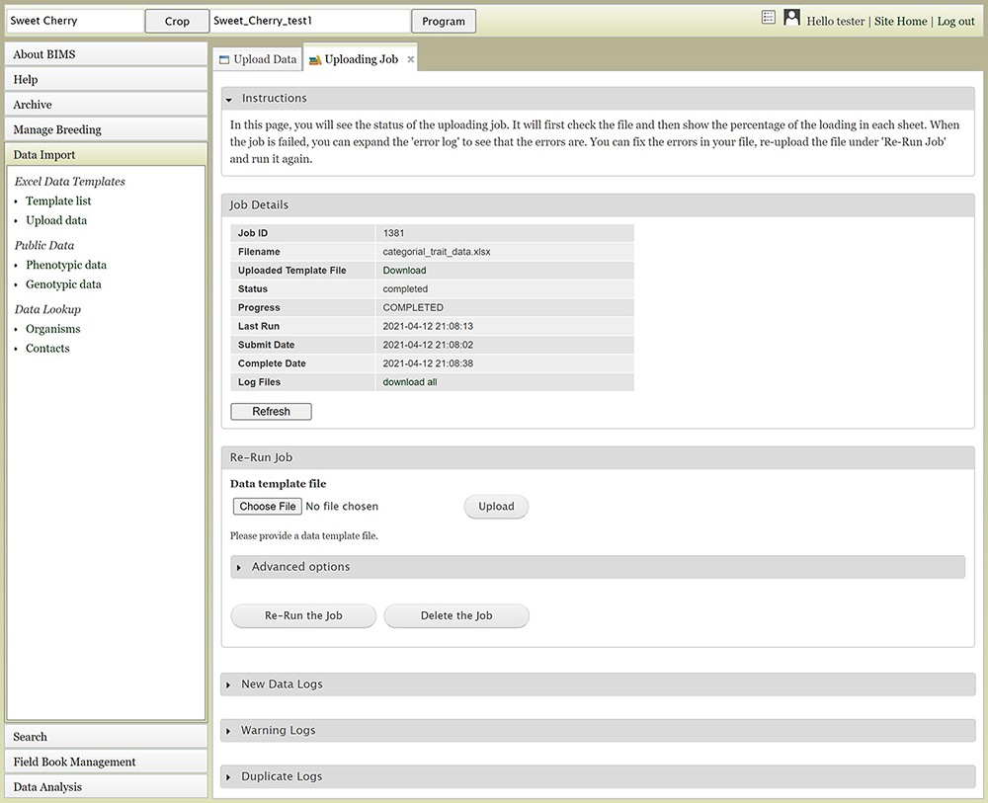
Figure 5. The Uploading Job tab that shows the progress of an uploading job. When the job is completed or failed, the ...
Notes:
Figure 5. The Uploading Job tab that shows the progress of an uploading job. When the job is completed or failed, the tab displays various logs such as New Data Log, Warning Log, Duplicate Log and Error Log.
Unless provided in the caption above, the following copyright applies to the content of this slide: © The Author(s) 2021. Published by Oxford University Press.This is an Open Access article distributed under the terms of the Creative Commons Attribution License (http://creativecommons.org/licenses/by/4.0/), which permits unrestricted reuse, distribution, and reproduction in any medium, provided the original work is properly cited.

