Slide 1
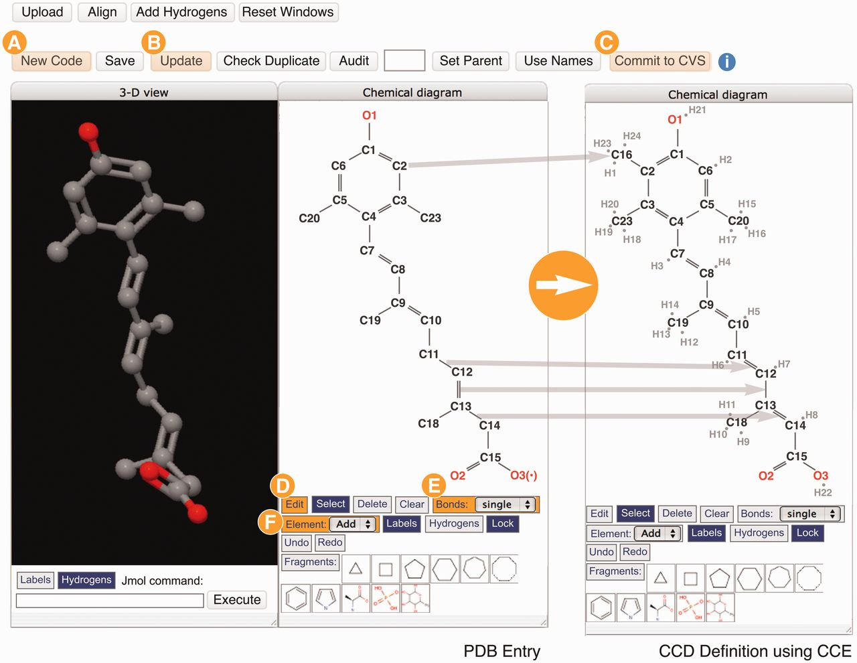
Figure 4. The Chemical Component Editor (Step 2.3 in Figure 1) used to create new CCD definitions. The interface ...
Notes:
Figure 4. The Chemical Component Editor (Step 2.3 in Figure 1) used to create new CCD definitions. The interface provides a variety of operations (top buttons) to support the creation of a new chemical definition with a unique code (labeled A), update the PDB entry file (labeled B) and add definitions to the CCD (labeled C). Molecular viewers interactively display the chemical component in 2D and 3D. In this example showing the creation of the definition for CCD ID R12, two steps performed are shown in the 2D sketch tool panels: changing bonds from single to double, and from double to single (CCE functions labeled D and E) and then adding missing atoms/elements (labeled F). Hydrogen atoms are added implicitly and the chemical descriptions are updated automatically. Changes are updated instantly in the 2D and 3D viewers.
Unless provided in the caption above, the following copyright applies to the content of this slide: © The Author(s) 2013. Published by Oxford University Press.This is an Open Access article distributed under the terms of the Creative Commons Attribution License (http://creativecommons.org/licenses/by/3.0/), which permits unrestricted reuse, distribution, and reproduction in any medium, provided the original work is properly cited.

