Slide 1
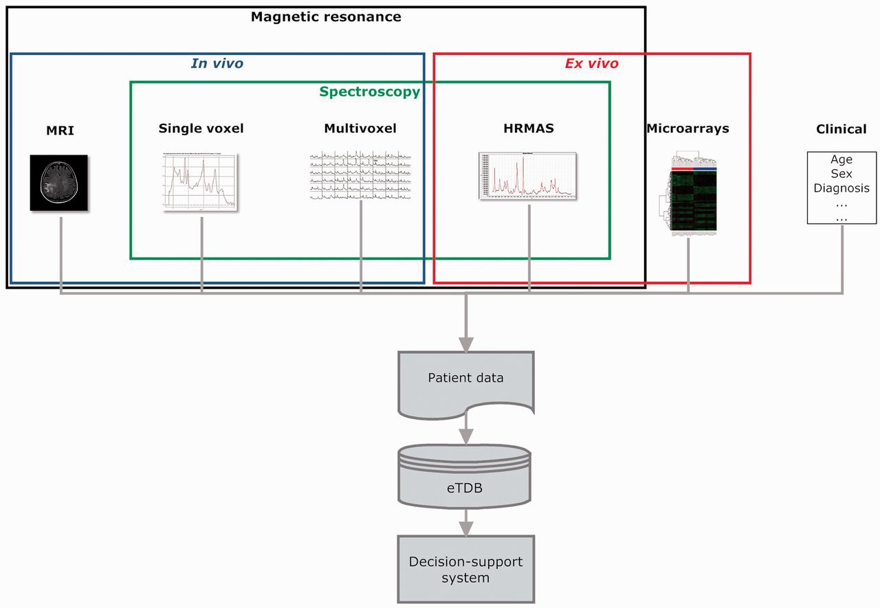
Figure 1 Overview of the eT project with respect to data. The database is built on the concept of patient and each ...
Notes:
Figure 1 Overview of the eT project with respect to data. The database is built on the concept of patient and each patient has different data types.
Unless provided in the caption above, the following copyright applies to the content of this slide: © The Author(s) 2012. Published by Oxford University Press.This is an Open Access article distributed under the terms of the Creative Commons Attribution License (http://creativecommons.org/licenses/by-nc/3.0/), which permits non-commercial reuse, distribution, and reproduction in any medium, provided the original work is properly cited. For commercial re-use, please contact journals.permissions@oup.com.

