Slide 1
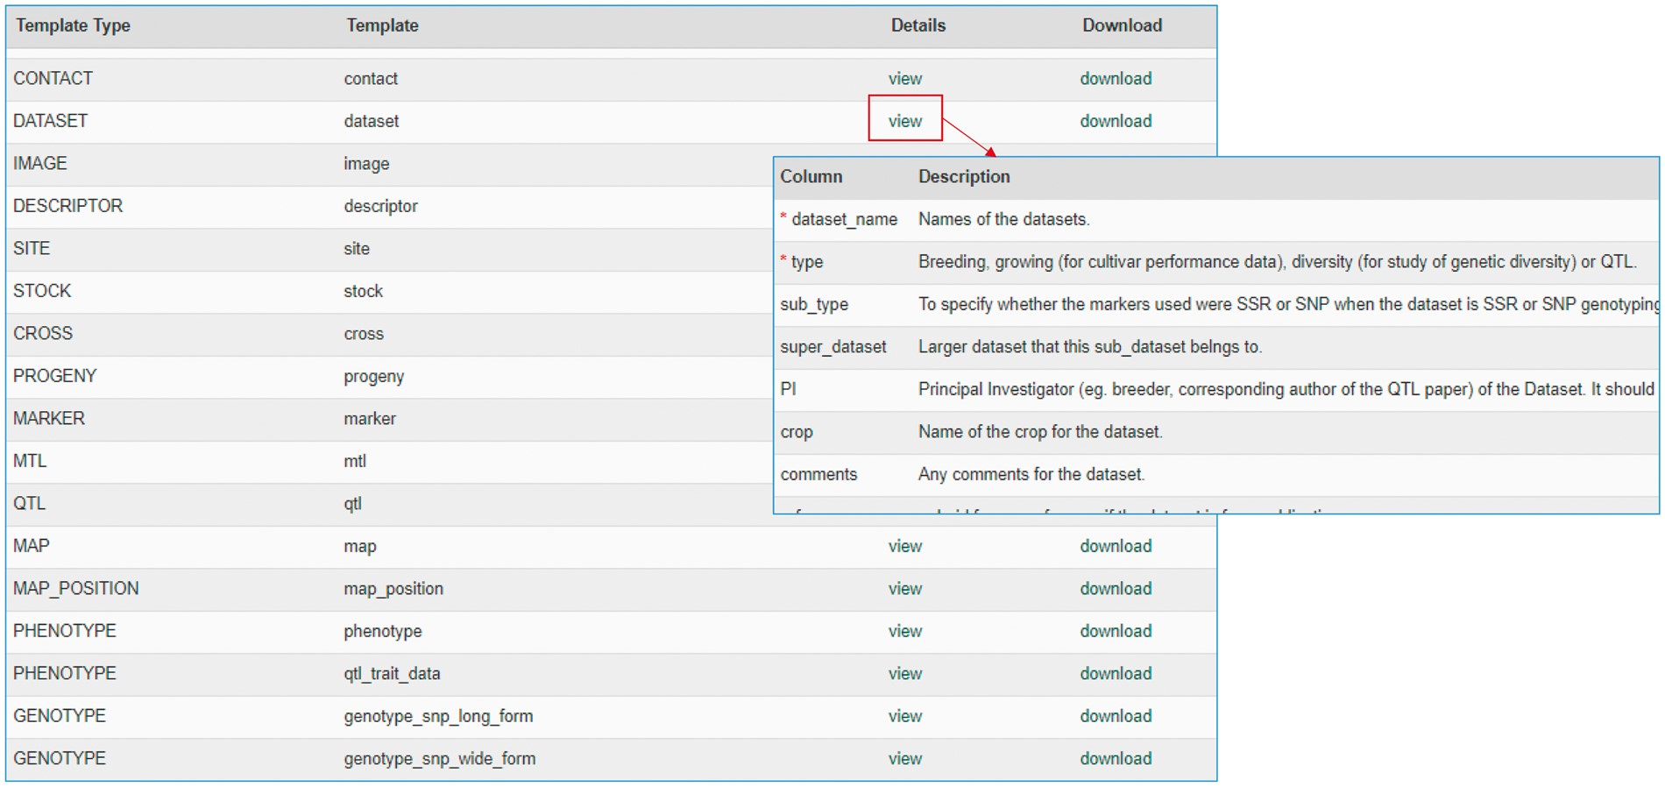
Figure 1. Data template page of the MCL user interface. Users can view the description of each data template or ...
Notes:
Figure 1. Data template page of the MCL user interface. Users can view the description of each data template or download the templates.
Unless provided in the caption above, the following copyright applies to the content of this slide: © The Author(s) 2017. Published by Oxford University Press.This is an Open Access article distributed under the terms of the Creative Commons Attribution License (http://creativecommons.org/licenses/by/4.0/), which permits unrestricted reuse, distribution, and reproduction in any medium, provided the original work is properly cited.

Slide 2
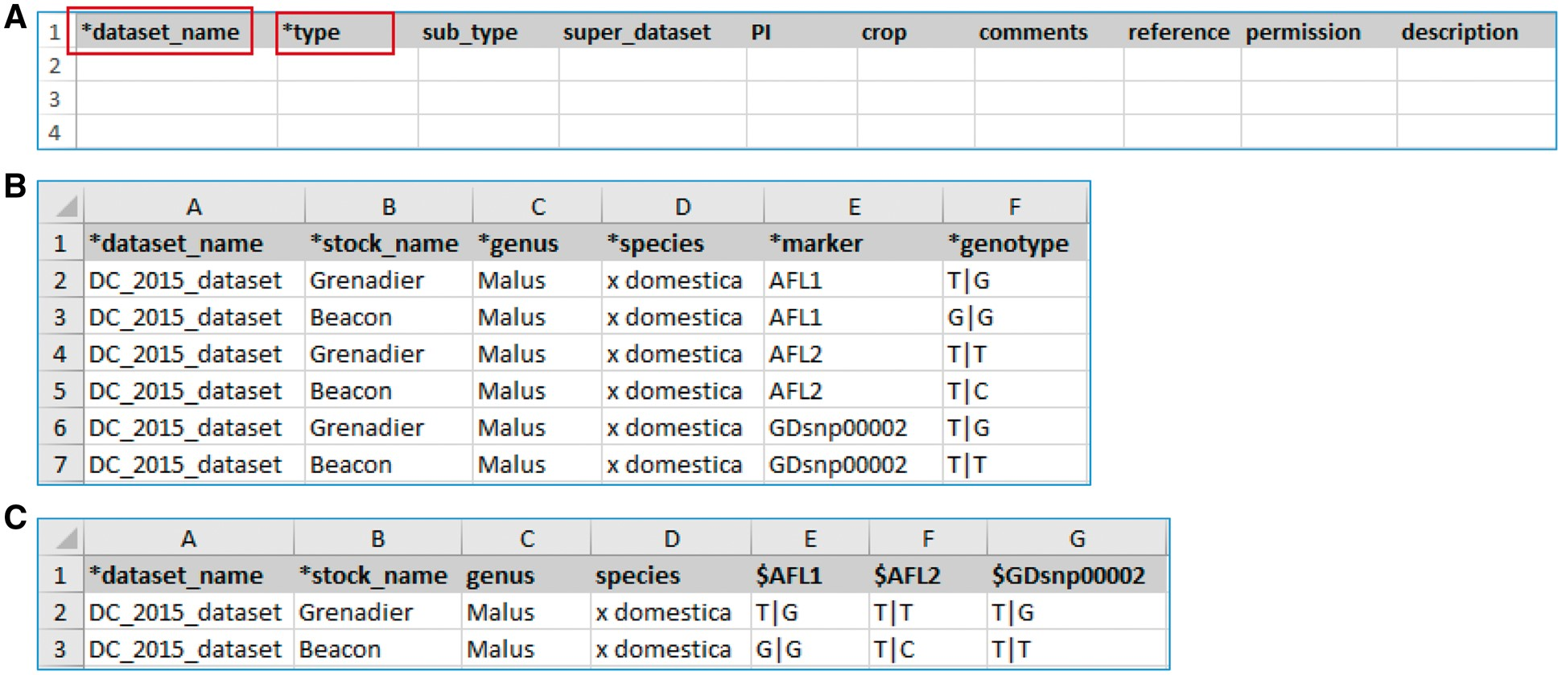
Figure 2. Example templates downloaded from the MCL module. (A) A template for contact data type. Columns with a prefix ...
Notes:
Figure 2. Example templates downloaded from the MCL module. (A) A template for contact data type. Columns with a prefix ‘*’are required fields. (B) A template for genotype datatype, ‘genotype_snp_long_form.’ (C) A template for genotype datatype, ‘genotype_snp_wide_form.’ Users can enter marker names as column headings with a prefix ‘$.’
Unless provided in the caption above, the following copyright applies to the content of this slide: © The Author(s) 2017. Published by Oxford University Press.This is an Open Access article distributed under the terms of the Creative Commons Attribution License (http://creativecommons.org/licenses/by/4.0/), which permits unrestricted reuse, distribution, and reproduction in any medium, provided the original work is properly cited.

Slide 3
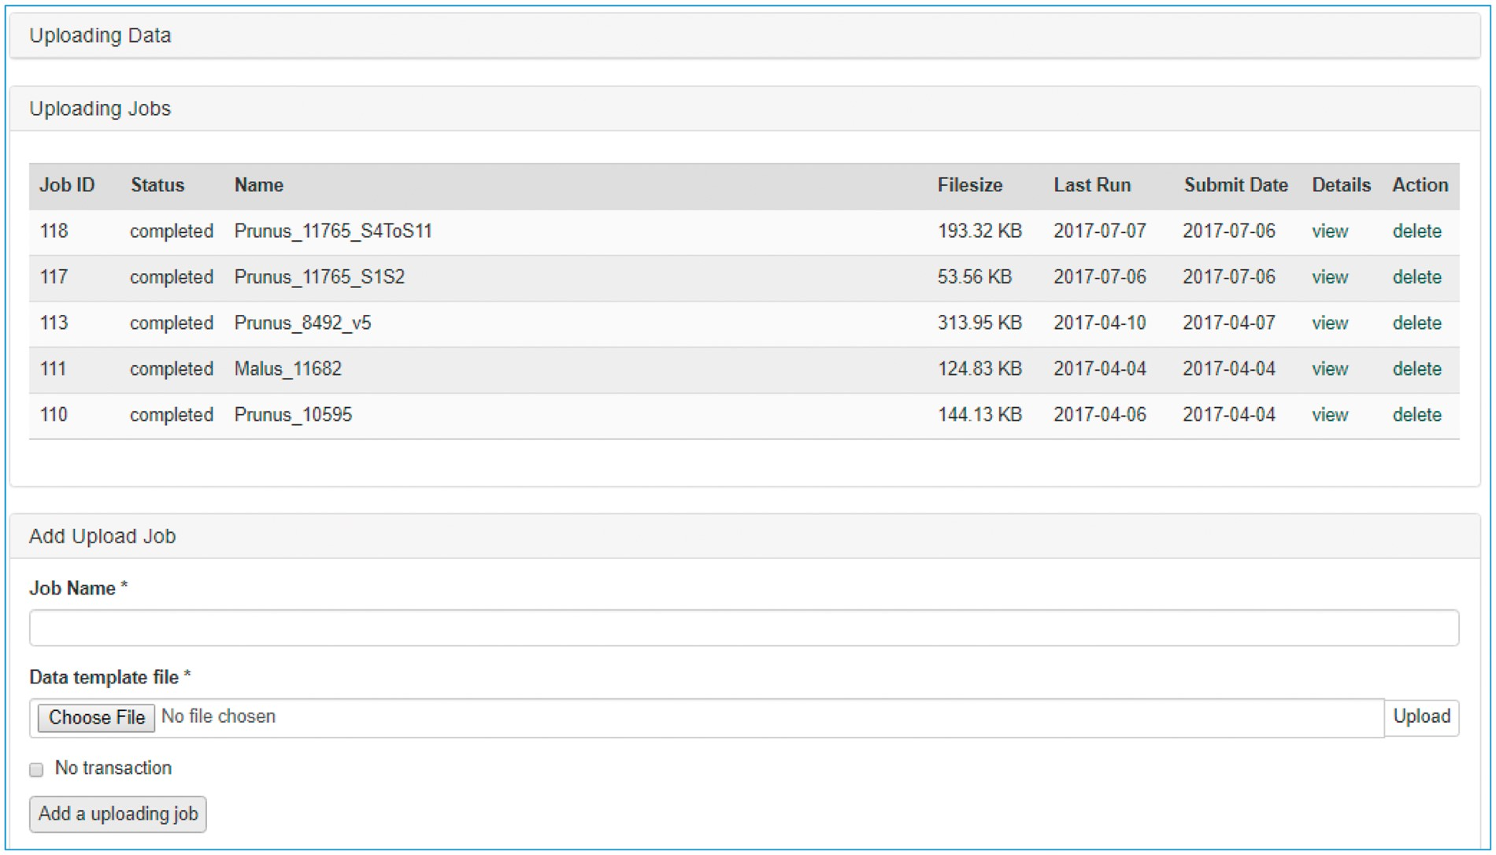
Figure 3. Data uploading page of the MCL user interface. The uploading page shows the status of all the submitted ...
Notes:
Figure 3. Data uploading page of the MCL user interface. The uploading page shows the status of all the submitted uploading jobs and provides links to each job details page.
Unless provided in the caption above, the following copyright applies to the content of this slide: © The Author(s) 2017. Published by Oxford University Press.This is an Open Access article distributed under the terms of the Creative Commons Attribution License (http://creativecommons.org/licenses/by/4.0/), which permits unrestricted reuse, distribution, and reproduction in any medium, provided the original work is properly cited.

Slide 4
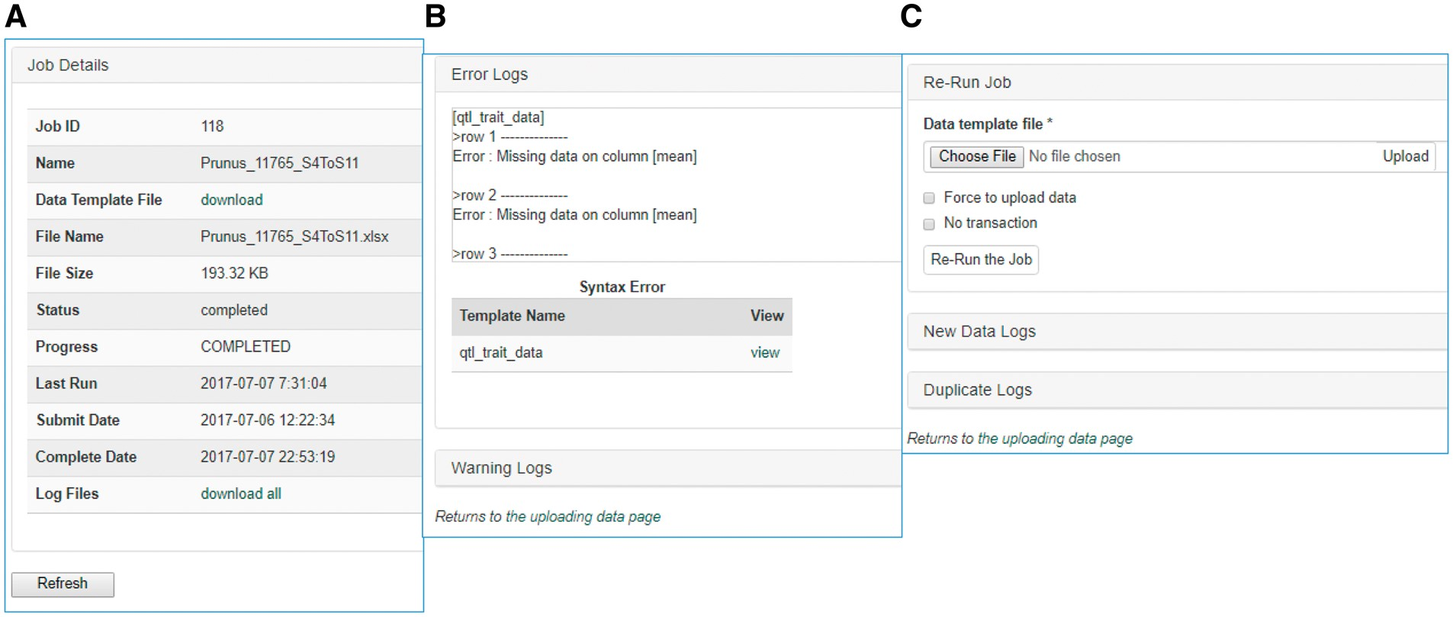
Figure 4. Sections of an uploading job detail page in MCL. (A) A table shows the details of the uploading job. (B) A ...
Notes:
Figure 4. Sections of an uploading job detail page in MCL. (A) A table shows the details of the uploading job. (B) A window that shows error logs. (C) A section where users can re-run the job after fixing any errors. New data logs show any new data that have been uploaded and the duplicate logs show any data in the template that already exist in the database.
Unless provided in the caption above, the following copyright applies to the content of this slide: © The Author(s) 2017. Published by Oxford University Press.This is an Open Access article distributed under the terms of the Creative Commons Attribution License (http://creativecommons.org/licenses/by/4.0/), which permits unrestricted reuse, distribution, and reproduction in any medium, provided the original work is properly cited.

Slide 5
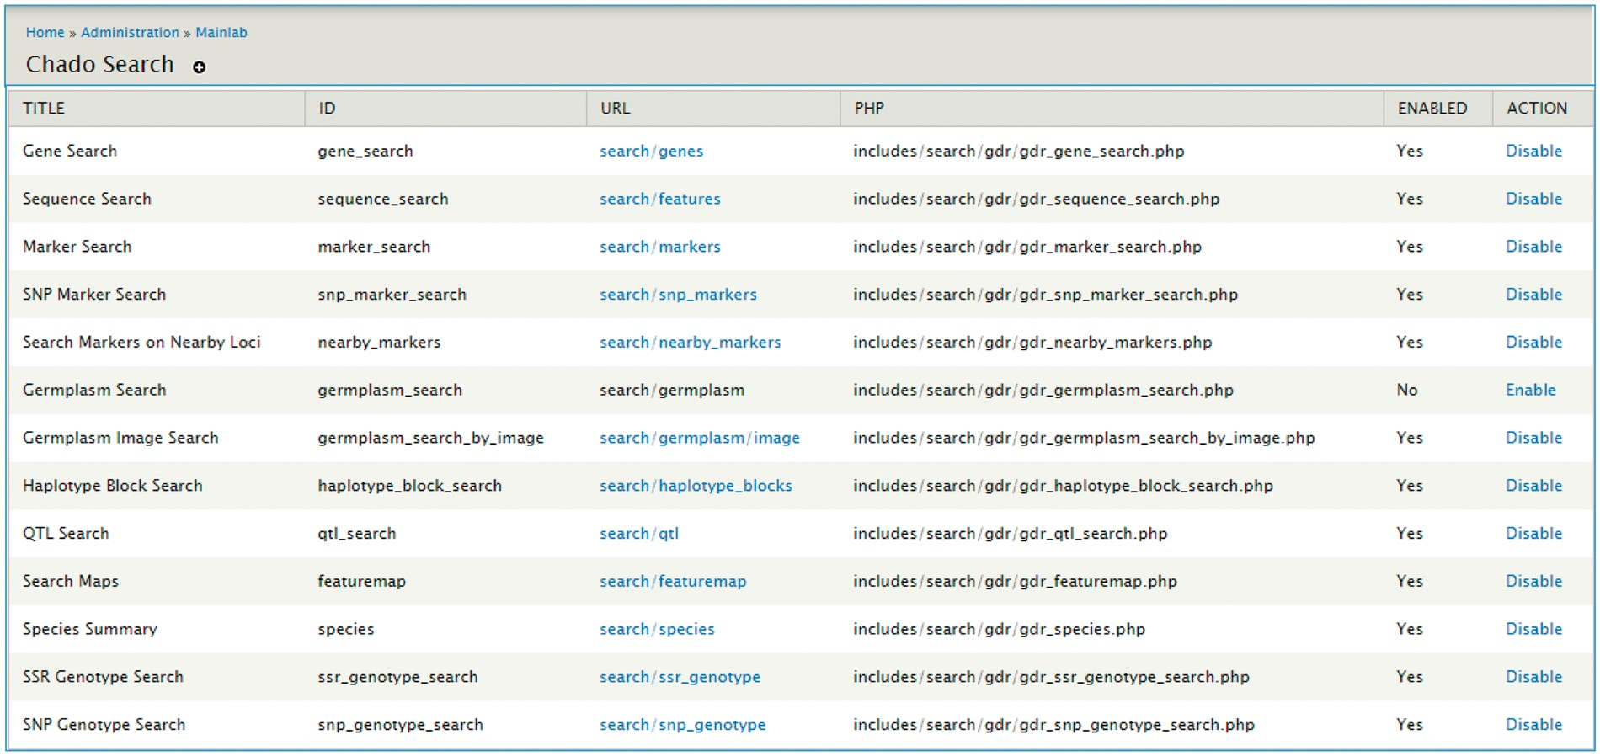
Figure 5. Mainlab Chado Search Admin page.
Notes:
Figure 5. Mainlab Chado Search Admin page.
Unless provided in the caption above, the following copyright applies to the content of this slide: © The Author(s) 2017. Published by Oxford University Press.This is an Open Access article distributed under the terms of the Creative Commons Attribution License (http://creativecommons.org/licenses/by/4.0/), which permits unrestricted reuse, distribution, and reproduction in any medium, provided the original work is properly cited.

Slide 6
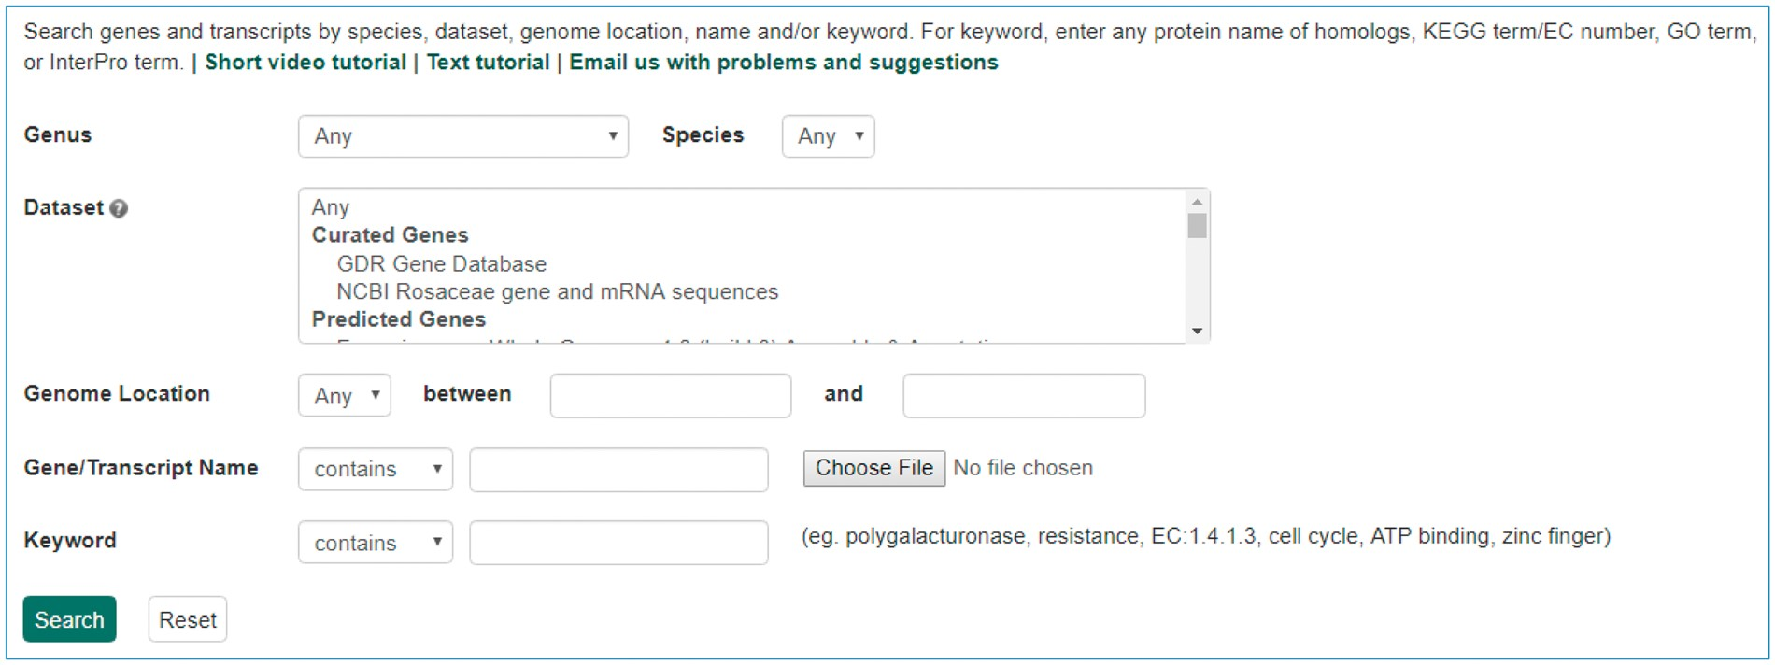
Figure 6. Search page for genes and transcripts in GDR. Users can search genes and transcripts using various filters ...
Notes:
Figure 6. Search page for genes and transcripts in GDR. Users can search genes and transcripts using various filters such as genus, species, dataset, aligned genome location, name and keyword.
Unless provided in the caption above, the following copyright applies to the content of this slide: © The Author(s) 2017. Published by Oxford University Press.This is an Open Access article distributed under the terms of the Creative Commons Attribution License (http://creativecommons.org/licenses/by/4.0/), which permits unrestricted reuse, distribution, and reproduction in any medium, provided the original work is properly cited.

Slide 7
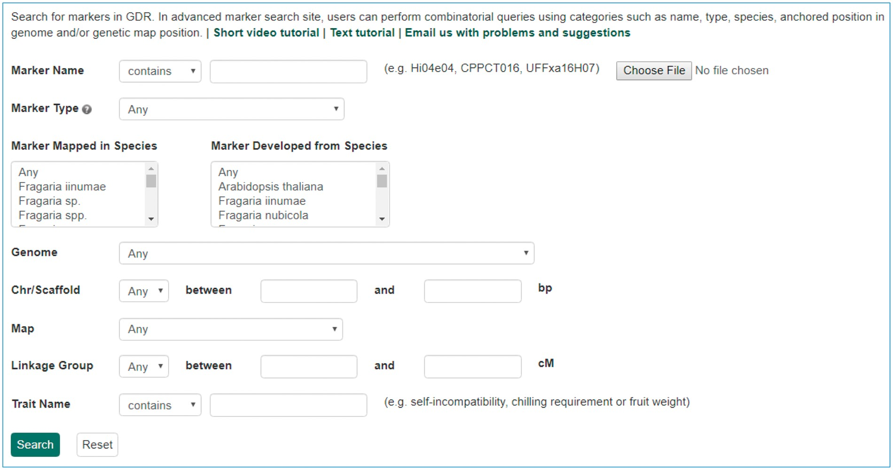
Figure 7. Search page for markers in GDR. Users can search markers by name, type, species, aligned genome positions, ...
Notes:
Figure 7. Search page for markers in GDR. Users can search markers by name, type, species, aligned genome positions, genetic map positions and associated trait names.
Unless provided in the caption above, the following copyright applies to the content of this slide: © The Author(s) 2017. Published by Oxford University Press.This is an Open Access article distributed under the terms of the Creative Commons Attribution License (http://creativecommons.org/licenses/by/4.0/), which permits unrestricted reuse, distribution, and reproduction in any medium, provided the original work is properly cited.

Slide 8
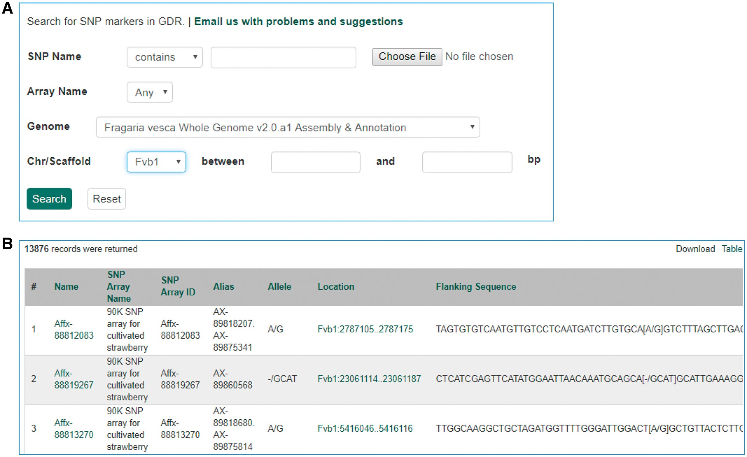
Figure 8. Search page for SNP markers in GDR. (A) SNP marker search page where users can search SNPs by name, SNP array ...
Notes:
Figure 8. Search page for SNP markers in GDR. (A) SNP marker search page where users can search SNPs by name, SNP array name and anchored genome position. (B) The returned search results include name, SNP array name, SNP array ID, aliases, alleles, genome location and flanking sequences.
Unless provided in the caption above, the following copyright applies to the content of this slide: © The Author(s) 2017. Published by Oxford University Press.This is an Open Access article distributed under the terms of the Creative Commons Attribution License (http://creativecommons.org/licenses/by/4.0/), which permits unrestricted reuse, distribution, and reproduction in any medium, provided the original work is properly cited.

Slide 9
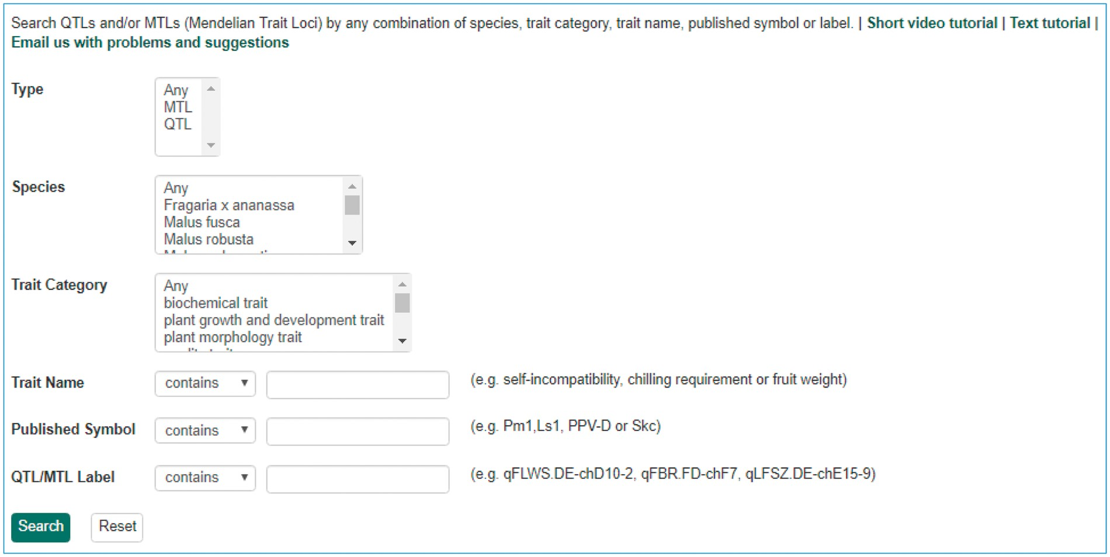
Figure 9. Search page for QTL in GDR. Users can search QTL or MTL by type, species, trait category, trait name, ...
Notes:
Figure 9. Search page for QTL in GDR. Users can search QTL or MTL by type, species, trait category, trait name, published symbol and/or label.
Unless provided in the caption above, the following copyright applies to the content of this slide: © The Author(s) 2017. Published by Oxford University Press.This is an Open Access article distributed under the terms of the Creative Commons Attribution License (http://creativecommons.org/licenses/by/4.0/), which permits unrestricted reuse, distribution, and reproduction in any medium, provided the original work is properly cited.

Slide 10
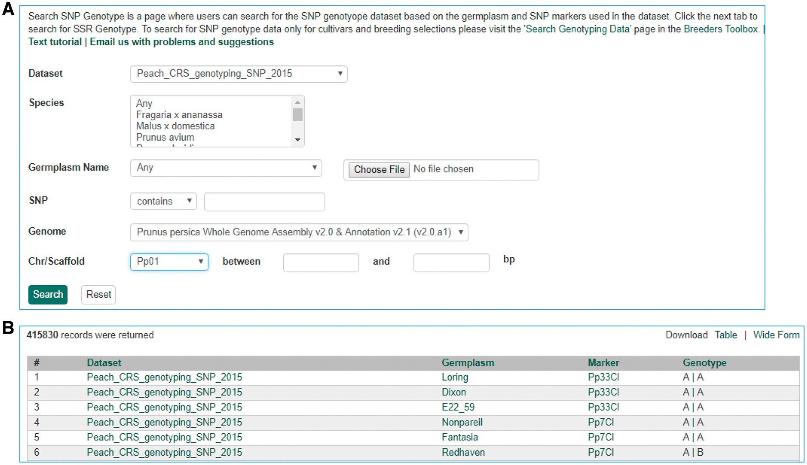
Figure 10. Search page for SNP genotype. (A) Users can search SNP genotype by dataset name, species, germplasm name, SNP ...
Notes:
Figure 10. Search page for SNP genotype. (A) Users can search SNP genotype by dataset name, species, germplasm name, SNP name and/or genome location of the SNP. (B) The returned search results show dataset name, germplasm, marker name and genotype.
Unless provided in the caption above, the following copyright applies to the content of this slide: © The Author(s) 2017. Published by Oxford University Press.This is an Open Access article distributed under the terms of the Creative Commons Attribution License (http://creativecommons.org/licenses/by/4.0/), which permits unrestricted reuse, distribution, and reproduction in any medium, provided the original work is properly cited.

Slide 11
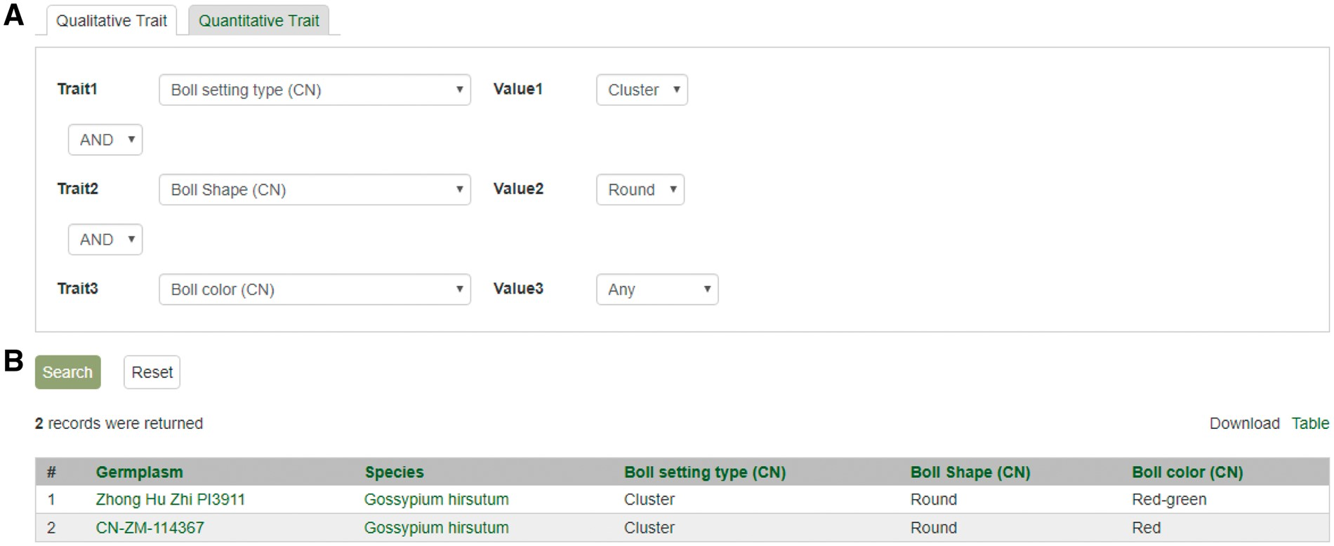
Figure 11. Search page for phenotype in CottonGEN. (A) There are two tabs, one for quantitative trait and the other for ...
Notes:
Figure 11. Search page for phenotype in CottonGEN. (A) There are two tabs, one for quantitative trait and the other for qualitative traits. In each page, users can choose up to three trait names and the range of phenotypic values to obtain germplasm that has the specified phenotype. (B) The returned search results show dataset name, germplasm, species and the trait values for the traits chosen.
Unless provided in the caption above, the following copyright applies to the content of this slide: © The Author(s) 2017. Published by Oxford University Press.This is an Open Access article distributed under the terms of the Creative Commons Attribution License (http://creativecommons.org/licenses/by/4.0/), which permits unrestricted reuse, distribution, and reproduction in any medium, provided the original work is properly cited.

Slide 12
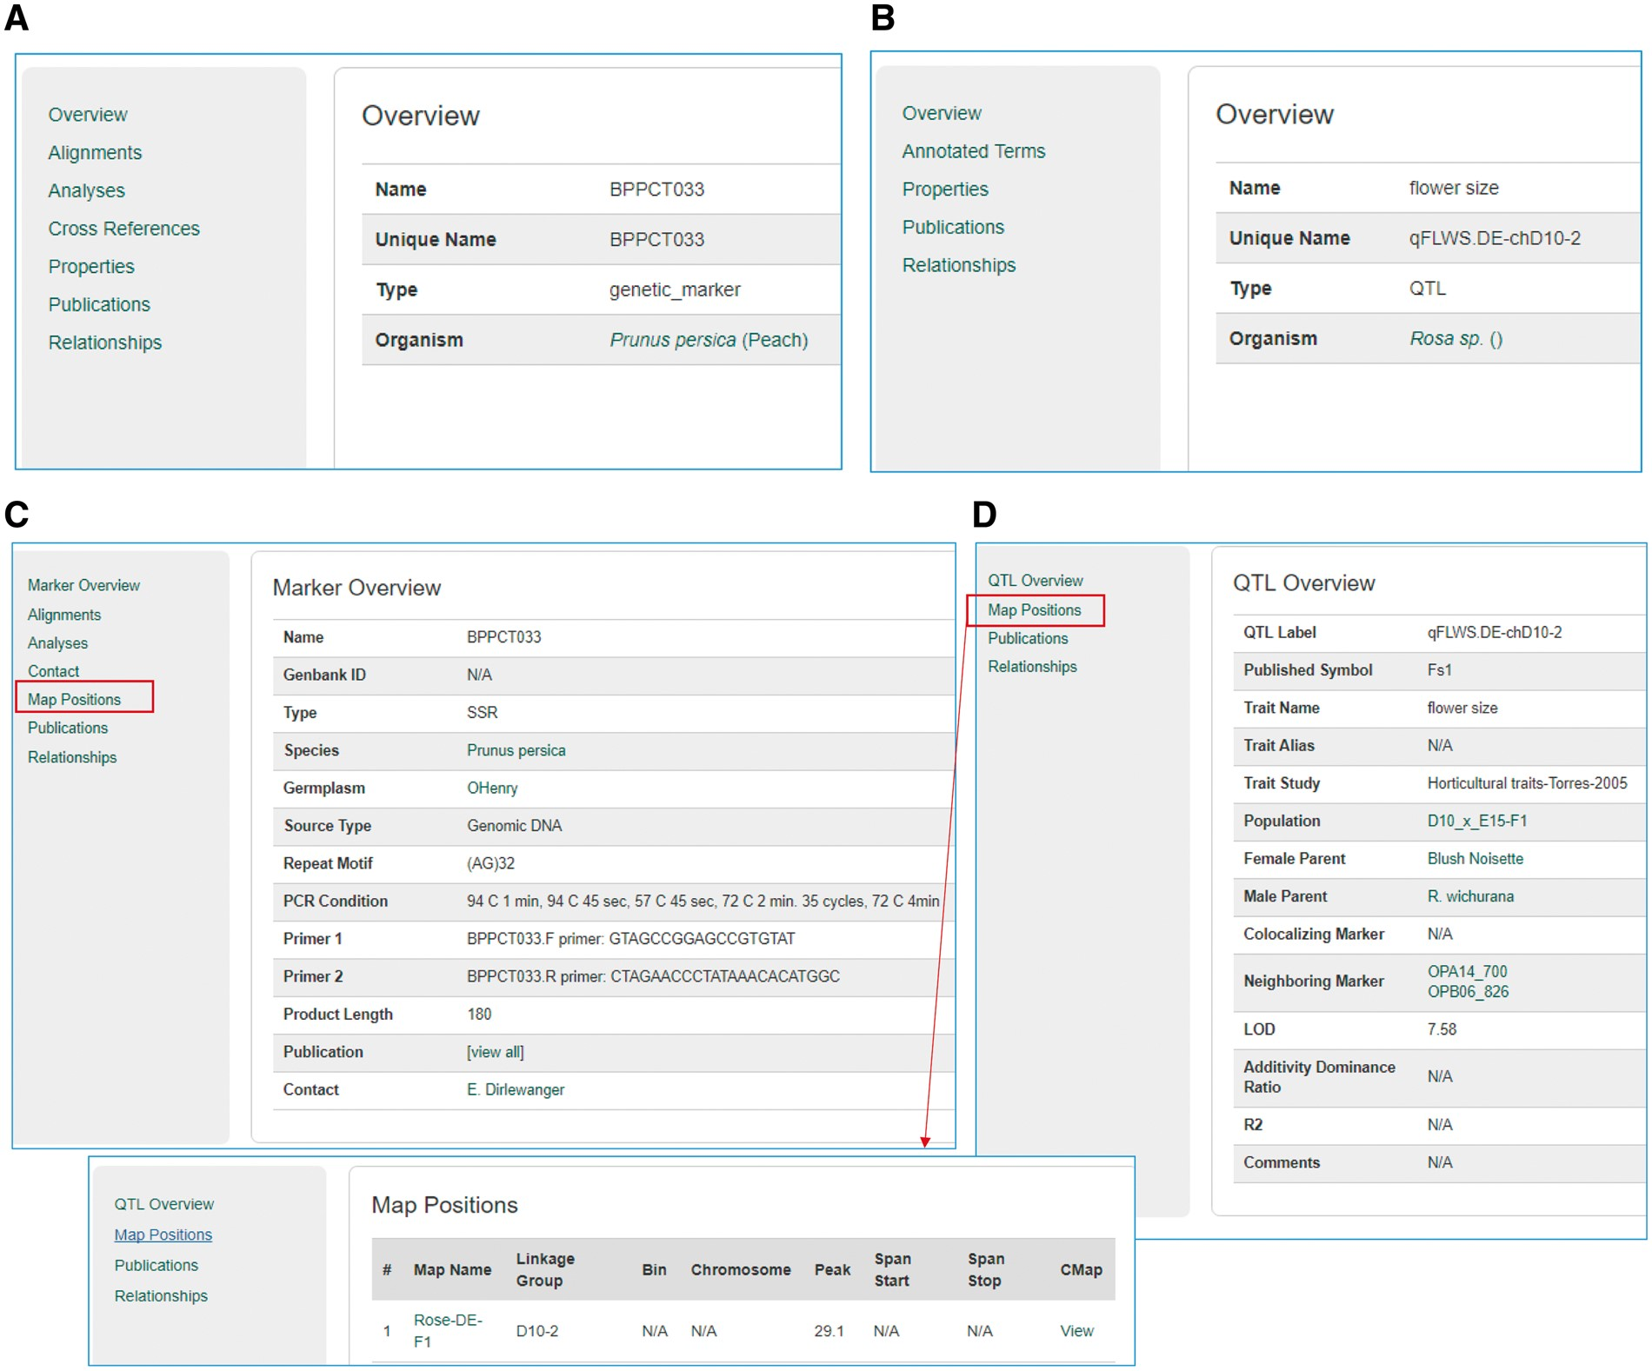
Figure 12. Sample pages from the Tripal core module and the Mainlab Tripal Chado Data Display module. (A) A marker page ...
Notes:
Figure 12. Sample pages from the Tripal core module and the Mainlab Tripal Chado Data Display module. (A) A marker page using the feature template from the Tripal core module. (B) A QTL page using the feature template from the Tripal core module. (C) A marker page using the marker template from the custom module. (D) A QTL page using the QTL template from the custom module.
Unless provided in the caption above, the following copyright applies to the content of this slide: © The Author(s) 2017. Published by Oxford University Press.This is an Open Access article distributed under the terms of the Creative Commons Attribution License (http://creativecommons.org/licenses/by/4.0/), which permits unrestricted reuse, distribution, and reproduction in any medium, provided the original work is properly cited.

Slide 13
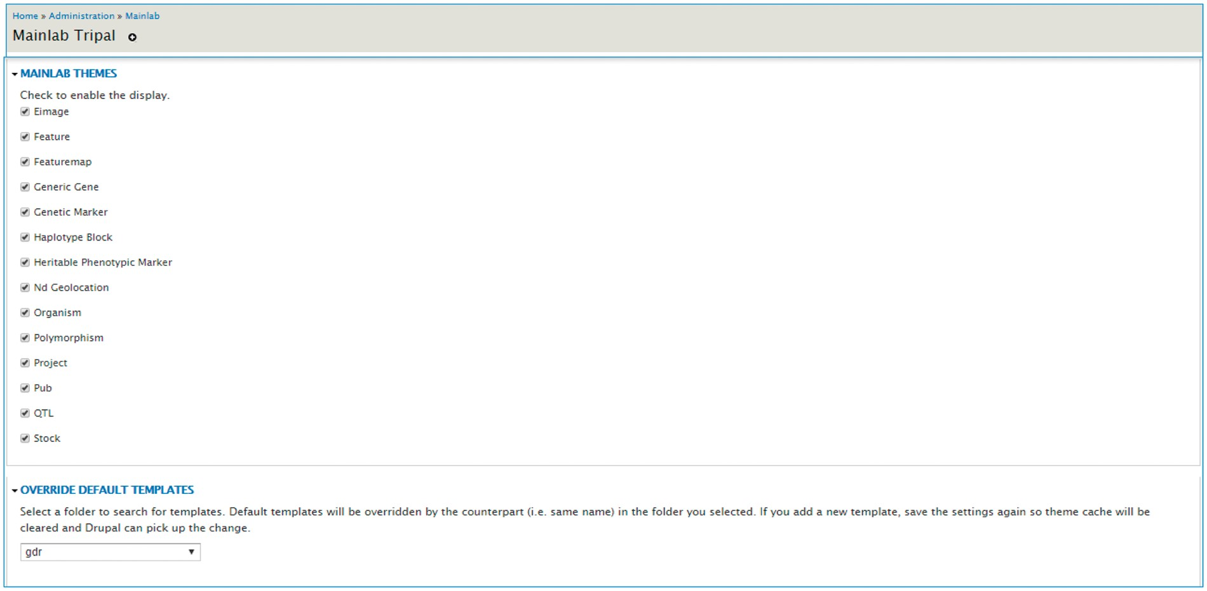
Figure 13. Mainlab Tripal Data Display admin page. Users can enable any templates and choose to over-ride default ...
Notes:
Figure 13. Mainlab Tripal Data Display admin page. Users can enable any templates and choose to over-ride default templates after site-specific modification.
Unless provided in the caption above, the following copyright applies to the content of this slide: © The Author(s) 2017. Published by Oxford University Press.This is an Open Access article distributed under the terms of the Creative Commons Attribution License (http://creativecommons.org/licenses/by/4.0/), which permits unrestricted reuse, distribution, and reproduction in any medium, provided the original work is properly cited.

