Slide 1
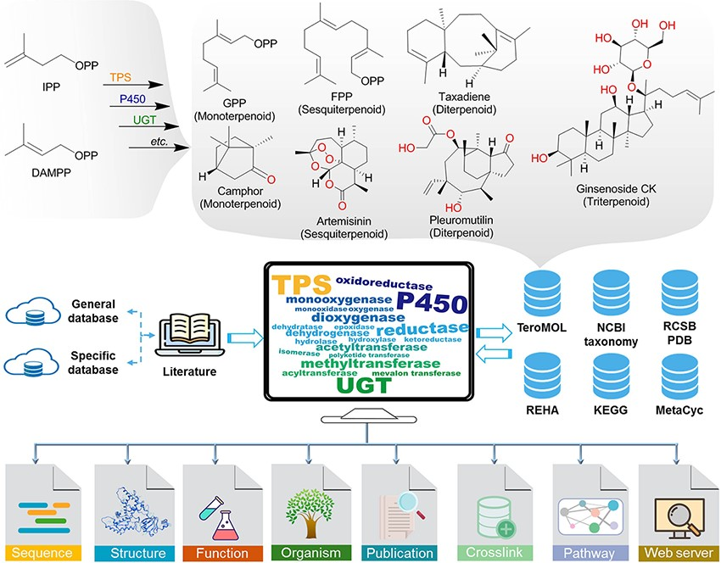
Figure 1. The brief biogenesis for terpenoids and the database resources for constructing the terpenome research ...
Notes:
Figure 1. The brief biogenesis for terpenoids and the database resources for constructing the terpenome research platform TeroKit. The protocol of data collection is provided in Scheme S1.
Unless provided in the caption above, the following copyright applies to the content of this slide: © The Author(s) 2023. Published by Oxford University Press.This is an Open Access article distributed under the terms of the Creative Commons Attribution License (https://creativecommons.org/licenses/by/4.0/), which permits unrestricted reuse, distribution, and reproduction in any medium, provided the original work is properly cited.

