Slide 1
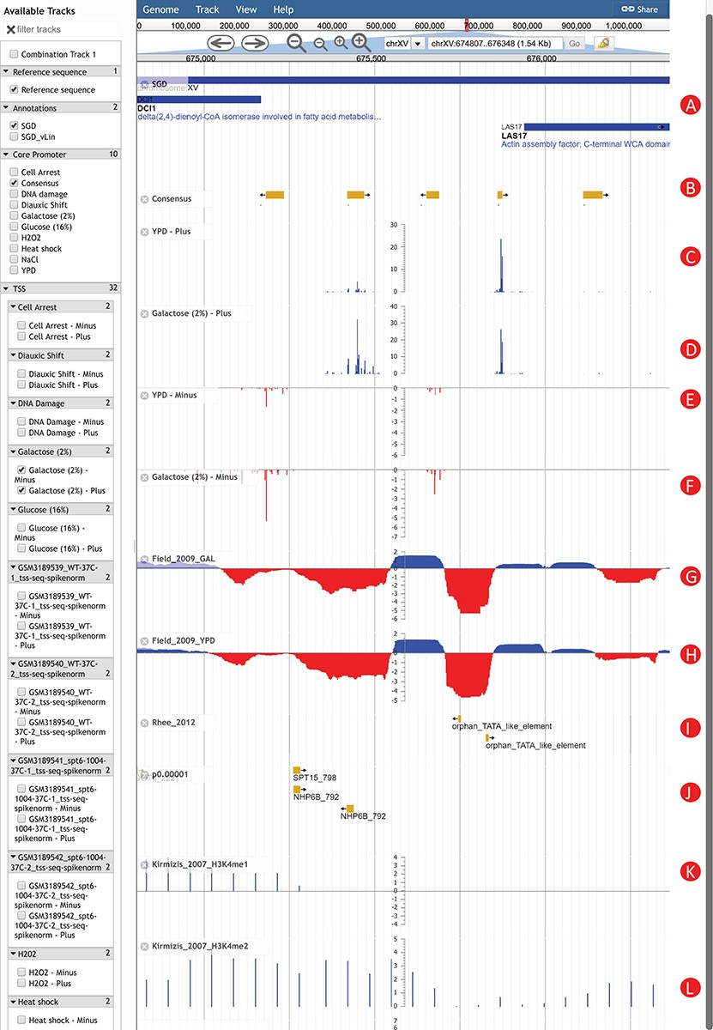
Figure 2 An Example of using YeasTSS Genome Browser to explore transcription initiation landscape. A 1.5 kb region ...
Notes:
Figure 2 An Example of using YeasTSS Genome Browser to explore transcription initiation landscape. A 1.5 kb region around the CP region of LAS17 on chrXV (674 807–676 348). The available tracks in S. cerevisiae are provided in the left panel of genome browser. Two consensus CPs on the forward strand are present within 1000 bp upstream of LAS17 ORF. The transcription activity of each CP can be visualized by the TSS tracks. Different CP activities can be observed between the YPD and YPGal (galactose 2%) growth conditions in S. cerevisiae. Only a few tracks were selected in this case. These tracks include: (A) Genome annotation from SGD; (B) consensus CPs; (C) TSS map on plus strand under YPD condition; (D) TSS map on plus strand under YPGal (galactose 2%) condition; (E) TSS map on minus strand under YPD condition; (F) TSS map on minus strand under YPGal condition; (G) nucleosome occupancy under YPD condition; (H) Nucleosome occupancy under YPGal condition; (I) TATA box; (J) position weight matrix (PWM) predicted binding sites; (K) histone modification H3K4me1; (L) histone modification H3K4me2.
Unless provided in the caption above, the following copyright applies to the content of this slide: © The Author(s) 2019. Published by Oxford University Press.This is an Open Access article distributed under the terms of the Creative Commons Attribution License (http://creativecommons.org/licenses/by/4.0/), which permits unrestricted reuse, distribution, and reproduction in any medium, provided the original work is properly cited.

