Slide 1
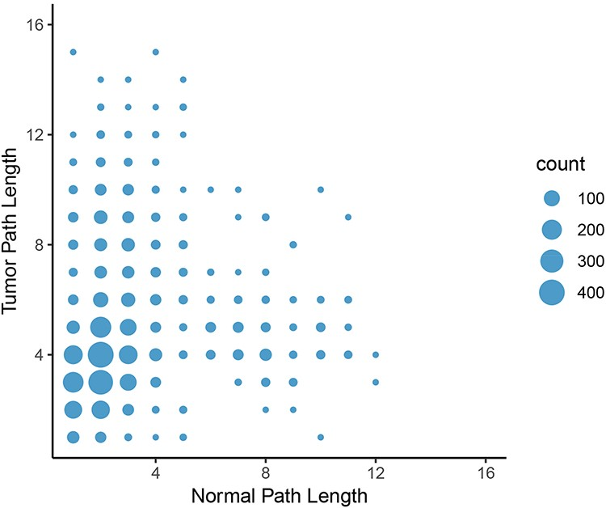
Figure 8. Change in path length between LUAD normal and tumor networks. On average, the path length between an ...
Notes:
Figure 8. Change in path length between LUAD normal and tumor networks. On average, the path length between an epigenetic regulator and an oncogene increased from the normal graph to the tumor graph, with the most common change in path length from two to four genes.
Unless provided in the caption above, the following copyright applies to the content of this slide: © The Author(s) 2020. Published by Oxford University Press.This is an Open Access article distributed under the terms of the Creative Commons Attribution License (http://creativecommons.org/licenses/by/4.0/), which permits unrestricted reuse, distribution, and reproduction in any medium, provided the original work is properly cited.

