Slide 1
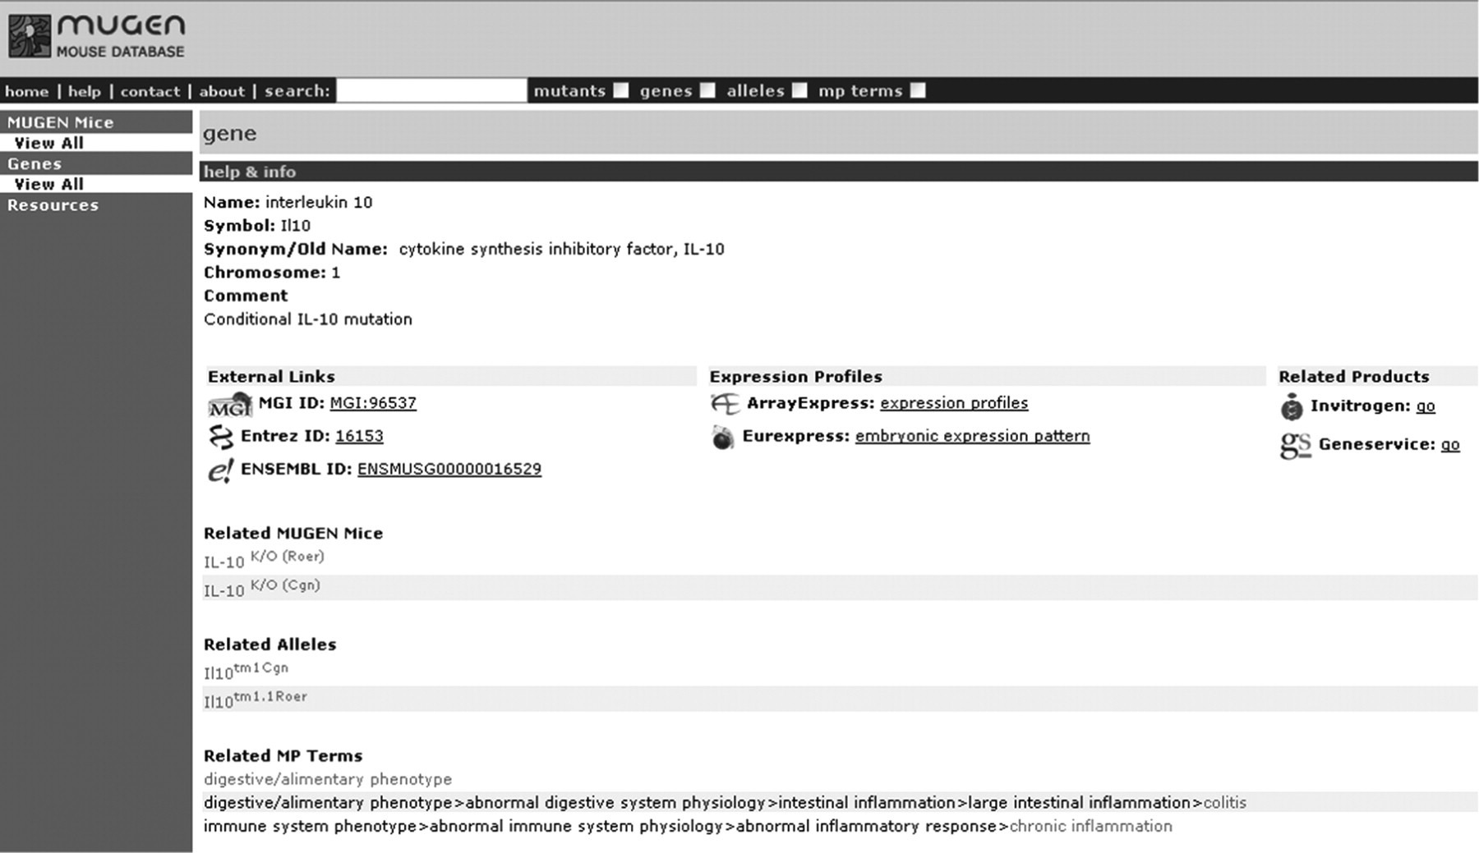
Figure 1. Sample screen shot of MMdb ‘IL-10’ gene with the direct trial links, under the gene information, to ...
Notes:
Figure 1. Sample screen shot of MMdb ‘IL-10’ gene with the direct trial links, under the gene information, to Invitrogen and Geneservice through the gene ID.
Unless provided in the caption above, the following copyright applies to the content of this slide: © The Author(s) 2009. Published by Oxford University Press.This is Open Access article distributed under the terms of the Creative Commons Attribution Non-Commercial License (http://creativecommons.org/licenses/by-nc/2.5/uk/) which permits unrestricted non-commercial use, distribution, and reproduction in any medium, provided the original work is properly cited.

Slide 2
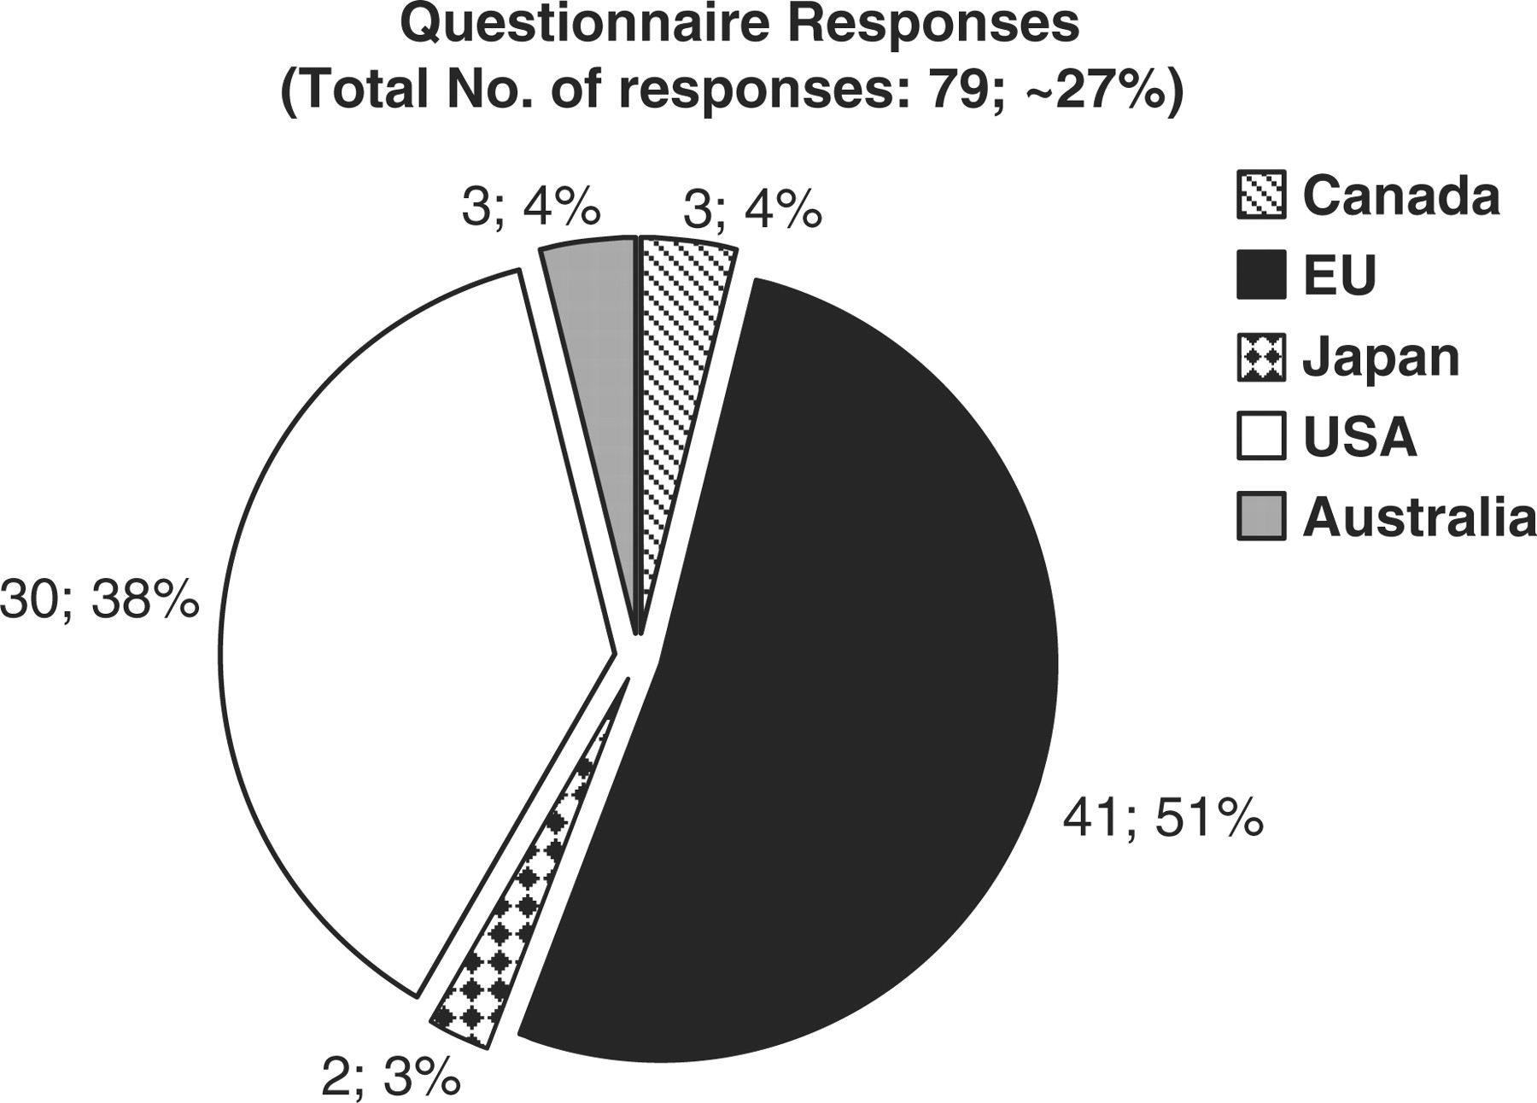
Figure 2. Graph representing the origin of each biological database or resource that responded to the online ...
Notes:
Figure 2. Graph representing the origin of each biological database or resource that responded to the online questionnaire. 51 percent of resources are in Europe, 38% in the USA, 4% in Australia and Canada, and 3% in Japan.
Unless provided in the caption above, the following copyright applies to the content of this slide: © The Author(s) 2009. Published by Oxford University Press.This is Open Access article distributed under the terms of the Creative Commons Attribution Non-Commercial License (http://creativecommons.org/licenses/by-nc/2.5/uk/) which permits unrestricted non-commercial use, distribution, and reproduction in any medium, provided the original work is properly cited.

Slide 3
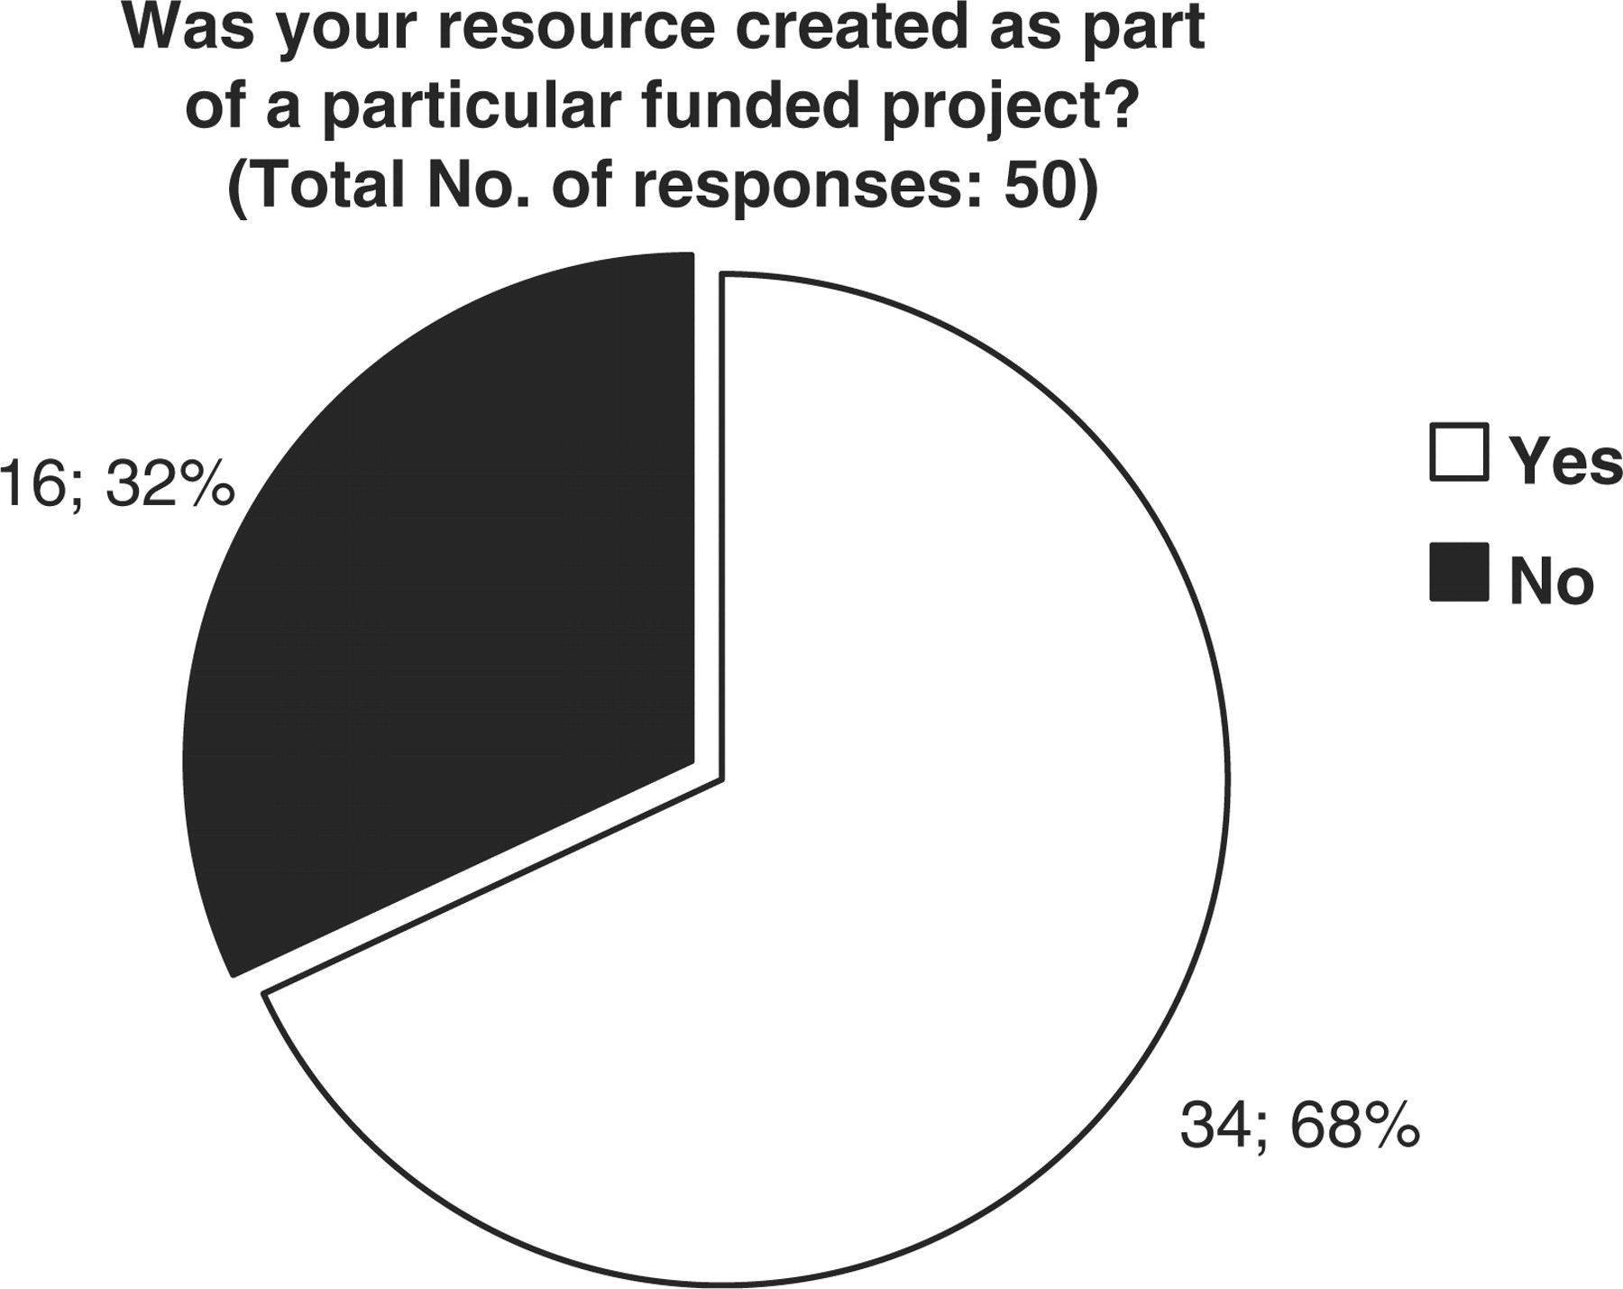
Figure 3. Representation of the financial support originally obtained for the creation of each biological database or ...
Notes:
Figure 3. Representation of the financial support originally obtained for the creation of each biological database or resource. 68 percent of resources were created as part of a particular funded project, while 32% were not.
Unless provided in the caption above, the following copyright applies to the content of this slide: © The Author(s) 2009. Published by Oxford University Press.This is Open Access article distributed under the terms of the Creative Commons Attribution Non-Commercial License (http://creativecommons.org/licenses/by-nc/2.5/uk/) which permits unrestricted non-commercial use, distribution, and reproduction in any medium, provided the original work is properly cited.

Slide 4
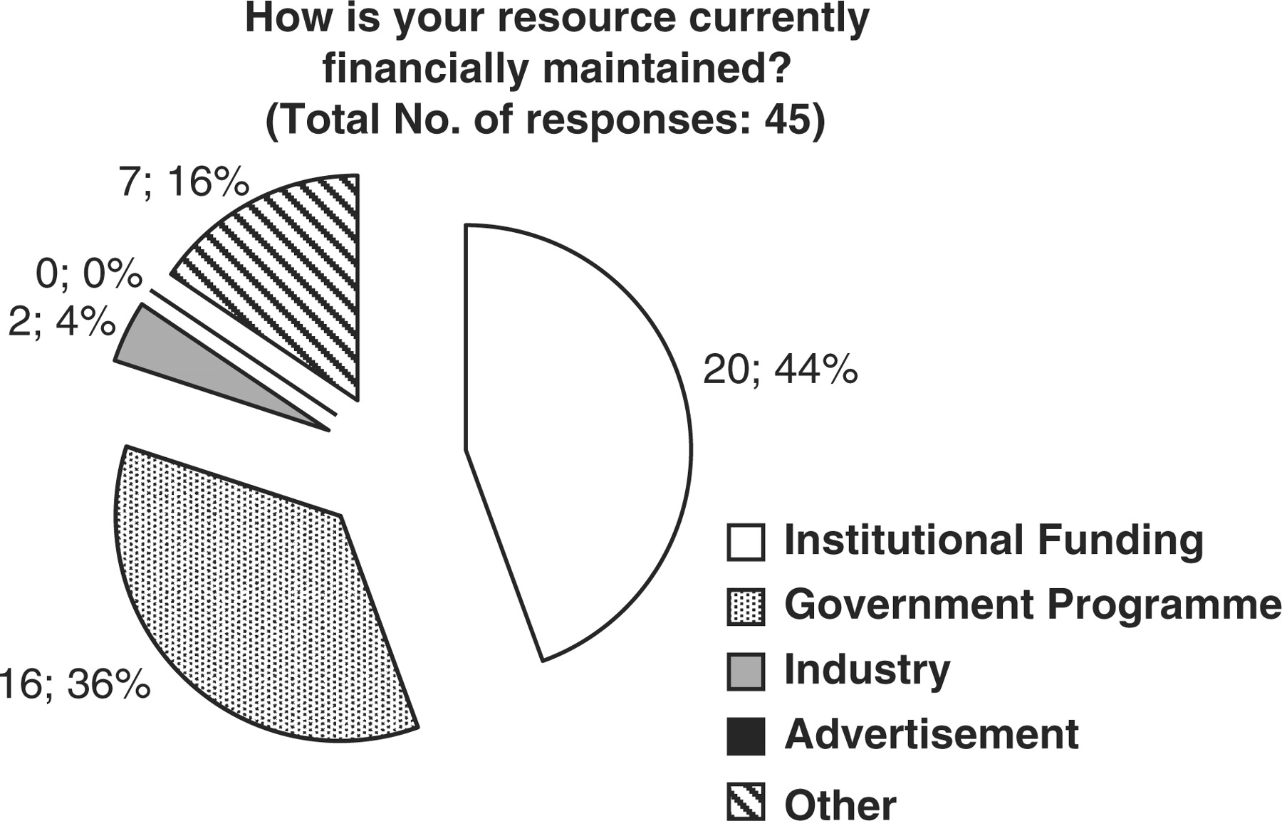
Figure 4. Representation of the financial support currently provided to maintain biological databases and resources. 44 ...
Notes:
Figure 4. Representation of the financial support currently provided to maintain biological databases and resources. 44 percent of resources subsidize through institutional funds, 36% through Government programs, 4% from Industrial funds and 16% from other sources.
Unless provided in the caption above, the following copyright applies to the content of this slide: © The Author(s) 2009. Published by Oxford University Press.This is Open Access article distributed under the terms of the Creative Commons Attribution Non-Commercial License (http://creativecommons.org/licenses/by-nc/2.5/uk/) which permits unrestricted non-commercial use, distribution, and reproduction in any medium, provided the original work is properly cited.

