Slide 1
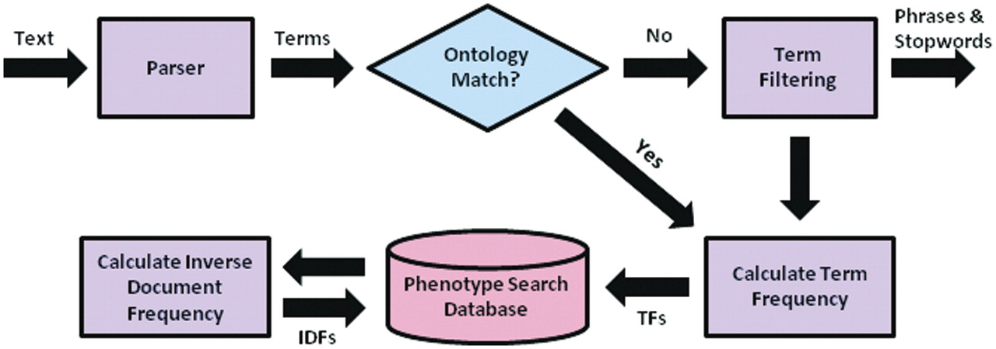
Figure 2. Preprocessing flow chart for the system, including parsing of text descriptions into individual term, ...
Notes:
Figure 2. Preprocessing flow chart for the system, including parsing of text descriptions into individual term, matching terms to ontological concepts, calculation of needed quantities for determining term weights, and insertion of terms and quantities into the MySQL database.
Unless provided in the caption above, the following copyright applies to the content of this slide: © The Author(s) 2011. Published by Oxford University Press.This is Open Access article distributed under the terms of the Creative Commons Attribution Non-Commercial License (http://creativecommons.org/licenses/by-nc/2.5), which permits unrestricted non-commercial use, distribution, and reproduction in any medium, provided the original work is properly cited.

